Slide 1
SATs May 2026 – Parents’ information evening

Slide 2
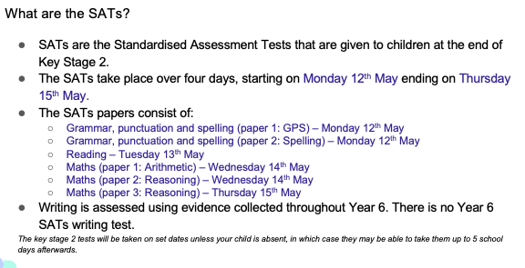
11
14
11
11
12
13
13
14

Slide 3
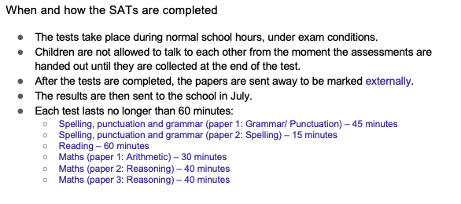

Slide 4
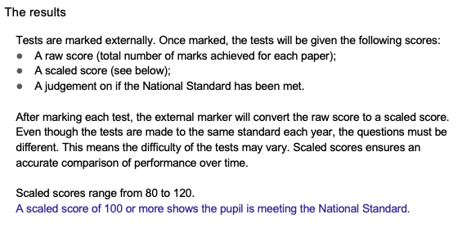

Slide 5
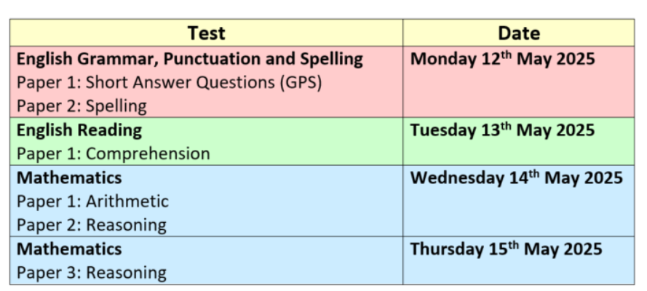
timetable
11
12
13
14

Slide 6
On the days…
When pupils arrive we will be providing an additional breakfast snack (croissant, pain au chocolate or similar) and will all congregate in the Year 6 classroom to make sure pupils are registered and ready to go.
Pupils will know in advance whether they are working within the classroom itself or in another room within the school, and which adults are in the rooms with them.
All stationery is provided for the tests themselves.

Slide 7
Individual papers content
GPS PAPER (45 minutes):
  This is made up of two elements – the grammar, punctuation and spelling paper 1 is 50 questions which are a mixture of multiple choice, writing short sentences, inserting punctuation, recognising word types, etc.
  Children need to ensure they use correct punctuation and spelling throughout the paper.
  Each question is worth 1 mark.
  The second element is a spelling paper – the teacher reads 20 sentences and the children insert the missing spelling word where indicated.
  They are worth 1 mark each.
  Combined score is out of 70.
  Pupils can request that an adult reads the question and possible answers but no intonation can be used by the adult doing so.

Slide 8
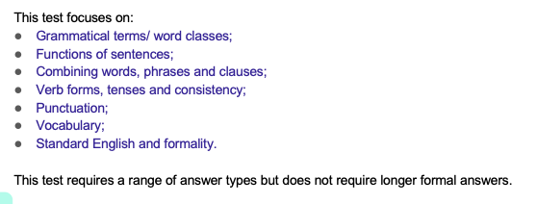

Slide 9
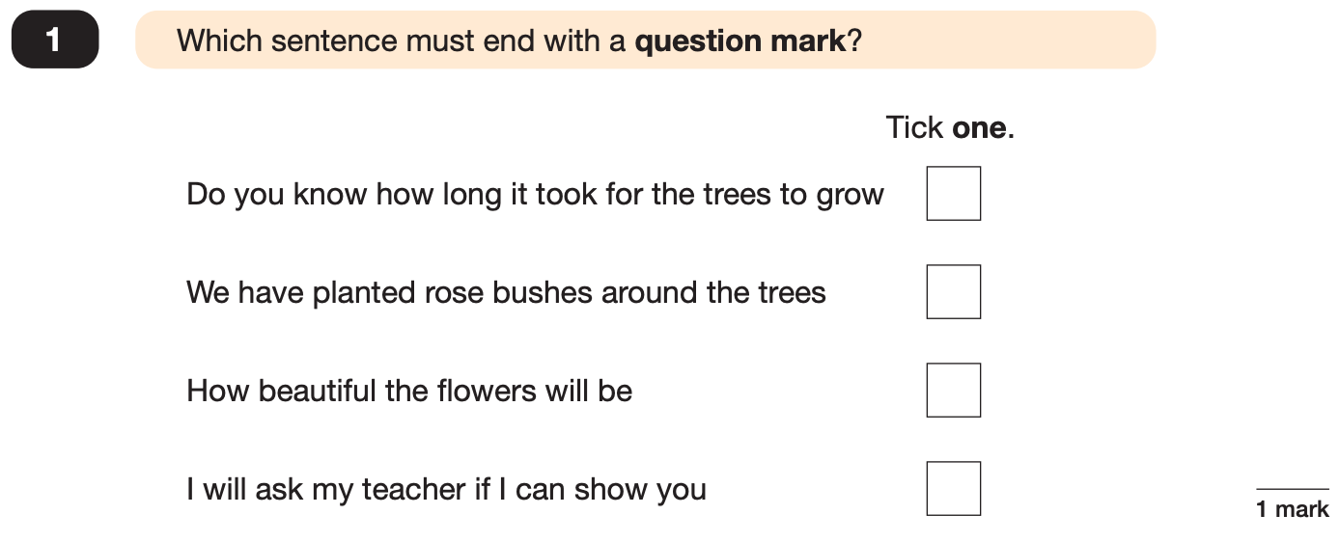
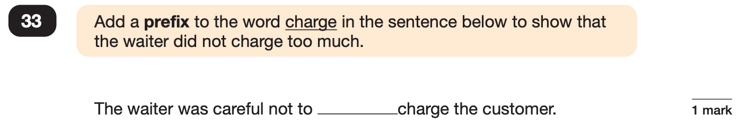
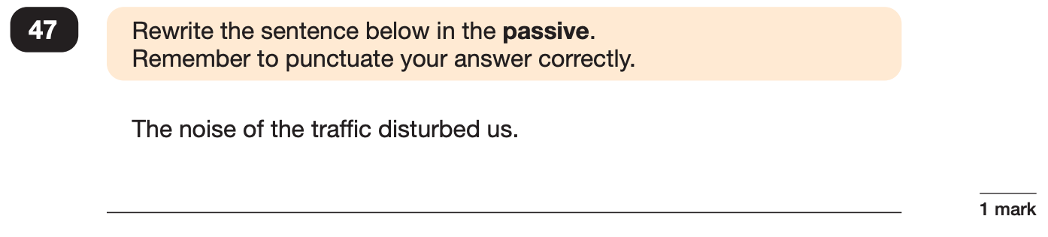
Grammar, Punctuation and Spelling: Paper 1 (GPS)
Example questions:
✓
over
e.g. We were disturbed by the noise of the traffic.
Notes:
Questions are from the 2024 GPS SATs paper.
For question 47 the answer scheme details several correct answers and answers that should not be accepted (e.g. misspellings of verb forms or errors in punctuation or capitalisation.)

Slide 10
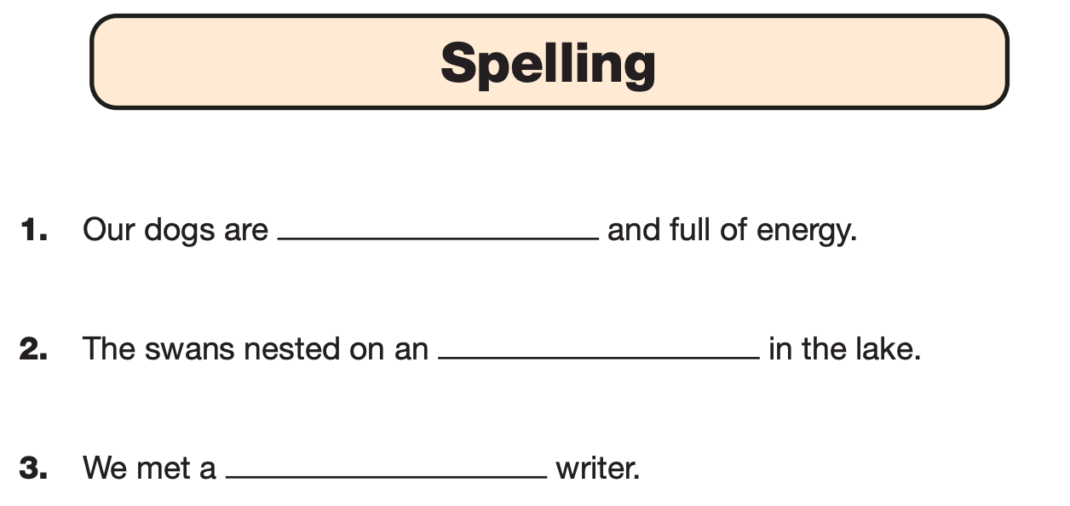
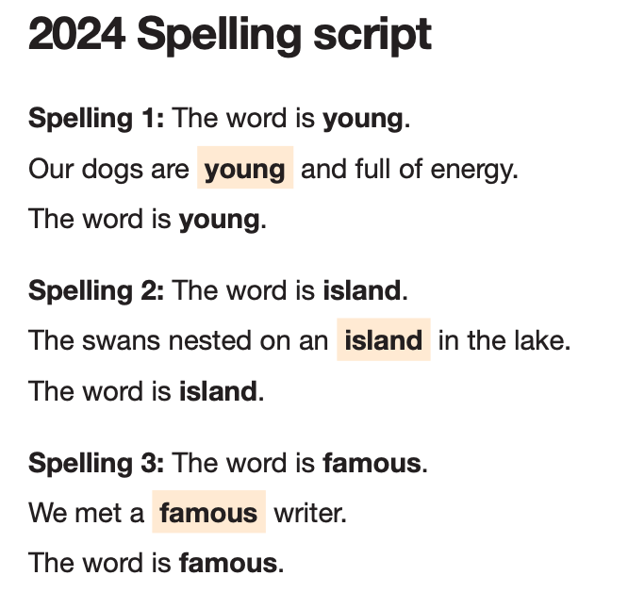
Grammar, Punctuation and Spelling: Paper 2 (spelling)
Paper 2 is a shorter paper that focuses solely on spellings.
Example questions:
Notes:
Questions are from the 2024 Spelling SATs paper.

Slide 11
Individual papers content
READING PAPER (60 minutes):
  This is the longest paper and has 3 different texts – usually two fiction and one non-fiction.
  Children have between 40 and 50 questions worth 1, 2 or sometimes 3 marks.
  No questions or parts of the text can be read by the adults for this test.
  The total marks available are 50.

Slide 12
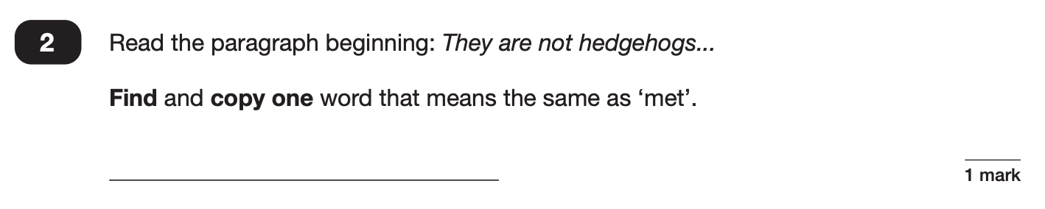
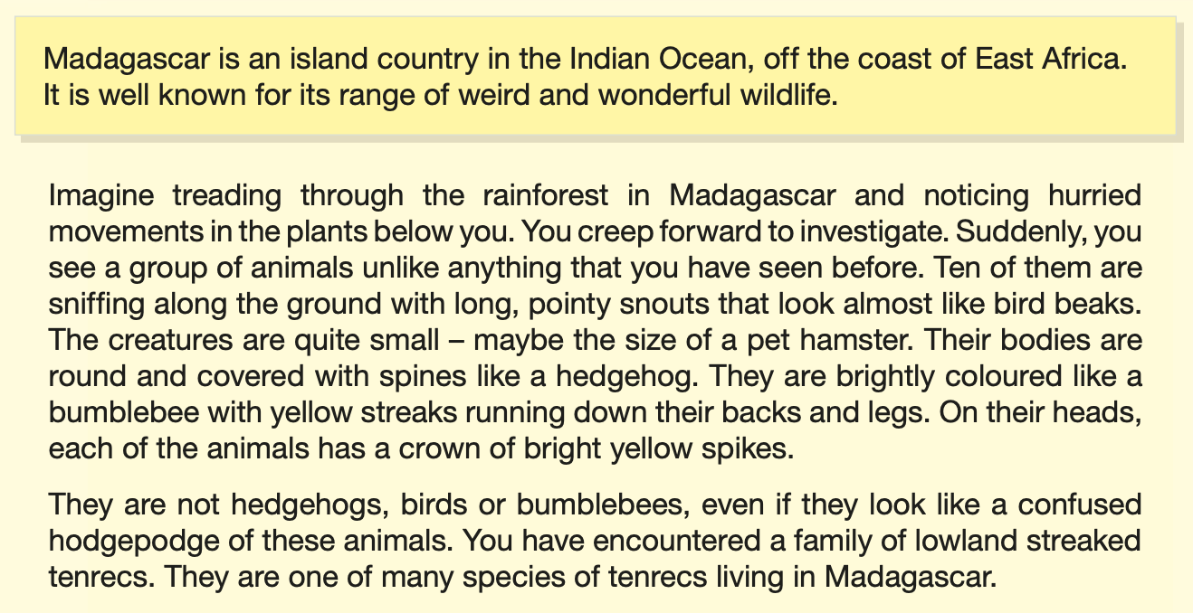
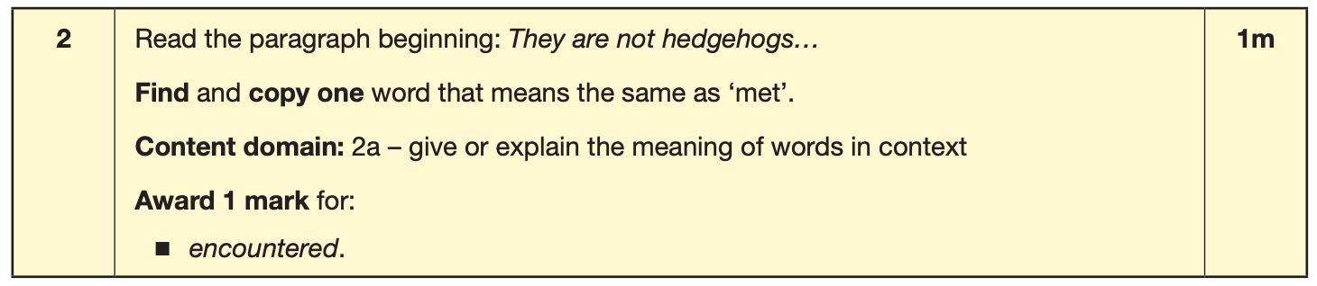
Reading
The reading SATs paper requires a range of answer styles.
Example questions:
Notes:
Questions are from the 2024 Reading SATs paper.
Question styles include:
Multiple choice questions
One-word answers
Short answer questions
Multiple mark (long answer) questions

Slide 13
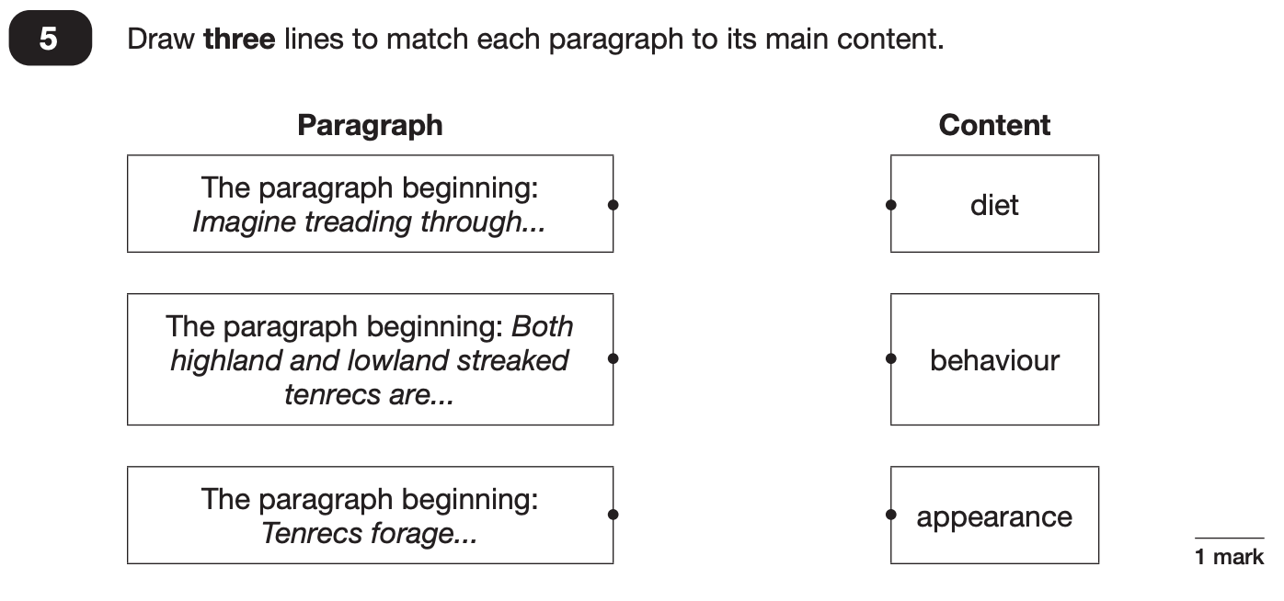
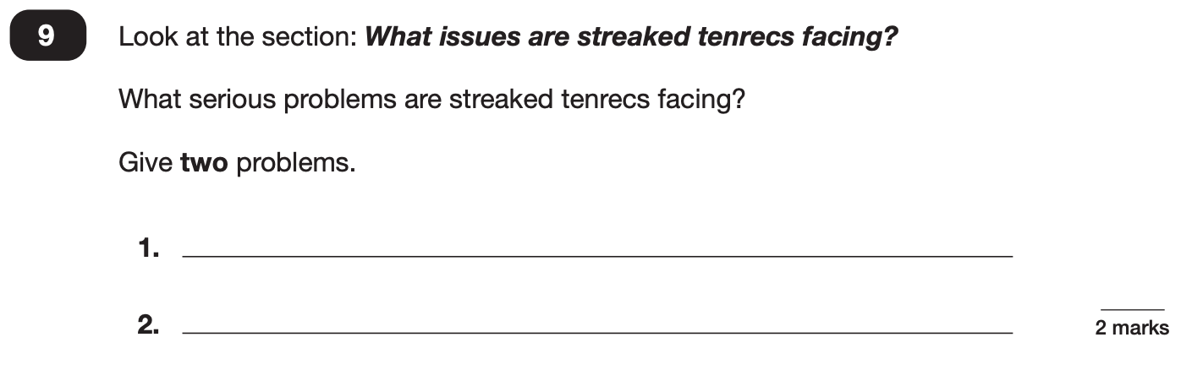
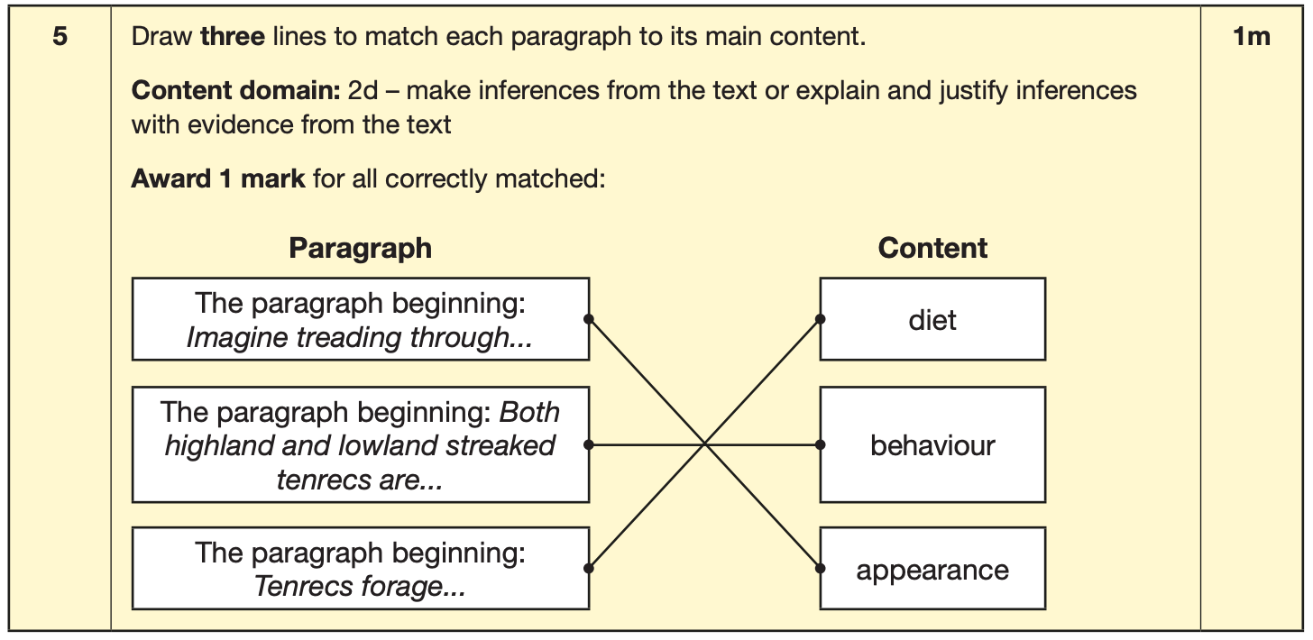
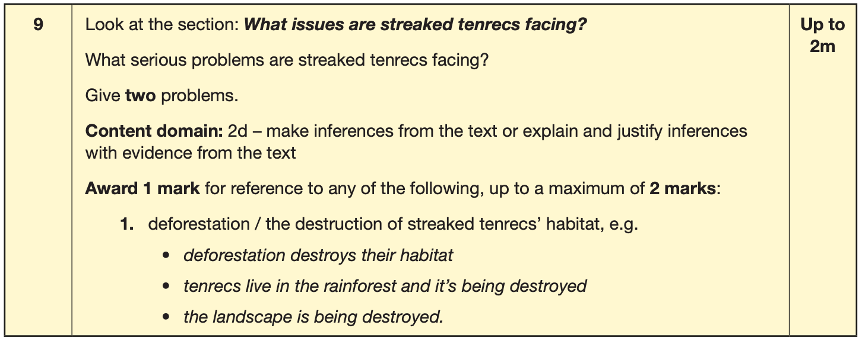
Reading
Example questions:
Notes:
Questions are from the 2024 Reading SATs paper.

Slide 14
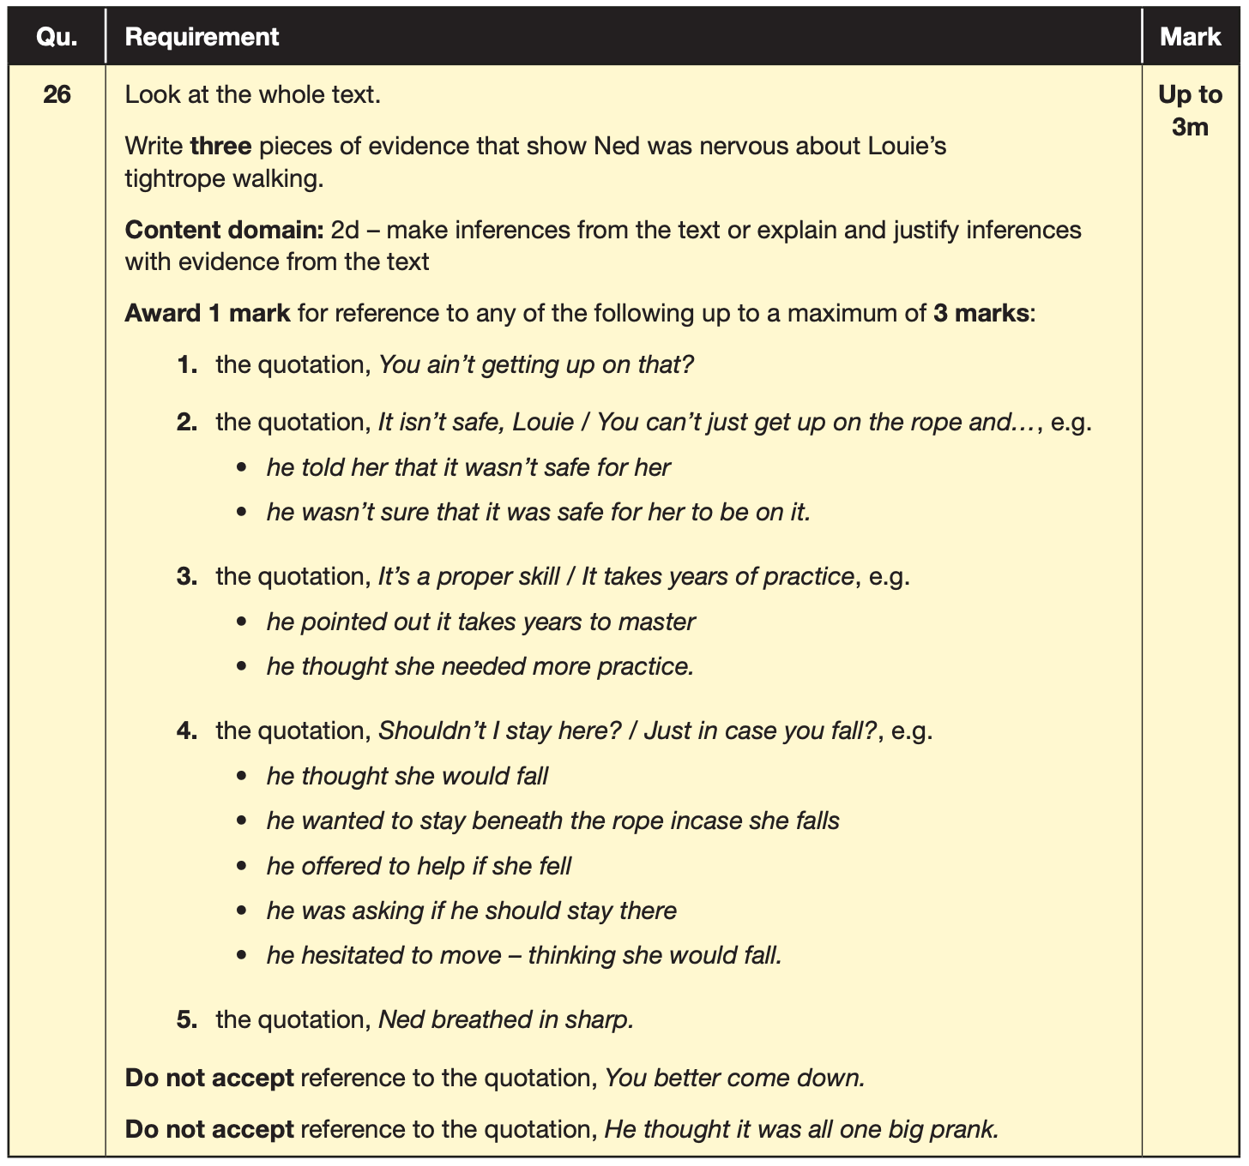
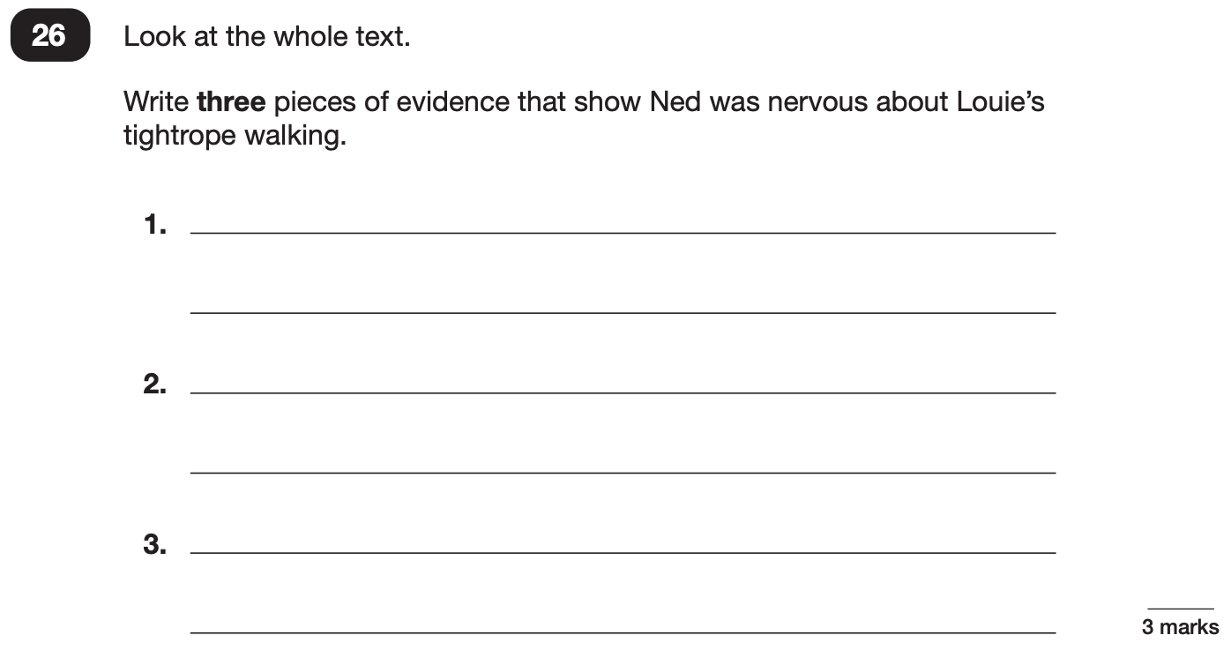
Reading
Example questions:
3 mark question
Notes:
Questions are from the 2024 Reading SATs paper.

Slide 15
Reading
Since the current testing formation for the SATs began in 2016, there has been a tendency for three types of questions to be the most popular.
In the 2024 Reading SATs paper,
10% of marks could be gained from answering questions involving giving and explaining the meaning of words in context;
38% of marks could be gained from answering questions involving retrieving and recording information or identifying key details from a text;
44% of marks could be gained from answering questions involving making inferences from a text and justifying inferences with text evidence.
When reading with your child at home try focusing on these types of questions.
Notes:
2% of questions: summarising main ideas from more than one paragraph.
6% of questions: making comparisons within the text
Example questions to ask at home:
What does this word mean?
Which word in this paragraph is the closest in meaning to…?
What [character] doing when [event] happened?
True or false questions about a paragraph/ text.
Why do you [character] did [event]? Can you think of another reason?

Slide 16
Individual papers content
MATHS PAPERS (30, 40, 40 minutes):
  Paper 1 is an arithmetic paper with 36 questions and is out of 40 marks.
  Papers 2 and 3 are reasoning and problem solving questions and the number ranges from 20 to 25 questions. These are each out of 35 marks.
  Total marks available for maths are 110.
  Although questions can be read to pupils if requesting, no mathematical symbols can be (e.g. +, -, =).

Slide 17
Maths: Wednesday 14th May and Thursday 15th May
The maths assessments consist of three tests.
Paper 1: Arithmetic (30 minutes) – Wednesday 13th May
Paper 2: Reasoning (40 minutes) – Wednesday 13th May
Paper 3: Reasoning (40 minutes) – Thursday 14th May

Slide 18
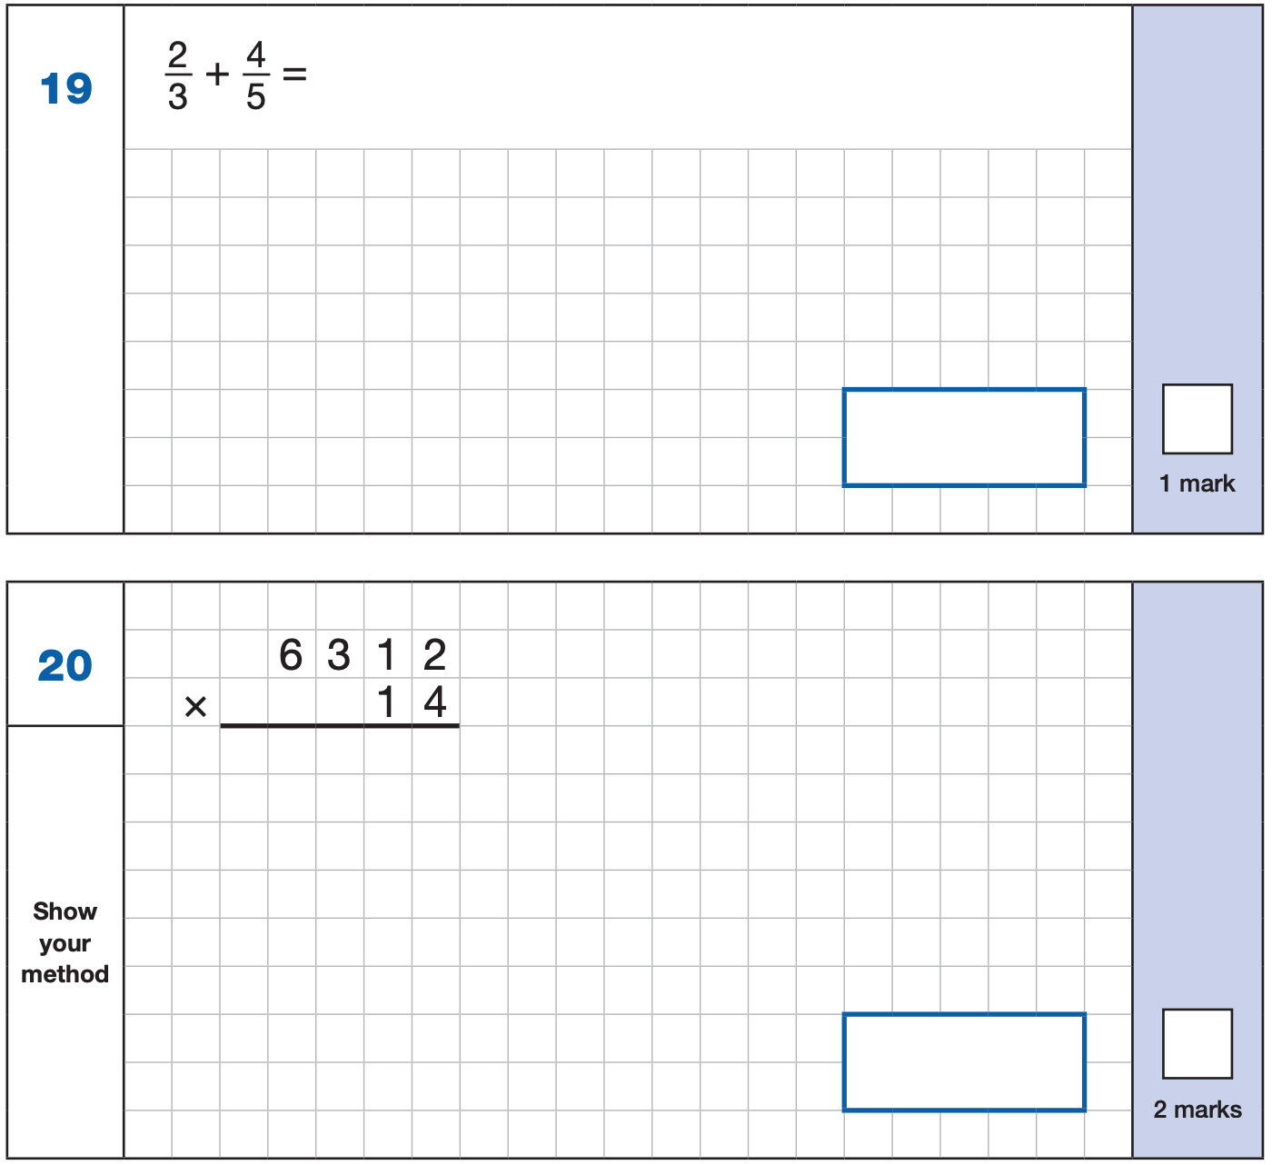
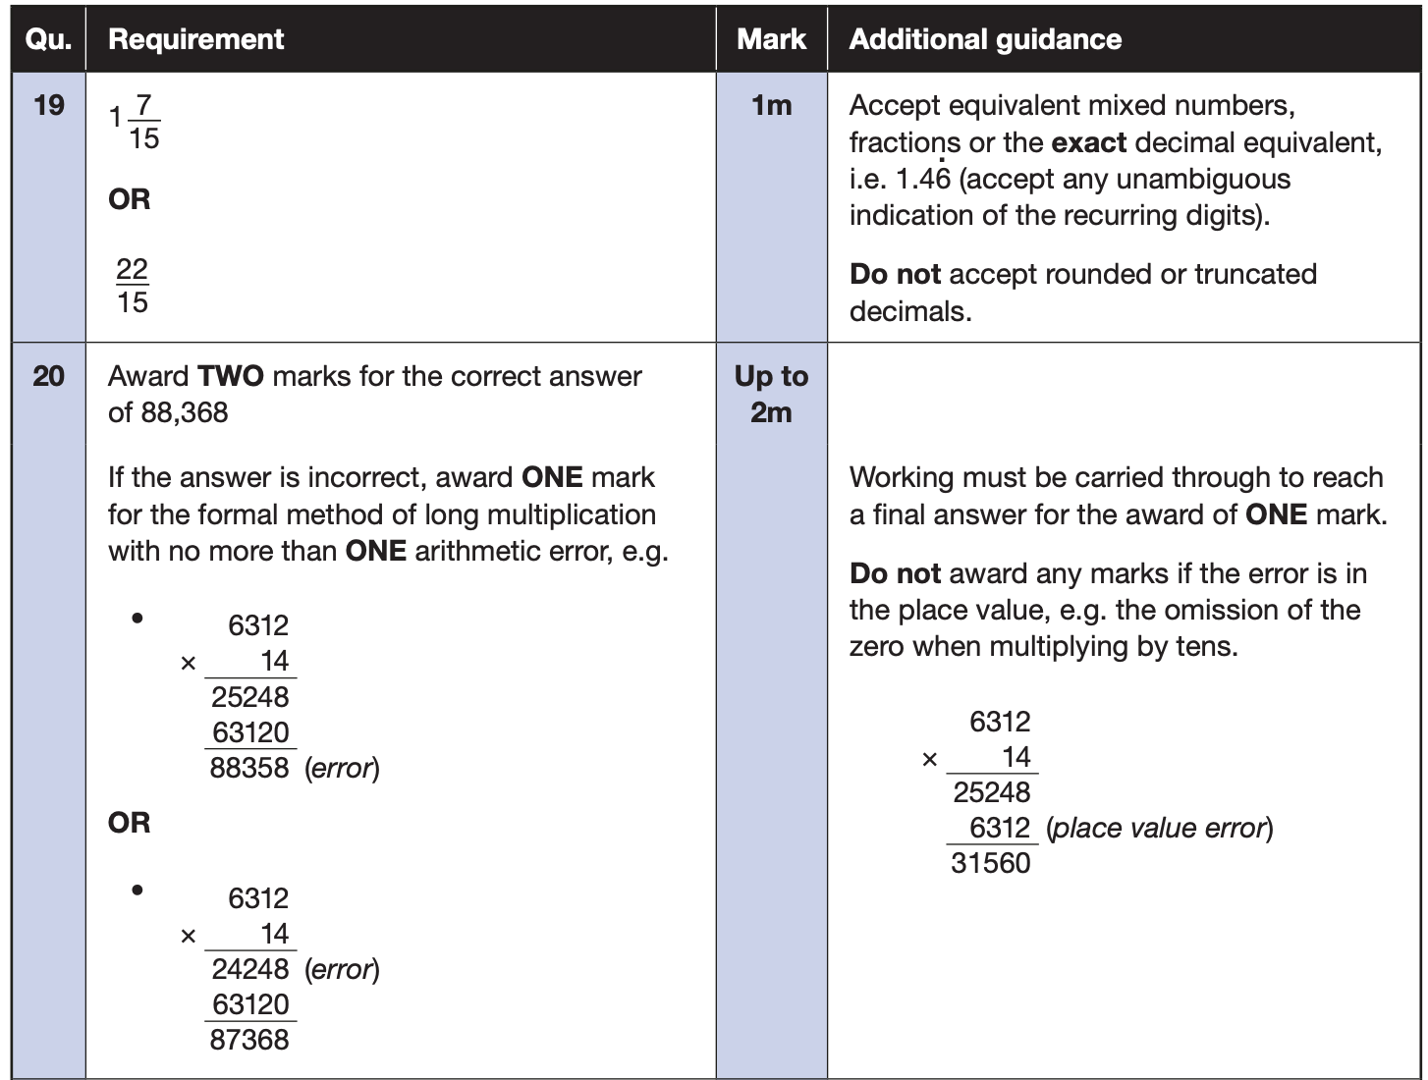
Maths Paper 1 (Arithmetic)
The maths arithmetic paper has a total of 40 marks and lasts for 30 minutes.
The test covers the four operations (addition, subtraction, multiplication, division, including order of operations requiring BIDMAS), percentages of amounts and calculating with decimals and fractions.
Example questions:
Notes:
Questions are from the 2024 Arithmetic SATs paper.
Identify that there are some questions that have 2 marks and some that have 1.

Slide 19
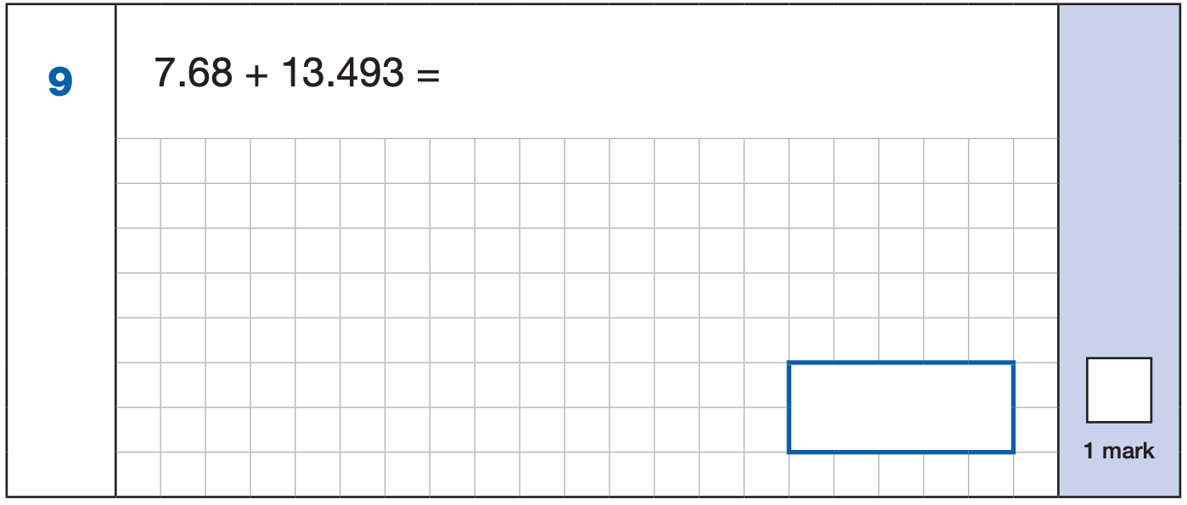
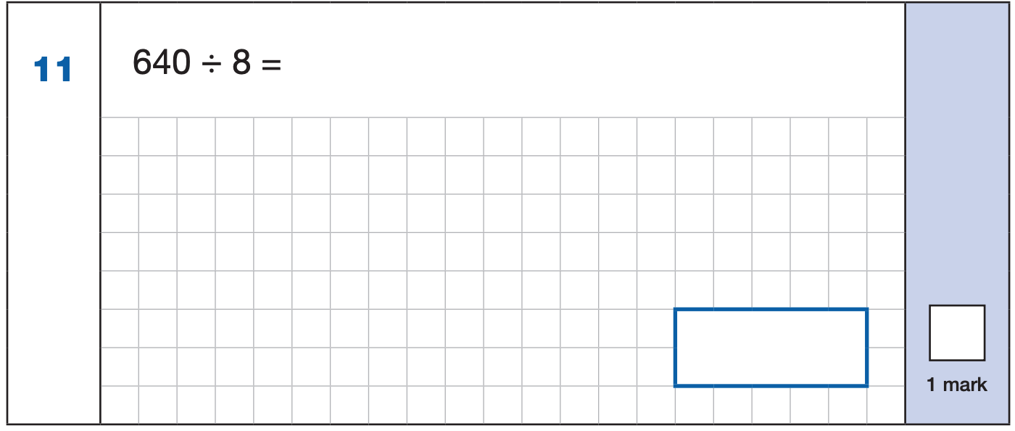
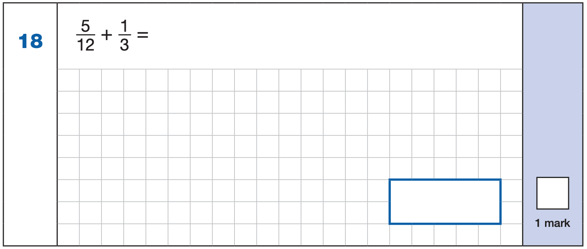
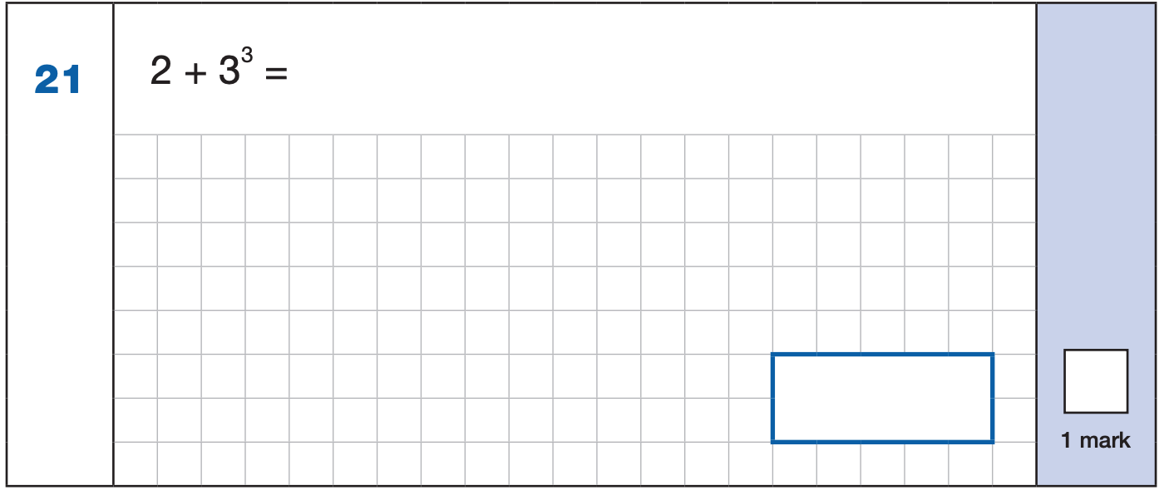

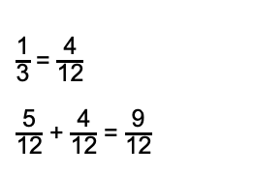
Maths Paper 1 (Arithmetic)
Example 1 mark questions:
7.680
+ 13.493.
21.173
¹ ¹ ¹
Mental method:
Using known fact of 64 ÷ 8 = 8
21.173
80
$\frac{\text{1}}{\text{3}}$ = $\frac{\text{4}}{\text{12}}$
$\frac{\text{5}}{\text{12}}$ + $\frac{\text{4}}{\text{12}}$ = $\frac{\text{9}}{\text{12}}$
3³ = 27
2 + 27 = 29
$$\frac{\text{9}}{\text{12}}$$
29
Notes:
Questions are from the 2024 Arithmetic SATs paper.
These are examples of how children could solve the calculations. There are some that could/ should be solved mentally as it is far quicker that way (40 marks in 30 minutes does not allow for 1 minute + per mark).
Answers should always be given in their simplest form unless stated otherwise.
Note that for question 18, equivalent fractions e.g. ¾ are accepted.

Slide 20
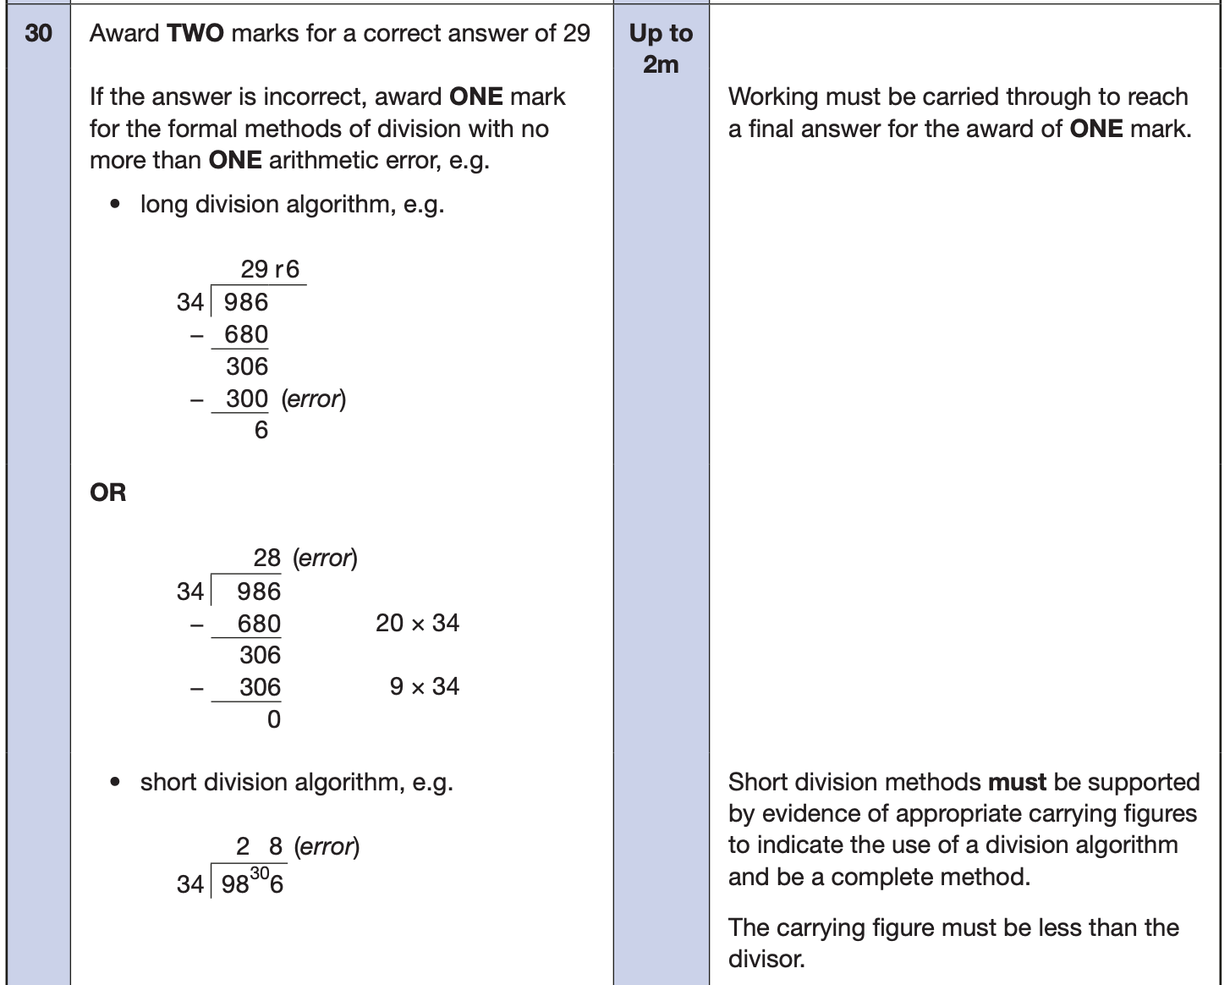
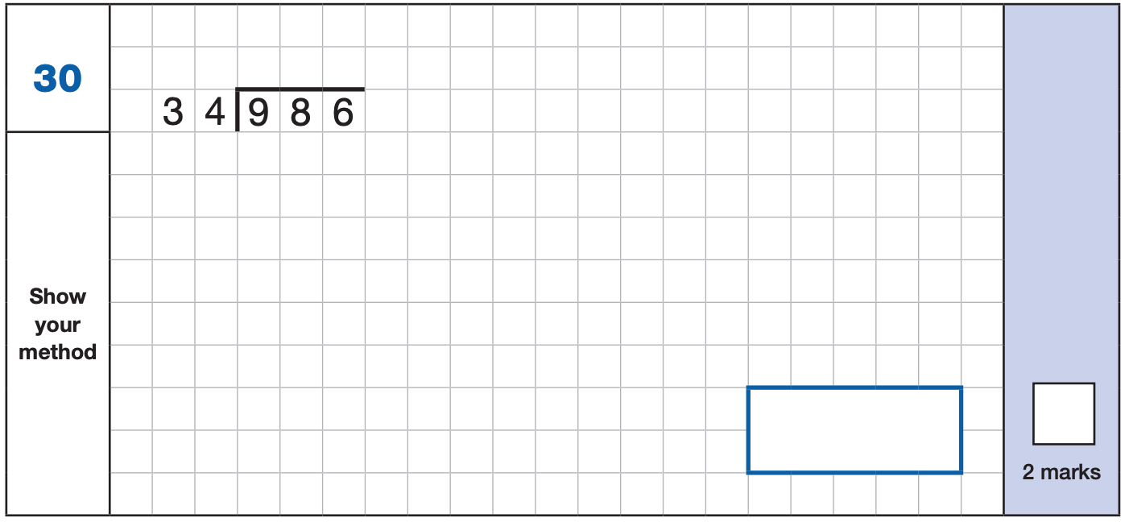
Maths Paper 1 (Arithmetic)
Example 2 mark question:
Notes:
Questions are from the 2024 Arithmetic SATs paper.

Slide 21
Maths Papers 2 and 3 (Reasoning)
Paper 2 will take place on Wednesday 13th May and paper 3 will take place on Thursday 14th May. These tests have a total of 35 marks each and lasts for 40 minutes each.
These papers require children to demonstrate their mathematical knowledge and skills, as well as their ability to solve problems and their mathematical reasoning. They cover a wide range of mathematical topics from key stage 2 including,
Number and place value (including Roman numerals);
The four operations;
Geometry (properties of shape, position and direction);
Statistics;
Measurement (length, perimeter, mass, volume, time, money);
Algebra;
Ratio and proportion;
Fractions, decimals and percentages.
Notes:
In general, the questions get progressively harder throughout the paper. As this is the case, it is not unusual for children to be unable to complete the entire paper in the given time.

Slide 22
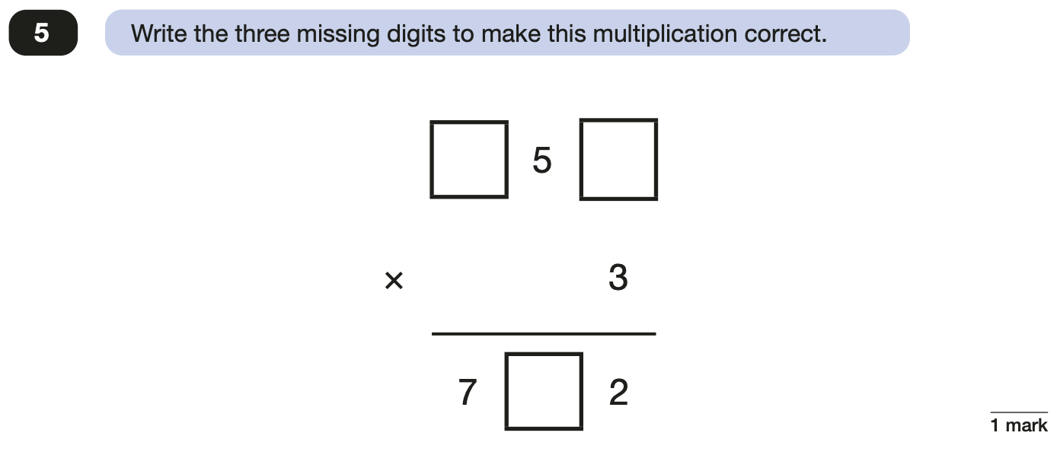
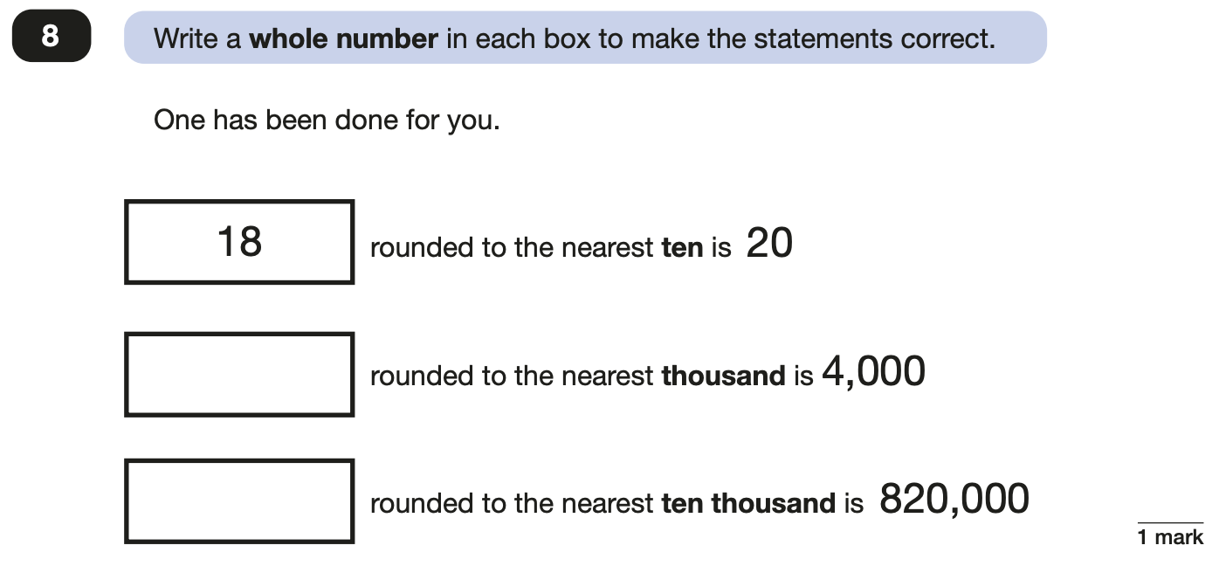
Maths Papers 2 (Reasoning)
Example questions:
2
4
3,500 to 4,499
6
815,000 to 824,999
Notes:
Questions are from the 2024 paper 2 Reasoning SATs paper.

Slide 23
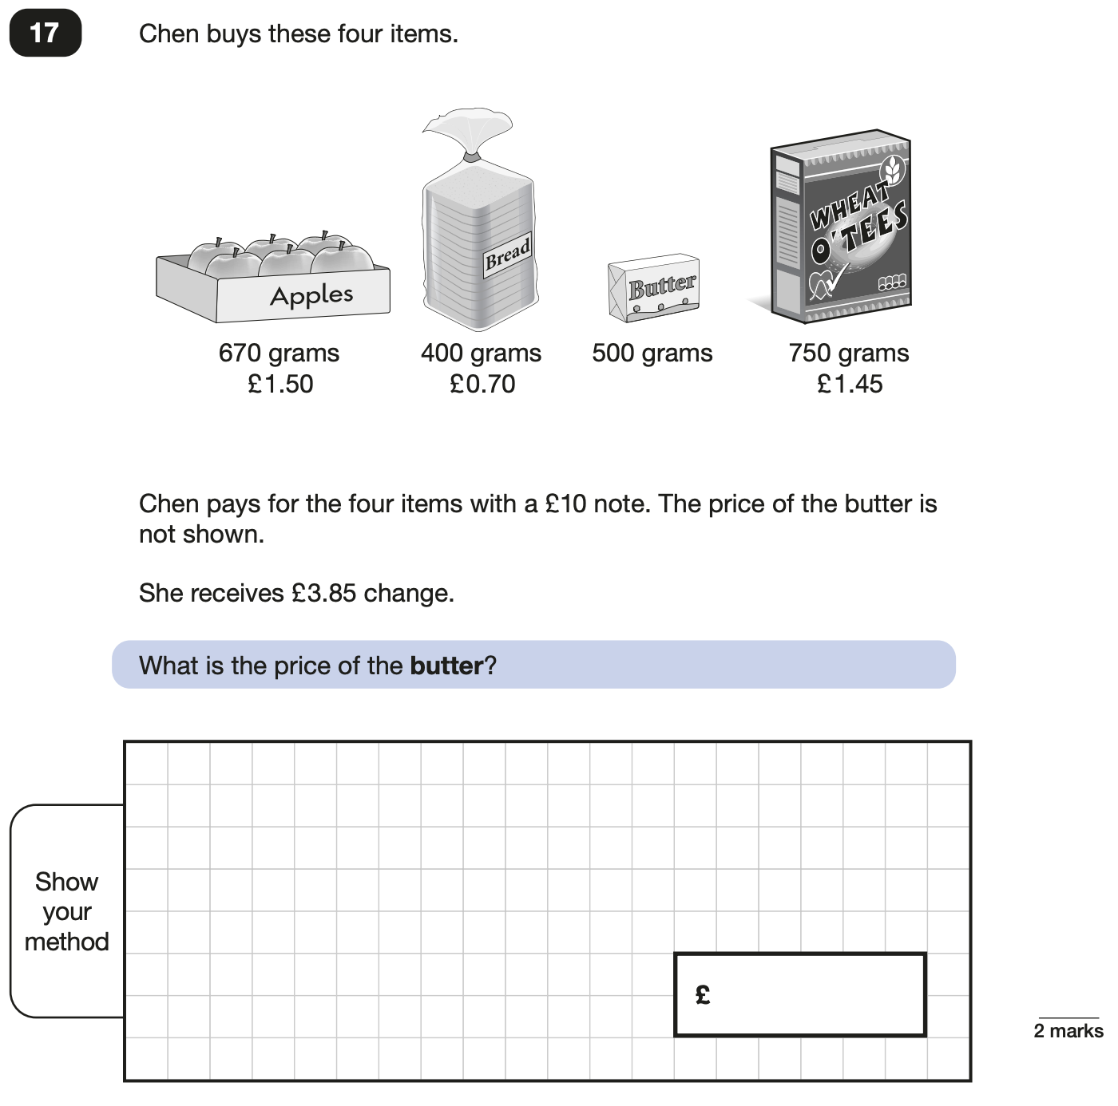
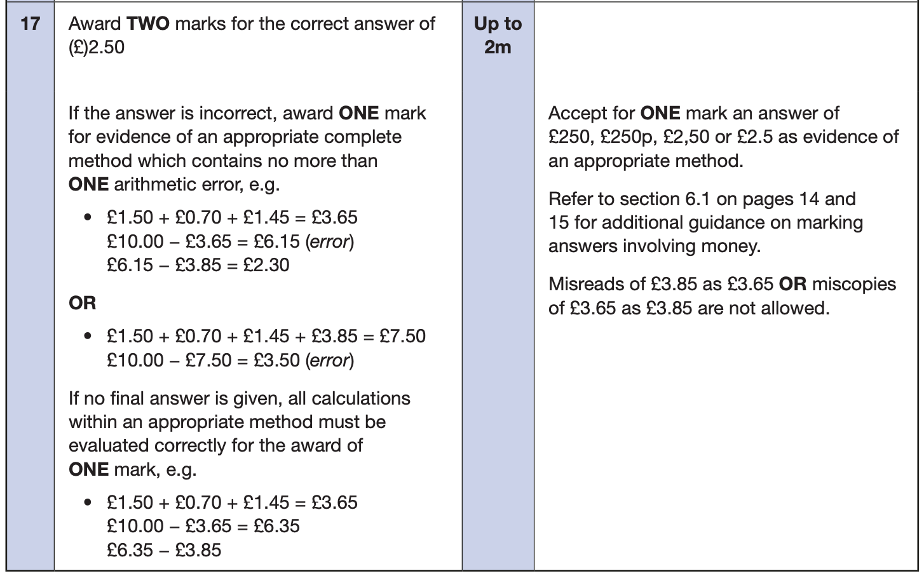
Maths Papers 2 (Reasoning)
Example questions:
Notes:
Questions are from the 2024 paper 2 Reasoning SATs paper.

Slide 24
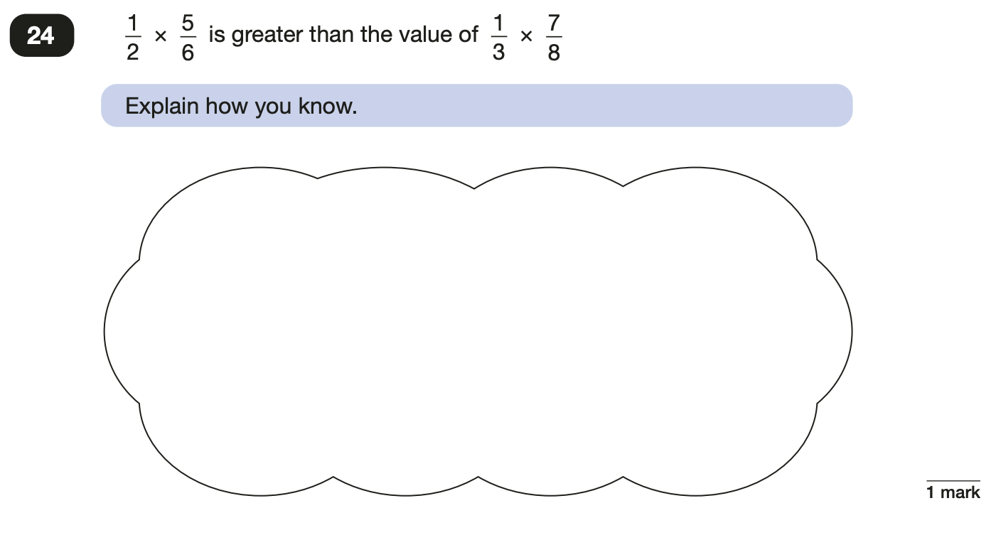
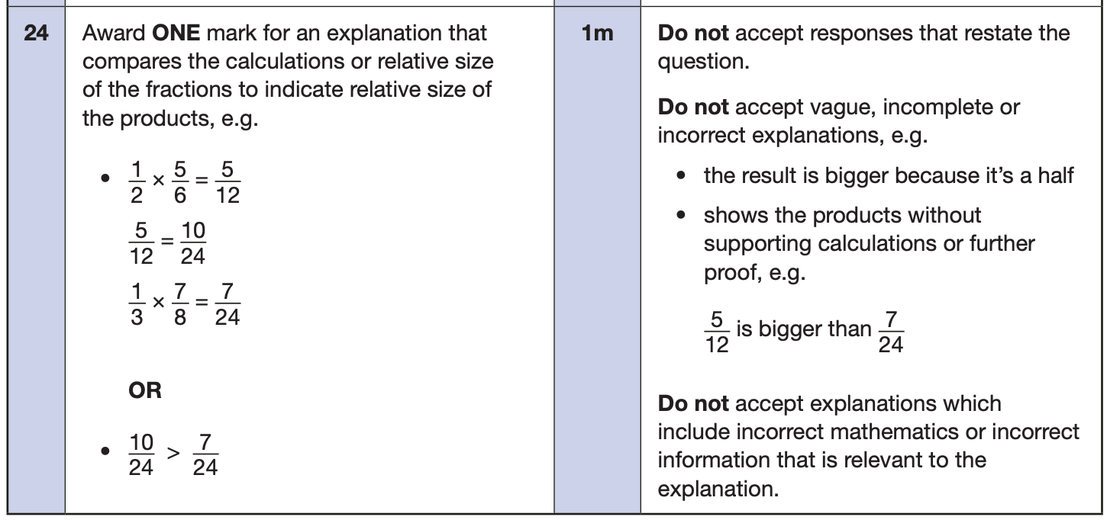
Maths Papers 3 (Reasoning)
Example questions:
Notes:
Questions are from the 2024 paper 3 Reasoning SATs paper.

Slide 25
Administration of tests
As a school, we are responsible for ensuring the correct administration of papers and we do not have access to them until we are in the rooms ready to begin the paper.
They are packed into sealed envelopes at the end of each test and stored securely until collected by courier – we do not mark them or have access to them again until marks are returned and papers shared electronically in July.
We share results within our annual reports that go out in July providing they have been returned in time to do so, otherwise we would share separately with parents/carers as soon as possible.
The majority of pupils take their tests within the classroom – one pupil per desk and there are two adults in the room during the tests.
Water bottles are allowed and encouraged (containing water only please) – all stationery is provided by the school for these tests.
Pupils will be given the opportunity to use the toilet before the start of each test – if they should need to leave the test for any reason they will need to be accompanied by one of the adults.

Slide 26
Administration of tests
Some pupils have been working in smaller groups of 3 or 4 pupils when doing practice papers – they will continue to do this for the official papers too.
A small number of pupils may require 1 to 1 adult support to complete the papers and again, this has been taking place for any practice papers they have completed.
The adults follow the same administration guidelines.
However, for some pupils it may be necessary to allow short rest breaks or to scribe on their behalf if this is an access arrangement that is normal classroom practice.
Occasionally pupils, whether in the whole class setting or in a small group or 1 to 1, may be asked to wait at the end of the test for an adult to check whether any of their answers need transcription – this would only be if the adults working with them felt that their handwritten answers were not clear enough to be read by the test marker.
For the spelling test in particular, we sometimes encourage pupils to avoid joining if we feel that someone that hasn’t worked with them before will find it tricky to decipher individual letters.

Slide 27
What to do if you are worried about your child
SATs often induce a certain degree of worry or anxiety but there is, of course, a tipping point.
SATs anxiety should not:
Affect a child’s appetite
Affect a child’s sleep
Affect a child’s personality
Induce panic, tears or disengagement from lessons or hobbies
Be a reason not to attend school.
If any of the above are evident, SATs may be causing an excessive degree of anxiety and may benefit from some additional support. This isn’t about removing the reality of SATs but rather equipping your 10 or 11 year old with the ability to better cope with the situation.

Slide 28
What to do if you are worried about your child
Talk to the school
Sometimes concerns present at home and not at school. If you notice a change in your child, talk to the school so that everyone concerned can offer the support needed.
Talk to your child
Talk to your child about what aspect of SATs concerns them the most. If you can help them pinpoint what is bothering them the most, you can take specific steps to help reassure them.
Encourage your child to talk to their teacher
SATs are obviously linked to school. Don’t be surprised if your child would prefer to seek reassurance from teachers over family members.
Try not to project your own anxieties or views about the SATs
Children can be very intuitive. If they see that you are anxious, this could add to their own anxieties. Similarly, if you don’t believe in SATs, your child may reflect this view.
Notes:
It may also be appropriate to discuss if there are any changes at home that could add stress to the child (e.g. moving house, a new sibling, recent bereavement).
There may be media coverage around the SATs, parents may want to discuss this with their children (positive or negative).

Slide 29
A PLEA…
We would like to ask that you ensure your child is in school in plenty of time on the mornings of the tests so that they feel relaxed and have time to gather their thoughts, go to the toilet and sort out their water bottles before we need to begin each day. Gates will be opened at normal time but if you could make sure that they arrive nearer to 8.30am than 8.45am that would be very helpful!

Slide 30
Any questions?

