Slide 1
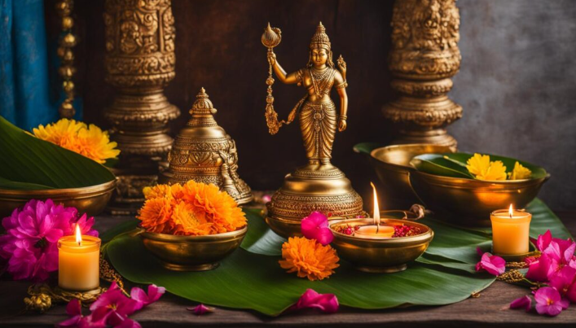
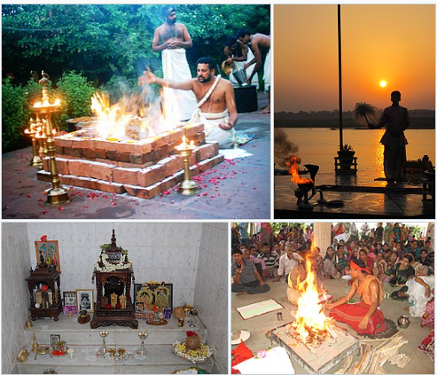
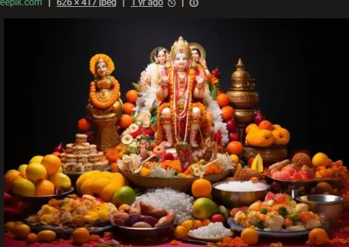
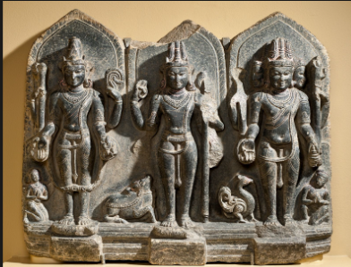
RE Year 5
Hinduism
Hinduism : How do Hindus see Brahman?
Very Important Vocabulary:
Braham- Brahman, in Hinduism, represents the ultimate reality and the foundation of the cosmos. Think of it as the underlying essence, the all-pervading energy that connects everything. It’s the origin and destination of all existence. Unlike deities that are often depicted in physical forms, Brahman is an abstract, formless concept.
Vishnu- Vishnu is the preserver and protector of the universe. His role is to return to the earth in troubled times and restore the balance of good and evil.
Brahma- Brahma's job was creation of the world and all creatures.
Shiva- Shiva's role is to destroy the universe in order to re-create it.
Puja- puja, in Hinduism, ceremonial worship, ranging from brief daily rites in the home to elaborate temple rituals.
Murti- a physical representation of a deity, usually a statue
.
What is Brahman in Hindu belief?
Hindus believe Brahman is everywhere and in everything, connecting all living things together. It is not usually thought of as a person or a god but a formless infinite presence.
Why do Hindus worship different deities if Brahman is one?
They worship different deities because this is seen as a different way of understanding and connecting with Brahman. Each deity shows a different quality or role such as, creating, protecting or transforming.
How are murtis used in Hindu worship?
Murtis are statues of Hindu deities. Hindus believe that murtis help them to worship and bring them closer to Brahman.
What is puja and how do Hindus worship Brahman?
Puja is special Hindu worship ritual where people show love, respect and devotion to god. It can take place in the home or in a temple. Hindus worship Brahman during puja, they pray, make offerings anf=d think about the divine.
How do Hindus see Brahman?
Hindus see Brahman as one ultimate reality and one spiritual power that is everywhere and in everything.
How do Hindus live according to their beliefs about Brahman?
They try to live in a kind and respectful way towards others and the world. They follow ideas such as Karma.

