Slide 1
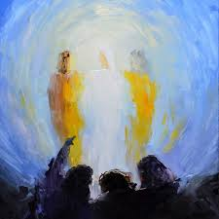
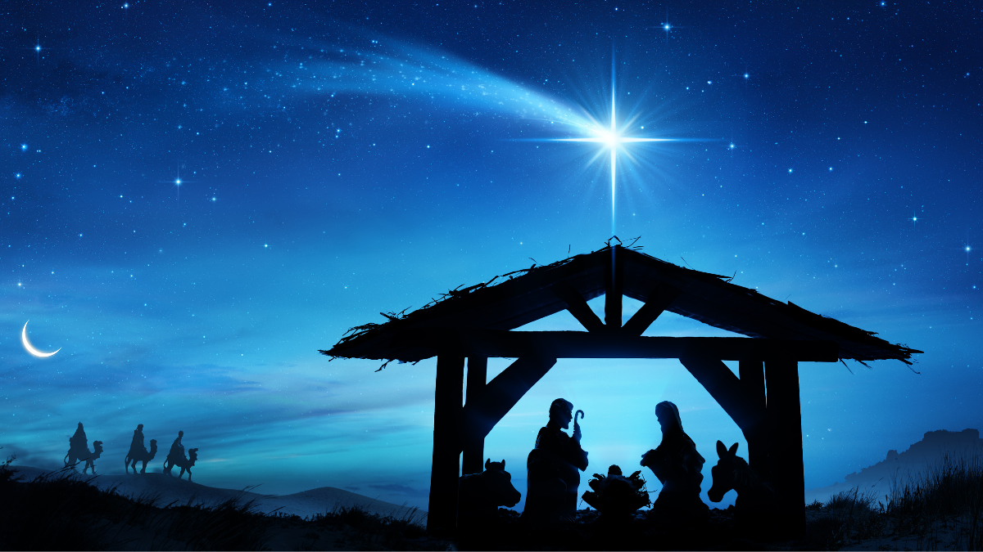
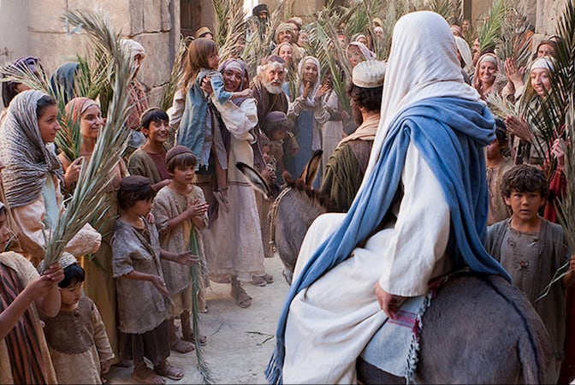
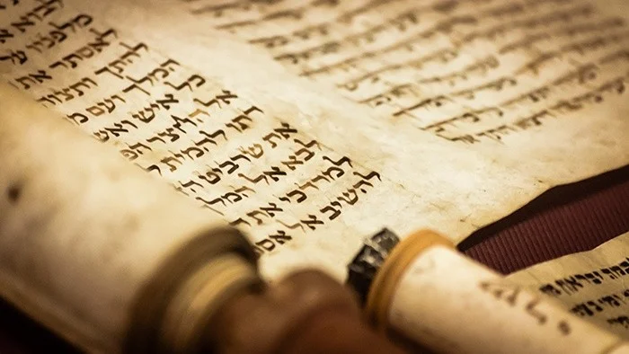
Incarnation
RE and Worldviews Year 6
Was Jesus the Messiah?
Very Important Vocabulary:
Messiah: A special person chosen by God to rescue people and bring goodness and peace into the world.
Incarnation: The belief that God became human as Jesus.
Restoration: Fixing what is broken and making things right again.
Transformation: A big change for the better.
Humility: Being modest and not acting like you’re better than others.
Descendant: Someone who comes from a family line, eg. great grandchildren. Jesus was said to be a descendant of King David.
Messiah expectations: What people hoped the Messiah would be like.
What does Jesus’ entry into Jerusalem reveal about his identity?
Matthew’s gospel tells of Jesus riding into Jerusalem on a donkey during Passover. This was a symbol of a peaceful king, not a warrior. Crowds shouted phrases that connected Jesus to the line of David. This event made many people believe Jesus might be the Messiah promised long ago.
How does the Transfiguration help Christians understand who Jesus is?
The Transfiguration is a dramatic moment where Jesus appears glowing with light. Moses and Elijah appear beside him—two major figures of Jewish history. A voice from heaven speaks. Christians interpret this story as clear evidence that Jesus is more than a prophet. It shows his divine identity.
What were Jewish people expecting from a Messiah?
Life was hard for the Jewish people—first exiled in Babylon, and later ruled by foreign powers like the Romans. Many people believed God would send someone to rescue them. Prophets in the Hebrew Bible described this person with clues: the Messiah would come from King David’s family, bring peace and justice, and lead the people back to God. Some prophecies even mention the place he would come from, or describe his character.
Why do Christians believe Jesus brings peace and transformation?
Christians believe Jesus’ teachings and actions show what a true Messiah is like. That he didn’t bring military victory but transformed lives through peace, forgiveness, and justice. Many Christians try to follow him by bringing peace and working for justice.
What clues do Christians find in the Nativity stories suggesting Jesus is the Messiah?
Matthew’s Gospel deliberately quotes Old Testament prophecies to show connections between Jesus and messianic expectations. These include someone born in Bethlehem, a descendent of King David, a great leader like David, someone to make Israel a great nation and bring peace to the world.

