Slide 1
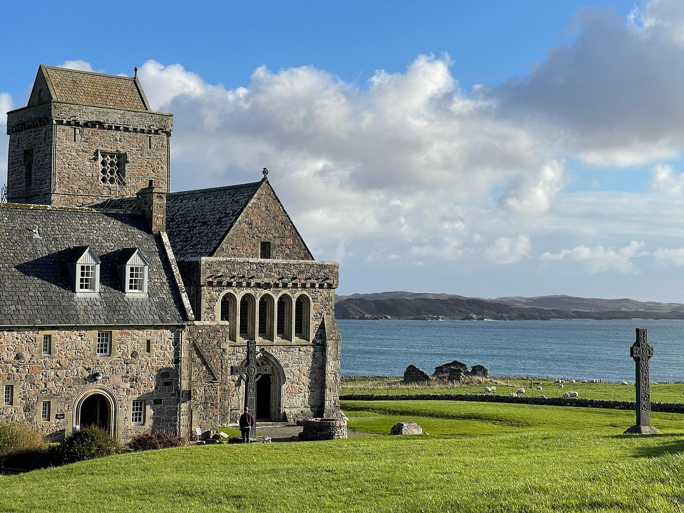
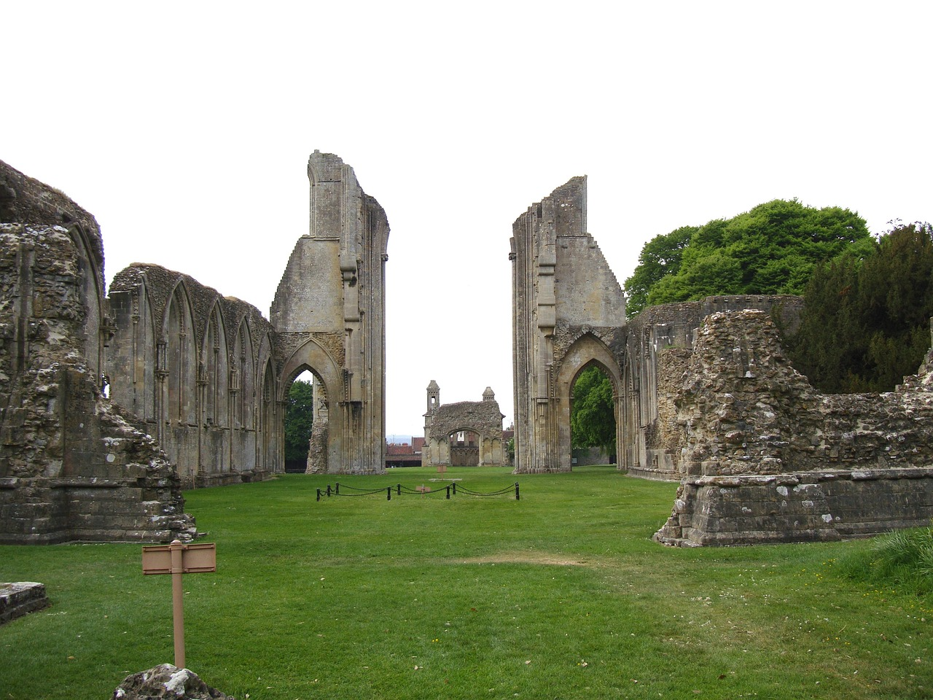
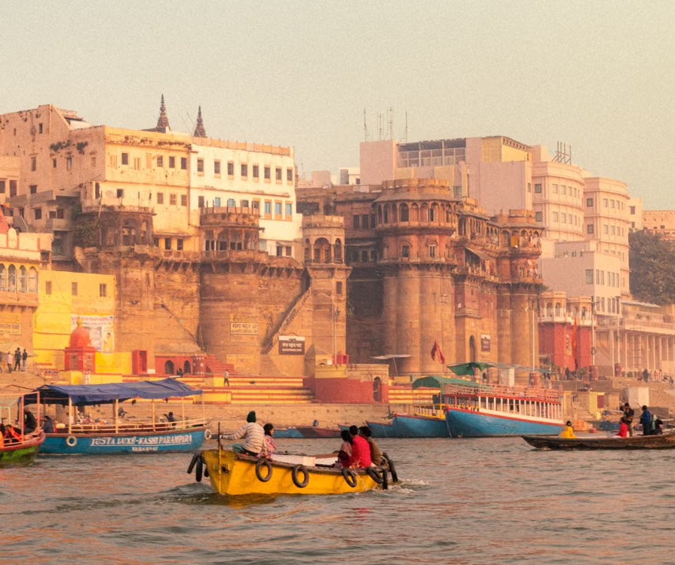

UKS2: Pilgrimage
Religion and Worldviews
Why are people still drawn to ancient places?
Very Important Vocabulary:
Pilgrimage: a journey to a sacred place
Pilgrim: someone who makes a journey to a sacred place
Sacred: holy or special
Worship: expressing faith through prayer or song
Monastery: a place where monks live and pray
Abbey: a community of monks or nuns
Contemporary: something modern or belonging to the present
Historical: something that belongs or relates to the past
Legend: a traditional story from the past that is widely believed but cannot be proven
Festival: a gathering or celebration centered around a specific theme or belief
Why did Iona become an ancient place of pilgrimage?
Iona became an important centre of Christian worship when St Columba founded a monastery there in the 6th century. It developed as a place where monks lived, prayed and spread Christianity across Scotland. Over time, people travelled to Iona to feel closer to God and connect with this early Christian heritage. Its remote location led to the idea of a ‘thin place’, where heaven and earth are believed to feel close.
Why do Christians still go to Iona today?
Iona remains an active place of pilgrimage through the modern Iona Community. Pilgrims visit for reflection, worship and community, showing how an ancient site can still meet modern spiritual needs. Visitors often describe peace, simplicity and connection to nature.
Why is the River Ganges a sacred place for Hindus?
The River Ganges is considered sacred in Hinduism and is often seen as a goddess, Ganga. Hindus believe the river can cleanse sins and help achieve spiritual purity. Pilgrims travel to cities such as Varanasi to bathe in its waters. The river plays both a spiritual and everyday role in people’s lives.
What is the Kumbh Mela and why do Hindus attend it?
The Kumbh Mela is a major Hindu pilgrimage festival held at sacred river sites. Pilgrims gather to bathe in the river, believing it cleanses sin and brings spiritual benefit. It is known as one of the largest religious gatherings and includes teaching, rituals and community life.
Iona
Glastonbury
How has Glastonbury changed as a place of pilgrimage over time?
Glastonbury has been a Christian pilgrimage site since the early Middle Ages, linked to legends such as Joseph of Arimathea. It became a major centre of pilgrimage before the Dissolution of the Monasteries. Today, it remains important for Christians but also attracts spiritual seekers beyond Christianity.
Why are people still drawn to ancient places?
Pilgrimage continues because places hold historical, religious and personal significance. Across religions, people seek connection, meaning, identity and community. Ancient places provide continuity, linking past and present beliefs. Different individuals experience pilgrimage differently depending on their worldview.
River Ganges
Kumbh Mela

