Slide 1
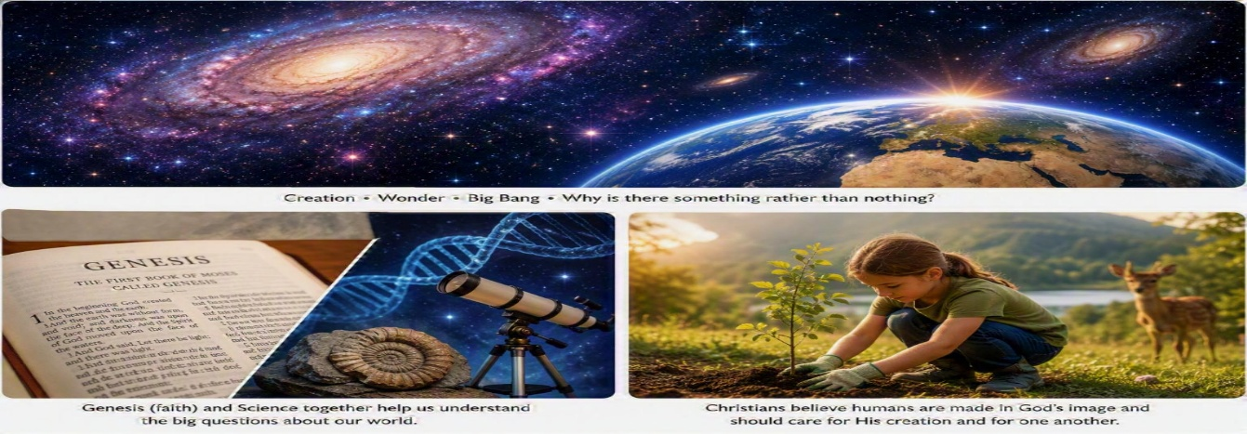
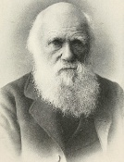
Understanding Christianity
RE and Worldviews Year 6 Term 4
Creation and science: Conflicting or complementary?
Very Important Vocabulary:
Creation: The Christian belief that God created the universe and everything in it..
Creator: A name Christians use for God as the maker of the universe..
Genesis: The first book of the Bible, containing the creation stories.
Literal Interpretation: Reading Genesis as an accurate historical account of exactly what happened.
Symbolic (Poetic) Interpretation: Reading Genesis as a text that teaches truth and meaning rather than scientific detail..
Big Bang Theory: The scientific explanation that the universe began expanding around 14 billion years ago.
Evolution: The scientific theory explaining how living things change over time through natural selection.
Evidence: Information used to support an idea, explanation or argument
Stewardship: The responsibility Christians believe humans have to care for God's creation.
The Fall: The Christian belief that Adam and Eve disobeyed God, damaging humanity's relationship with Him.
Different Christian Views
Some Christians believe: Genesis is literally true.
• Six days means six actual days.
• God directly created everything.
• Some reject evolution.
Many Other Christians believe: Genesis teaches meaning and purpose.
• God created the universe.
• Evolution can explain how life developed.
• Science and faith can work together.
Human Responsibility
Christians believe people are made in God's image
.This means humans should:
• Care for other people • Protect nature • Show kindness • Act responsibly
What Kind of Text is Genesis 1?
Many Christians believe Genesis 1 is not a science textbook. It uses repeated phrases and patterns that make it sound poetic.
Examples include: ‘And God said...’ ‘And it was so...’ ‘God saw that it was good...’
Some Christians believe Genesis teaches that God is Creator and gives purpose to human life.
The Fall
Genesis 3 tells the story Christians call The Fall.
Christians believe:
Before the Fall: ✓ Harmony with God ✓ Obedience
After the Fall: ✓ Sin entered the world ✓ People make wrong choices ✓ People need forgiveness
What Does Science Say?
Scientists use evidence gathered through observation, experiments and research.
The Big Bang: Scientists believe the universe began expanding around 14 billion years ago.
Evolution: Scientists believe life developed gradually over long periods of time through natural selection.
Science explains how the universe and life developed.
Can Science and Christianity Work Together?
Science | Religion
How did the universe begin? | Why is there a universe?
How did life develop? | What is the purpose of life?
Uses evidence and observation | Explores meaning and values
Key People
Charles Darwin: Developed the theory of evolution through natural selection.
Christian Scientists: Many scientists today are Christians who see science as helping them
understand God's creation.

