Slide 1
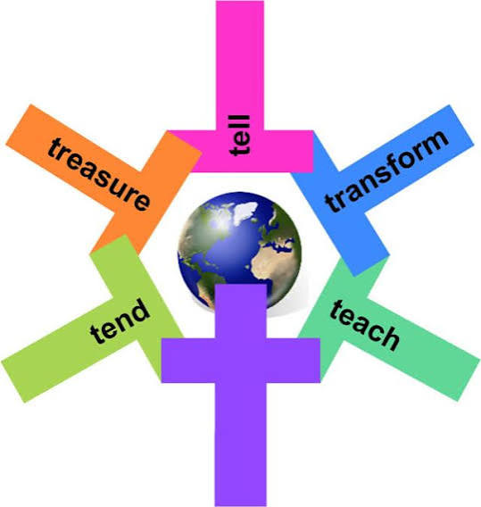
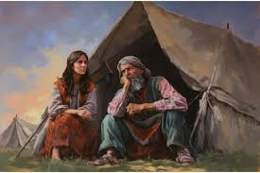
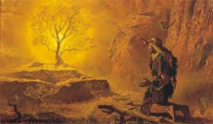
How can following God bring freedom and justice?
RE and Worldviews Year 5
Very Important Vocabulary:
Covenant: A covenant is a special promise or agreement between two people or groups that they are expected to keep.
Commandment: A commandment is an important rule that tells people how they should behave.
Exodus: Exodus is the second book of the Bible. It tells the story of how God helped the Israelites escape from slavery in Egypt and gave them the Ten Commandments through Moses.
Justice: Justice means treating people fairly and making sure everyone is treated in the right way..
Salvation: Salvation means being saved from sin and brought close to God. Christians believe that Jesus came to bring salvation to everyone who believes in him.
Liberation: Liberation means being set free from something that is unfair or harmful, such as slavery or oppression.
Ethics: Ethics means thinking about what is right and wrong and choosing to do the right thing.
Oppression: Oppression means treating people unfairly by using power to control them or stop them from being free.
What are commandments?
The Ten Commandments and many other laws in the Torah helped God's people know how to live. They taught people how to worship God, be fair to others, care for poor people, and live peacefully together. Many of the laws protected people who needed extra help, such as strangers, widows, and those who were poor. Christians believe these laws show what God thinks is right and fair. Today, Christians discuss which laws they should still follow and how to use them to make good choices.
What do Christians today think?
Christians apply this idea of rescue to living today by trying to serve God and to bring freedom to others, for example by loving others, caring for them, bringing health, food, justice, and telling the story of Jesus. Christians see the Christian Church as part of the ongoing story of the People of God
What story does the Old Testament tell?
The Old Testament pieces together the story of the People of God. As their circumstances change (for example, from being nomads (Abraham, Jacob) to being city dwellers (David)), they have to learn new ways of following God.
How do Christians today try to bring freedom and justice??
Christians believe they should help bring freedom, fairness, and hope to the world. They try to be a good example by showing kindness, helping others, and sharing God's love. Many Christians follow the Five Marks of Mission, which encourage them to tell others about Jesus, teach people, care for those in need, work to make the world fairer, and look after God's creation. Christian charities, such as Toybox, Tearfund, and Christian Aid, help people who are poor or in danger by providing support and working to make life better for everyone.
Who was Moses?
The story of Moses and the Exodus shows how God rescued his people from slavery in Egypt; Christians see this story as looking forward to how Jesus’ death and resurrection also rescue people from slavery to sin.

