Slide 1



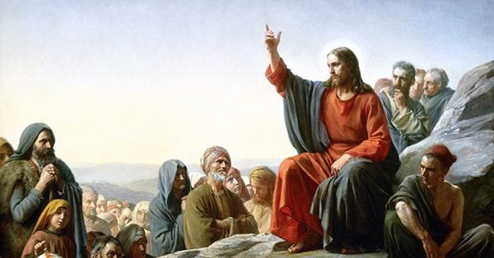
What kind of king Is Jesus?
RE and Worldviews UKS2
Kingdom of God: What kind of king Is Jesus?
Very Important Vocabulary:
Christianity A major religion based on the life and teachings of Jesus, followed through the Bible.
Jesus Central figure in Christianity, believed to be the Son of God and saviour.
Bible Holy scripture of Christianity containing the Old and New Testaments with teachings and stories.
Parable A short story teaching a moral or spiritual lesson, often used by Jesus.
Kingdom A realm ruled by a king; in Christianity, it can mean God’s rule over people.
Kingdom of God Idea of God’s rule in people’s lives now and in a future perfect world.
Moral A lesson about right and wrong behaviour.
Community A group of people sharing beliefs or values who support each other.
Charity Helping people who need support, such as giving money, food or time to those who are poor or in difficulty.
.
Jesus’ parables
The purpose of Jesus’ parables was to teach important spiritual and moral lessons in a simple and memorable way. Parables are short stories that use everyday situations to explain deeper truths about God, faith and how people should live. Jesus used them to help people understand ideas such as forgiveness, kindness, humility and the Kingdom of God. They were easy to remember and made people think carefully about their actions and choices. Parables also challenged listeners to reflect on their behaviour and change for the better. In this way, they helped spread Jesus’ message to all kinds of people.
Forgiveness and mercy:
Jesus taught that forgiveness is essential and should be given freely, just as God forgives people. He encouraged his followers to forgive others not just once, but repeatedly, showing that mercy is more important than holding onto anger or revenge. Christians believe Jesus shows the best way to live: loving God and loving your neighbour.
The Kingdom of God:
Jesus often spoke about the Kingdom of God, which is not a physical place but a way of living where God’s will is done on earth as it is in heaven. He taught that the Kingdom is present wherever people act with love, justice and mercy. It is different from earthly kingdoms because it is not based on power, wealth or control.
How Christians try to extend the Kingdom of God today
Christians believe they help extend God’s Kingdom by living according to Jesus’ teaching through forgiveness, justice, compassion and challenging unfair systems. Many churches engage in practical service such as supporting refugees, combating poverty or advocating for justice. These actions are rooted in the belief that following Jesus means transforming society.
What kind of king is Jesus?
Jesus is a king who serves rather than dominates. His kingship is rooted in inclusion, forgiveness, justice and transformation rather than wealth or force. Christians believe his rule continues through his followers and will be fulfilled in the future Kingdom.

