Slide 1
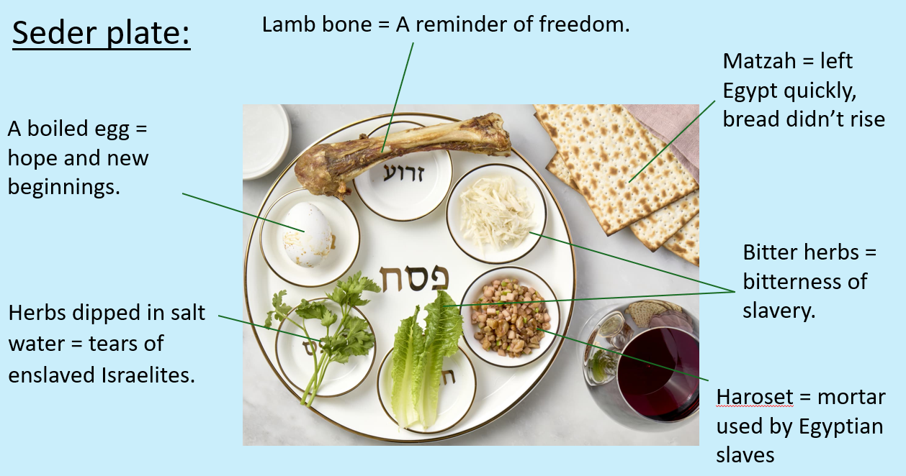
Pesach
RE and Worldviews Year 3
How do Jews remember God's covenant?
Very Important Vocabulary:
Passover: Another name for Pesach..
Covenant: A special, serious promise.
Exodus: The journey when the Jewish people escaped from Egypt.
Torah: The Jewish holy book.
Seder: A special Passover meal where families tell the story of leaving Egypt.
Matzah: Flat bread eaten on Passover because the people left Egypt so quickly that their bread didn’t have time to rise.
Chametz: Foods made with dough that rises, like bread; people don’t eat it on Passover.
Haggadah: The book read at the Seder that tells the Passover story.
How do Jewish families prepare for Pesach?
Jewish families believe preparation for Pesach helps them remember the Exodus properly. Preparation takes several days. Some families are very strict about cleaning while others focus more on prayer and learning. One important part of preparation is removing chametz. Jewish people believe this reminds them that the Israelites had to leave Egypt quickly and could not wait for bread to rise.
How does the Seder meal help Jews remember God’s covenant?
The Seder meal is a special way of Jewish people retelling the Exodus story so every generation remembers God’s covenant. Each item on the Seder plate is a symbol. During the Seder, children ask questions. Jewish people believe asking questions helps learning and keeps the story alive. This shows Pesach is not just about the past – it is about teaching the future.
What is the Jewish covenant?
God promised Abraham that his family would grow into a great people, that they would have land to live in and that God would protect them. Jewish people believe Abraham trusted God. Because of this, the covenant became central to Jewish identity – it helped Jewish people understand who they are and who God is. Pesach is one of the main ways Jews remember that God keeps His promises.
Why is the story of Moses and the Exodus central to Pesach?
The Israelites, also called Hebrews, were living in Egypt. At first life was good, but over time they became enslaved. Jewish people believe God chose a man called Moses to help free them. Moses did not free the Israelites on his own, that God caused the Exodus. Jewish people believe the Exodus shows God keeping His covenant. That is why this story is told every year at Pesach.
What does the Exodus story really mean to Jewish people?
Jewish people believe the Exodus story teaches them important messages and values that still matter today. That remembering slavery helps them understand freedom better. The Torah teaches Jews to remember that they were once slaves so they treat others with kindness and fairness. For many Jewish people, Pesach is a time to remember freedom, justice, gratitude and responsibility.

