Slide 1

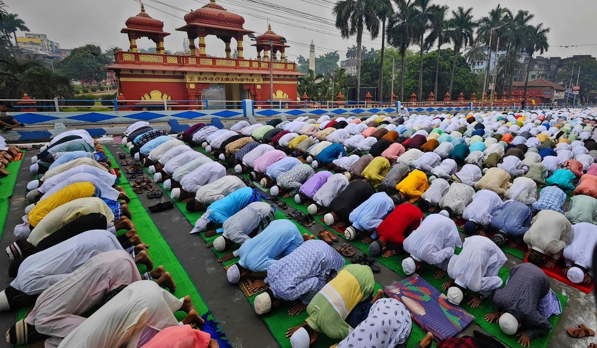
Islam
RE and Worldviews
How does prayer and fasting help Muslims find harmony?
Very Important Vocabulary:
Allah: Allah is the Arabic word for God.
Muslim: A Muslim is someone who believes in Islam and lives according to its rules.
Islam: Islam is a major world religion.
Shahadah: Shahadah is the Muslim statement of faith and is one of the Five Pillars of Islam.
Salat: Muslims pray five times a day in a ritual called Salat.
Mosque: A mosque is a special place where Muslims gather to pray together.
Imam: The imam leads the prayer in the mosque.
Sawm/Fasting: Fasting means not eating or drinking during the daytime.
Ramadan: During Ramadan, many Muslims fast during daylight hours.
Ummah: Ummah means Muslim community.
How does daily prayer help Muslims feel calm and focused?
Muslims pray five times a day in a ritual called Salat. Prayer helps Muslims pause, reflect, and remember Allah throughout the day. It supports mindfulness, calmness, and connection with God. Prayer also helps Muslims live disciplined and balanced lives
Why does praying together in a mosque help Muslims live in harmony?
A mosque is a special place where Muslims gather to pray together, especially on Fridays. Praying together builds community and equality, as everyone stands side by side. Mosques also teach kindness, learning, and respect. Community prayer strengthens shared values.
Who is Allah and how does believing in Allah help Muslims live in harmony?
Muslims believe in one God, Allah, who created the world and wants people to live good and peaceful lives. Many Muslims believe that following Allah’s guidance helps them live calmly and kindly with others. Harmony means living peacefully with God, yourself, and other people. Belief in Allah is at the centre of everything Muslims do.
How does fasting during Ramadan help Muslims make good choices?
During Ramadan, many Muslims fast during daylight hours. Fasting (Sawm) teaches self‑control, empathy, and gratitude. Ramadan is also about kindness, prayer, and helping others, not just food. Muslims aim to improve behaviour during this time.
What is the Shahadah and how does it help Muslims belong?
The Shahadah is the Muslim statement of faith and is one of the Five Pillars of Islam. It says that there is only one God and that Muhammad is the messenger of Allah. Saying the Shahadah shows belonging to the Muslim community (the ummah). It helps Muslims feel connected and united through shared belief.
How do prayer and fasting help Muslims live in harmony?
Prayer and fasting are key practices in Islam that help Muslims feel close to Allah. These practices encourage calmness, self‑control, gratitude, and kindness towards others. Harmony is about balance between belief, actions, and community. Muslims express this in different ways.

