Slide 1
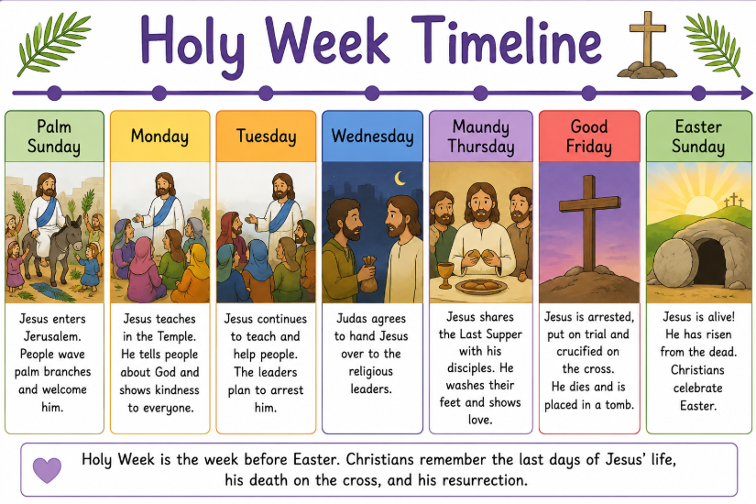
Salvation
RE and Worldviews Year 3
Salvation: Why do Christians call the day Jesus died ‘Good Friday’?
Very Important Vocabulary:
Salvation: Christians believe salvation means being saved from sin and being close to God.
Good Friday: The day Christians remember that Jesus died on the cross.
Easter: A Christian festival celebrating that Jesus came back to life.
Holy Week: The week before Easter when Christians remember the last days of Jesus’ life.
Cross: The wooden cross where Jesus died. It is an important Christian symbol.
Crucifixion: The way Jesus died on a cross.
Resurrection: Christians believe Jesus came back to life on Easter Sunday.
Sacrifice: Giving up something important to help someone else. Christians believes Jesus gave his life for others.
Forgiveness: Choosing to stop being angry with someone after they have done something wrong.
Sin: Things people do that go against God’s way.
Disciple: One of Jesus’ special followers who learned from him.
Palm Sunday: The day Jesus rode into Jerusalem and people welcomed him with palm branches.
Why did Jesus die?
Christians believe Jesus died as a sacrifice because he loved everyone. They believe he took the punishment for sin so people could have a relationship God.
What happened after Good Friday?
Christians believe that Easter Sunday Jesus rose from the dead. This is called the Resurrection and gives Christians hope of new life.
How do Christians remember Good Friday?
Christians may:
Go to church
Pray quietly
Read the story of Jesus’ death
Walk the Stations of the Cross
Reflect on Jesus’s sacrifice
What happened on Good Friday?
Christians believe Jesus was arrested, put on trial, carried his cross, was crucified, died, and was buried. Good Friday remembers these events.
Why is it called ‘Good’ Friday?
Although it was a sad day, Christians call it ‘Good’ Friday because they believe Jesus chose to die to save people from sin. His death made forgiveness and salvation possible.
Why is Good Friday important today?
Good Friday reminds Christians about God’s love, forgiveness and sacrifice. It encourages Christians to forgive others, show kindness and trust in God.

