Slide 1

Welcome to Year 5
2026-2027

Slide 2
Class 5 Team
Teacher – Mrs Hanks (Monday, Tuesday, Wednesday)
Mrs Bryant(Thursday, Friday)
Support staff: Mrs Manson, Mrs Baird, Mrs Campbell

Slide 3
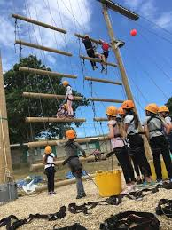
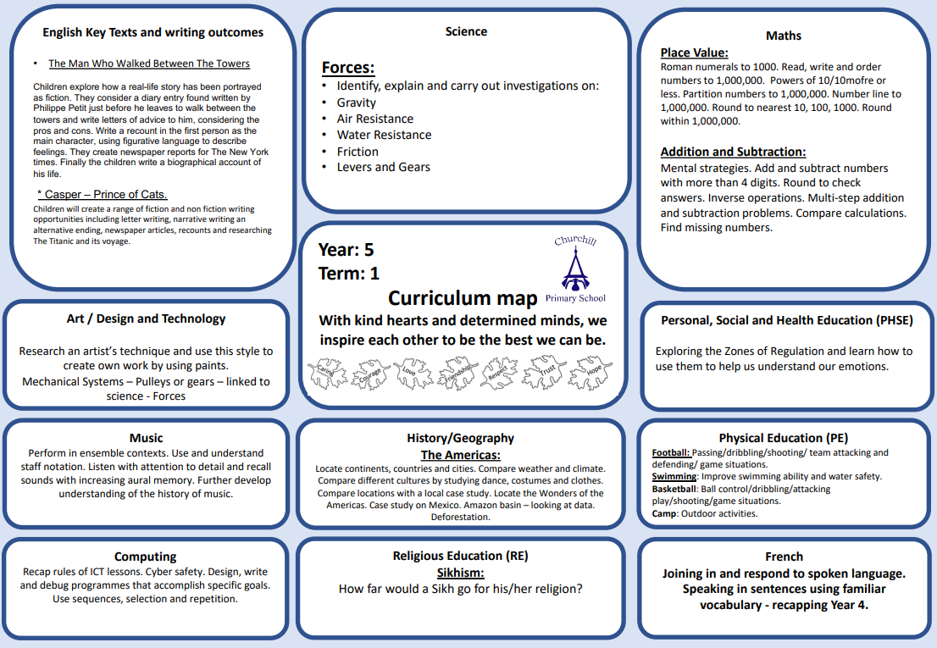
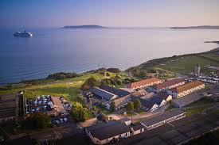
About Year 5
Developing Independent Learners
Osmington Bay
Developing greater independence. Walking home.
Greater responsibility and expectations – setting the example for the rest of the school. Young Leaders.

Slide 4


Slide 5
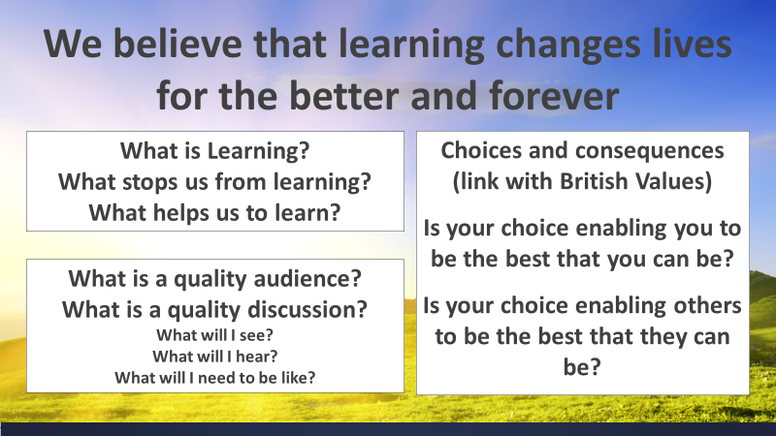

Slide 6


Slide 7
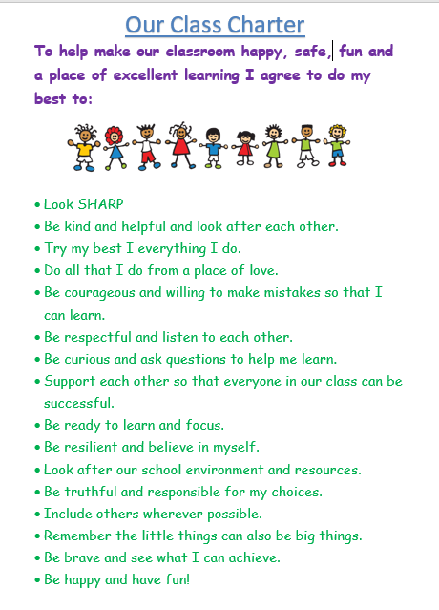

Slide 8
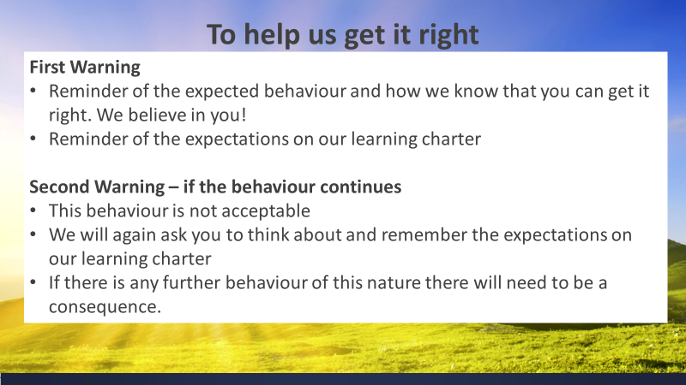

Slide 9
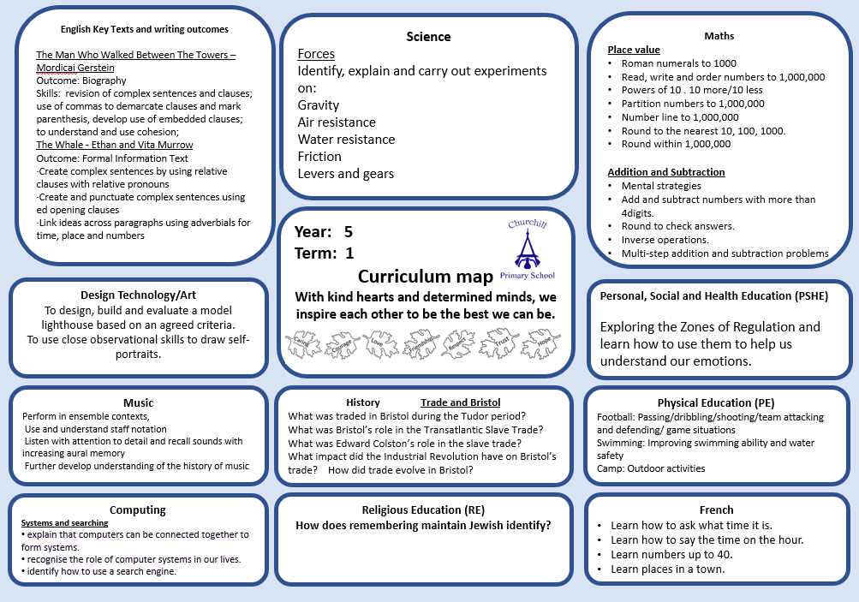
https://schoolreadinglist.co.uk/reading-lists-for-ks2-school-pupils/suggested-reading-list-for-year-5-pupils-ks2-age-9-10/

Slide 10
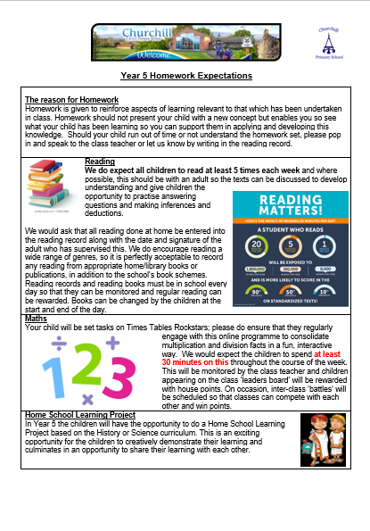

Slide 11
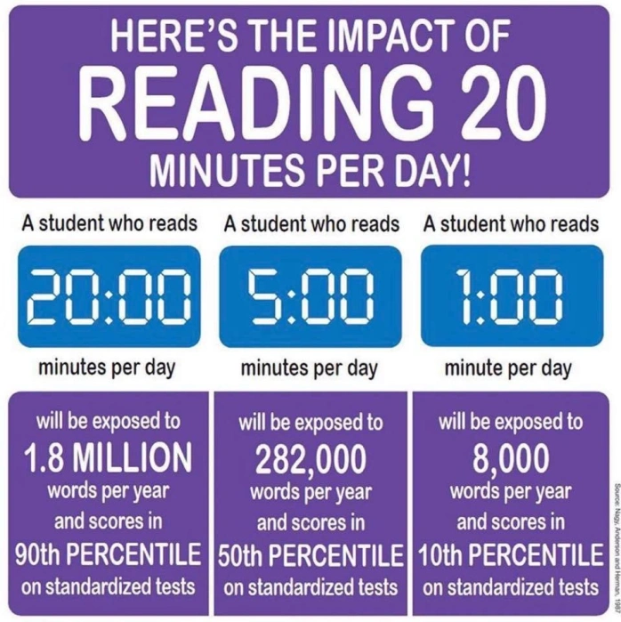

Slide 12
Year 5
History & Geography:
Term 1 – Trade in Bristol
Term 2 – Informal settlements
Term 3 – Benin
Term 4 - Earthquakes
Term 5 – Democracy in Ancient Greece
Term 6 – Renewable and non-renewable energy

Slide 13
Class 5 reminders:
Term 1 – swimming lessons every Friday this term starting Friday 11th September 2024. Please bring swimming kit in a bag.
Please make sure the correct PE kit is in school every day – we will send it home at the end of each term.
Homework: Maths = TT Rockstars.
Reading = Please read 5 times a week to an adult and get it signed.
If you haven’t already, please send back your forms for how your children will get home from school and permission slips to watch PG films.

Slide 14
Class 5 – Dates to remember:
Osmington Bay Camp Talk is set for Thursday September 24th @ 3.20pm. Until then, please let your child know that it is so much fun and that they will be with friends in their room!
T@3 – Friday 23rd October
Parents Evenings – Tuesday 10th November and Thursday 12th November
Bikeability – Week beginning 1st March
Farm Visit – Date tbc
St Giles Trust workshop – Date tbc
Operation Topaz workshop – Date tbc
RNLI Water safety workshop – 29th April

Slide 15

We use ‘The Zones of Regulation’ within our PSHE curriculum as a whole school approach to teach pupils about self-regulation and how to categorise complex feelings and emotional states,
The curriculum helps to improve how pupils can recognise and communicate how they are feeling in a safe and non-judgemental way, whilst learning strategies or tools to help them move between four Zones: Blue, Yellow, Red and Green – which are used to help them identify and recognise how regulated they feel.
This provides us with a common language within our school community that all pupils can engage with and understand from EYFS through to Year 6 and we regularly revisit the tools and strategies in our PSHE sessions across the whole school during Term 1.
We have also introduced‘Regulation Stations’
as areas where children can go to self-regulate
around our site, which will have pictorial reminders
of the tools and strategies they could use.
If you would like any further information regarding
the Zones of Regulation, or further resources you
can use at home with your child, please ask a
member of the team.

Slide 16

The Six Principles of Nurture
Here at Churchill Primary, we embed the Six Principles of Nurture across all areas of our school life, and they are at the root of our vision, values, ethos and policies.
We have child-friendly versions of the principles displayed at school for our pupils to engage with.

Slide 17

Discovering digital at primary

Slide 18

Introduction to the Mental Health Support Team
  The MHST service is part of a national Government strategy to improve access to Mental Health support for children and young people.
  The service is designed specifically to provide extra capacity for prevention and early intervention.
  It is designed to complement and extend existing support systems, not replace them - and to deliver “Whole School Approach” work
  MHSTs work with children and young people aged 5-18 specifically in education settings

Slide 19
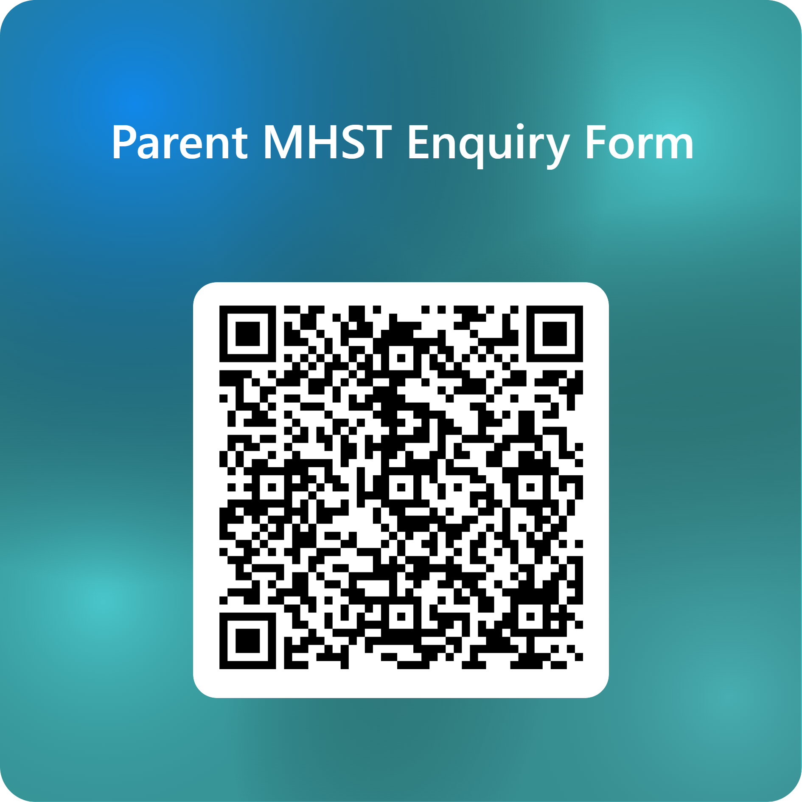

Support is here for you or/and your
child/children
Scan the QR code.
Complete the online form to register your interest.
Mr G will contact you to discuss your concerns.
A time will be made to meet with your child’s class teacher to complete the MHST referral form.
Once the referral has been accepted by the MHST, you will be contacted to meet with them in school.

Slide 20
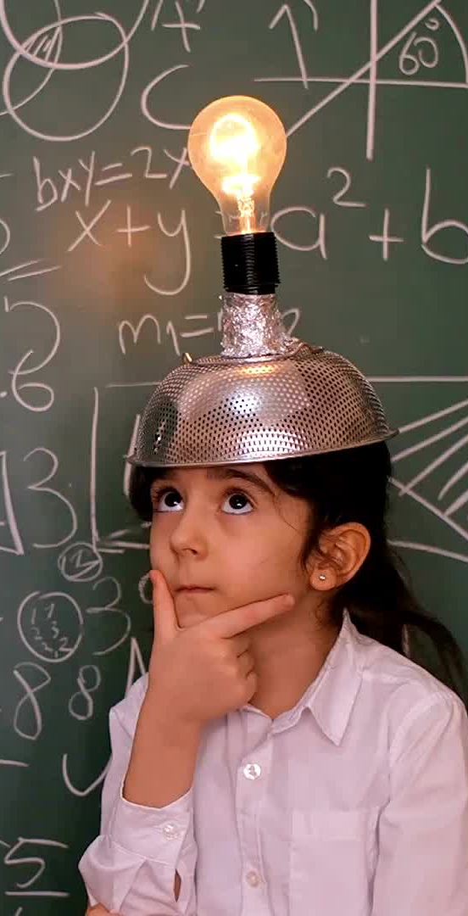
Class 5:
Please always feel free to come and talk to us if you have any questions or contact us through the office email if this is more convenient. We will do our best to get back to you as soon as possible.
We very much look forward to working alongside you in the coming academic year.

Slide 21

Class 5

