Slide 1
Welcome to Year 3
Class teacher: Miss Green
Learning Partner: Mrs Ford
We are thrilled to be working with you and your children this year and are delighted to welcome them back this September. Your child's well-being and success are our top priorities, and we are committed to making this a positive and productive year.
If you have any questions or need assistance, please don't hesitate to speak with us in the morning or afternoon. Alternatively, you can contact the school office, and we will be happy to help in any way we can.
We look forward to a fantastic year together!
.

Slide 2
Things you might want to know.
Reading records need to be in everyday as we have ERIC at the end of the day.
PE is on a Tuesday and Friday. (Summer kit/ Winter kit. Hair tied back if longer than shoulders.)
No spelling tests- copy of class spelling worksheet can be available for those who wish.
Reading books are independently changed by the children either at the start of the day, break times and end of the day. Please encourage your child to change their books regularly.
Spring time- Year 3 are taking part in the NSSPEA dance festival at the Weston Playhouse

Slide 3

Homework
Reading:
Children are expected to read at least 5 times per week.
Reading should be done with an adult when possible to:
Discuss the text
Develop understanding
Practice answering questions
Make simple inferences
Maths:
Secure recall of number bonds
Begin rapid recall of multiplication and division facts
By the end of Year 3, children should be able to quickly recall:
Number bonds to 20
Times tables for 2, 3, 4, 5, 8, and 10, including division facts
Children will be set tasks on Times Tables Rockstars:
They should use it at least 10 minutes, 2 times per week
The programme helps consolidate facts in a fun and interactive way
Homework:
Optional! Home learning project based on History/Science learning

Slide 4
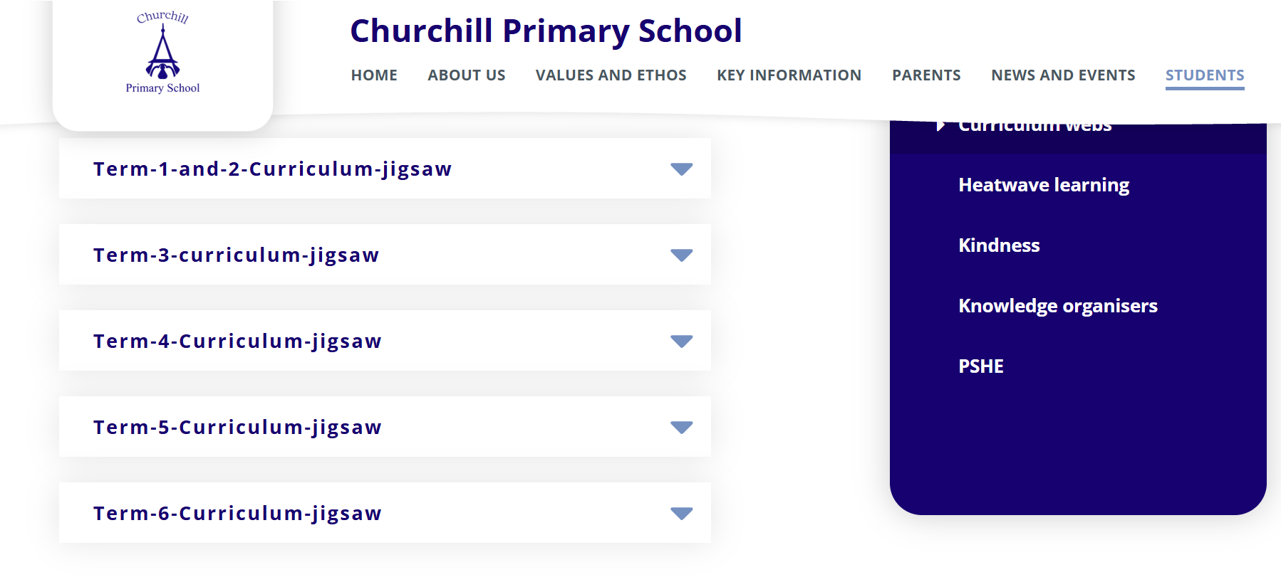
Curriculum https://www.churchillprimaryschool.co.uk/students/class-pages/year-3/curriculum-webs

Slide 5


Slide 6
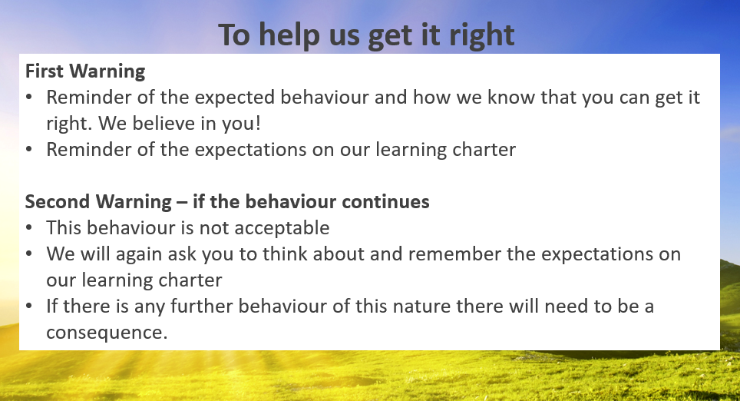

Slide 7
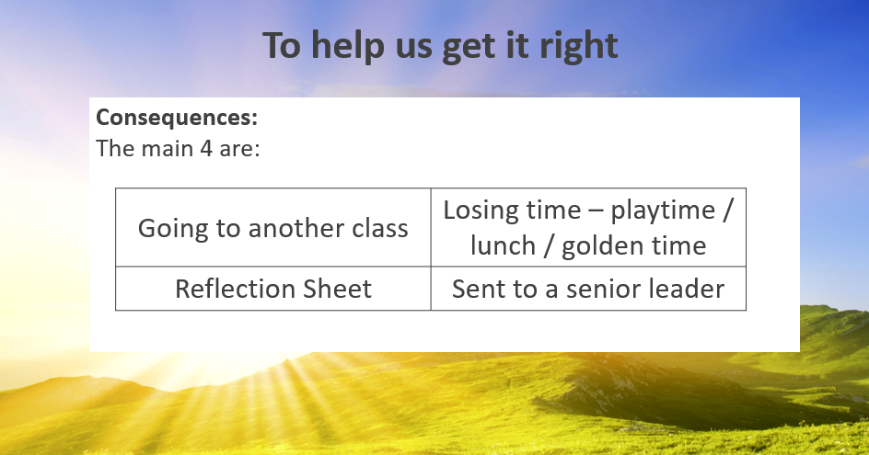

Slide 8


Slide 9

Introduction to the Mental Health Support Team
  The MHST service is part of a national Government strategy to improve access to Mental Health support for children and young people.
  The service is designed specifically to provide extra capacity for prevention and early intervention.
  It is designed to complement and extend existing support systems, not replace them - and to deliver “Whole School Approach” work
  MHSTs work with children and young people aged 5-18 specifically in education settings

Slide 10


Slide 11
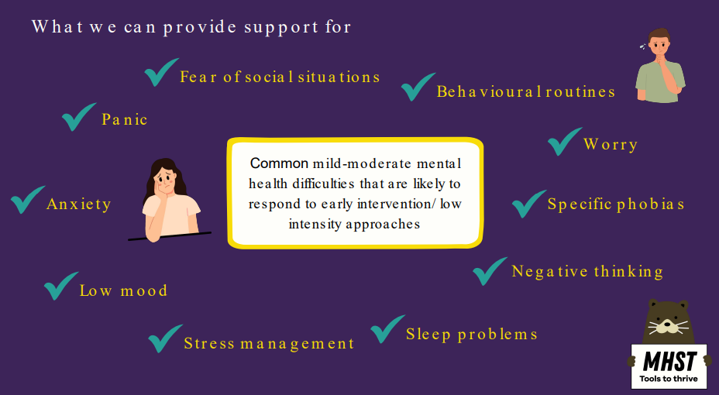

Slide 12
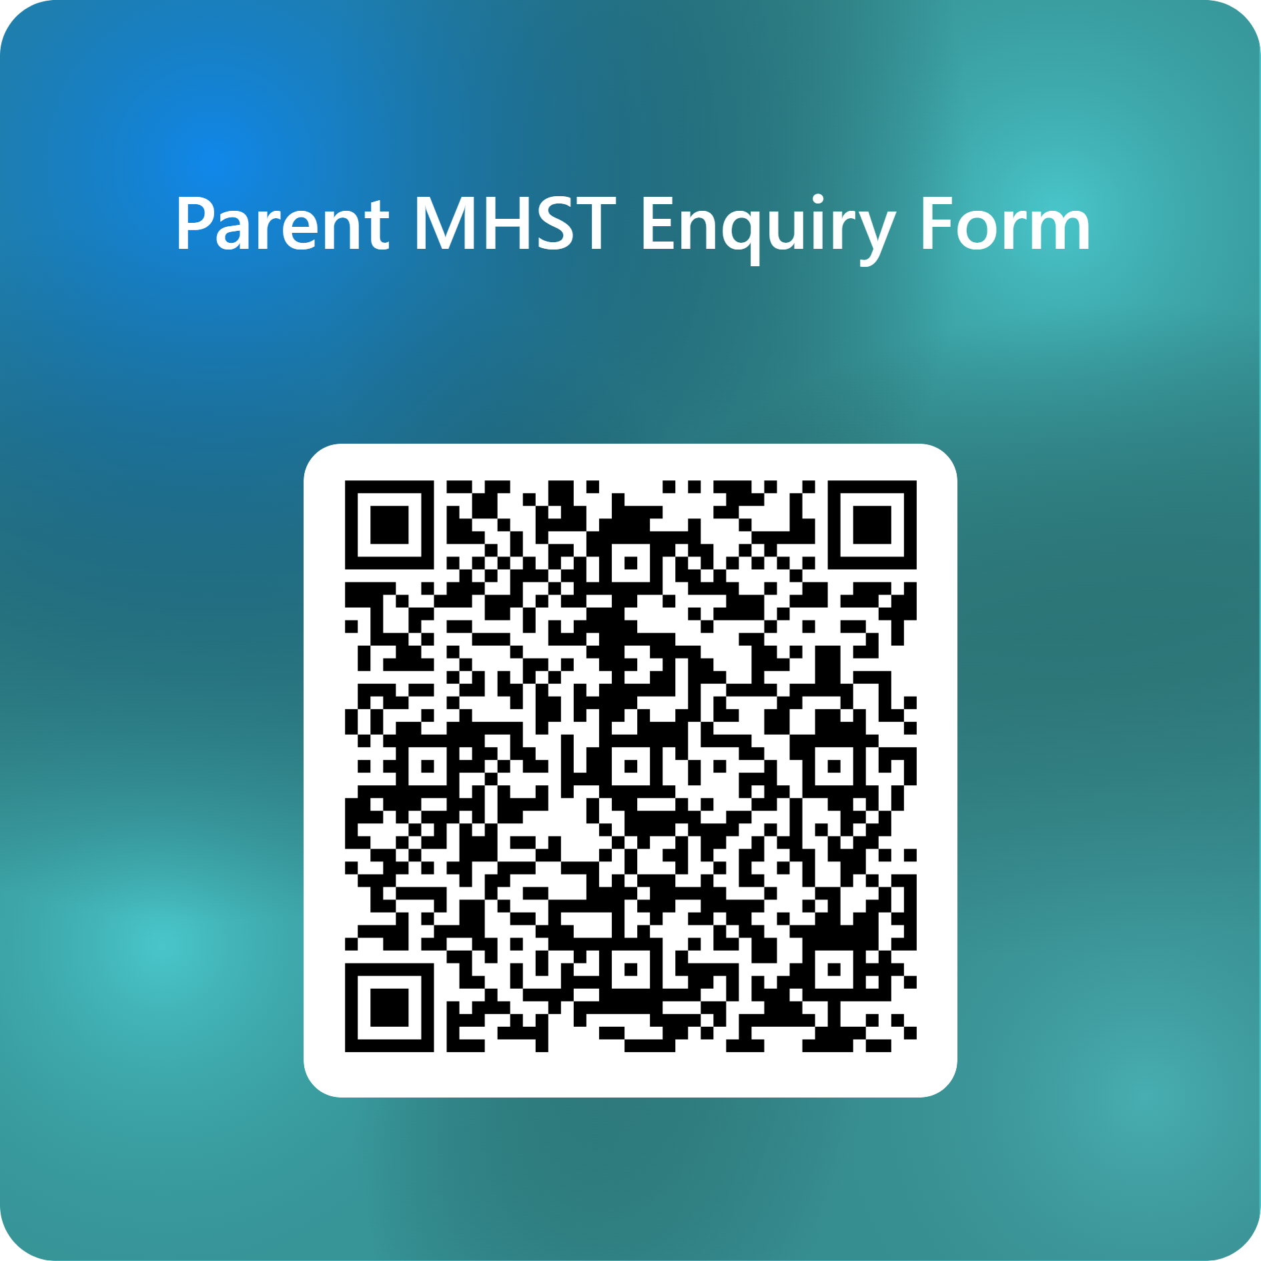

Support is here for you or/and your
child/children
Scan the QR code.
Complete the online form to register your interest.
Mr G will contact you to discuss your concerns.
A time will be made to meet with your child’s class teacher to complete the MHST referral form.
Once the referral has been accepted by the MHST, you will be contacted to meet with them in school.

Slide 13
Who we work with:
  The child / young person
  The child/young person and their parent/carer
  Parent/carer alone - for children under 8 (anxiety/ behaviour)
  Anxiety or worries - specific, social, separation, panic, general and some obsessive compulsive difficulties (OCD).
  Low Mood (most often found in secondary but can present in primary)
  Behavioural difficulties
We only ever work with people who consent to and want the
support

Slide 14
Any questions?

