Slide 1

Welcome to Year 2
Miss Pike / Mrs Linham
Miss Harris / Mrs Holdaway

Slide 2
Our aims in Year 2
To enjoy school.
To become independent and confident learners.
To build on and apply the skills taught in Year 1.
To work hard to one’s own potential.
To be kind, caring and well behaved at all times.
To prepare for the transition into Key Stage 2.
To celebrate success and achievements.

Slide 3
How We Work
Year 2
Miss Pike – Monday, Tuesday, Wednesday
Mrs Linham - Thursday and Friday
PPA times
Miss Pike – Wednesday pm (Mrs Campbell will teach Science)
Mrs Linham – Thursday PM (Mrs Campbell will teach PSHE)

Slide 4

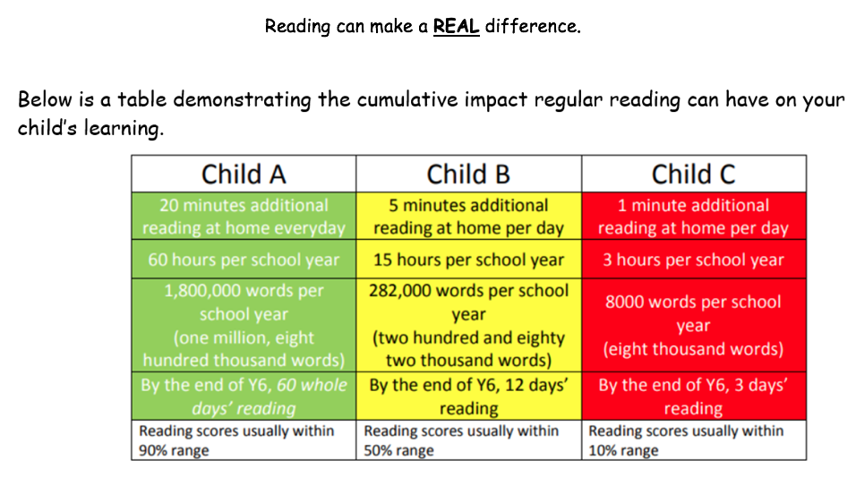
Reading
Reading at home……..aim for 5 times a week if possible.
In school, books can be changed if yellow reading records have been signed by an adult.

Slide 5
Reading For Fluency
This means reading with a story telling voice, using expression, taking note of punctuation and reading words accurately and automatically.
It does not mean reading a text in the quickest possible time!!!
Reading For Pleasure
Be inspired and excited about reading texts- ANYTHING……. fiction, comics, poetry, magazines, dictionaries, newspapers etc

Slide 6
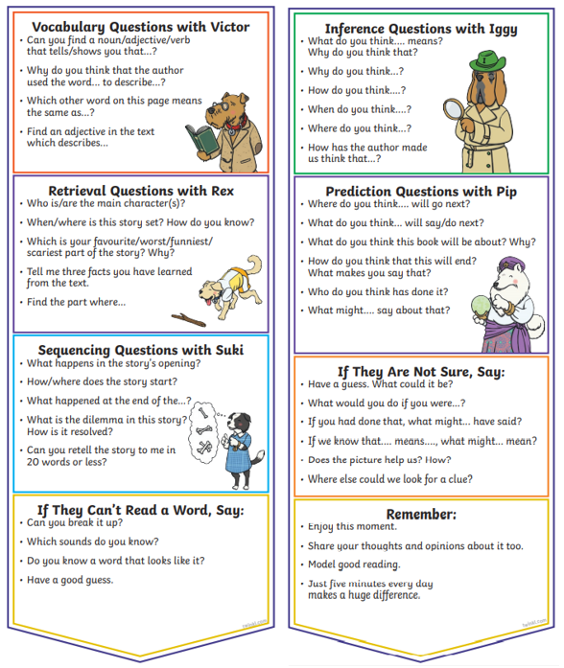
Reading Comprehension
Children have a bookmark stuck inside the front cover of their
yellow reading records.
This helps support parents with
structuring questions to ask
children to make sure they
understand what they are
reading.

Slide 7
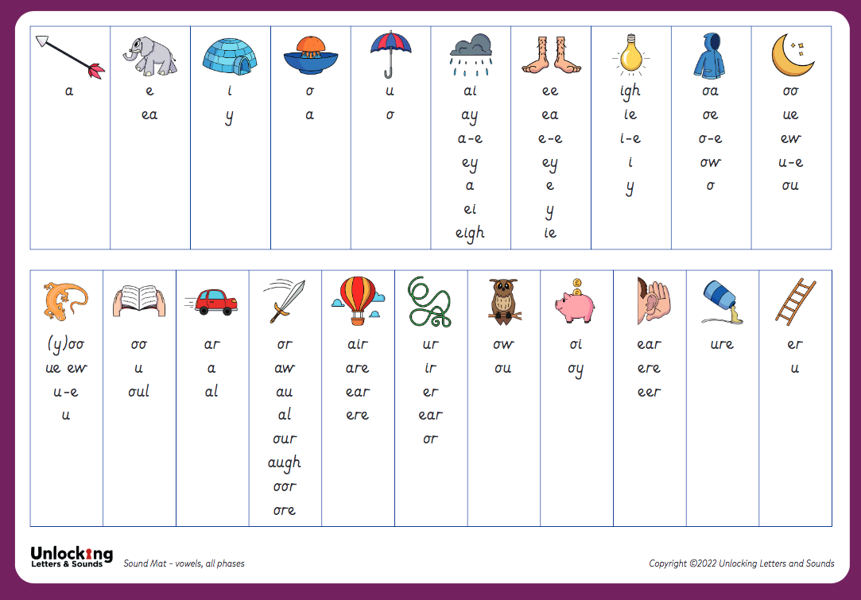
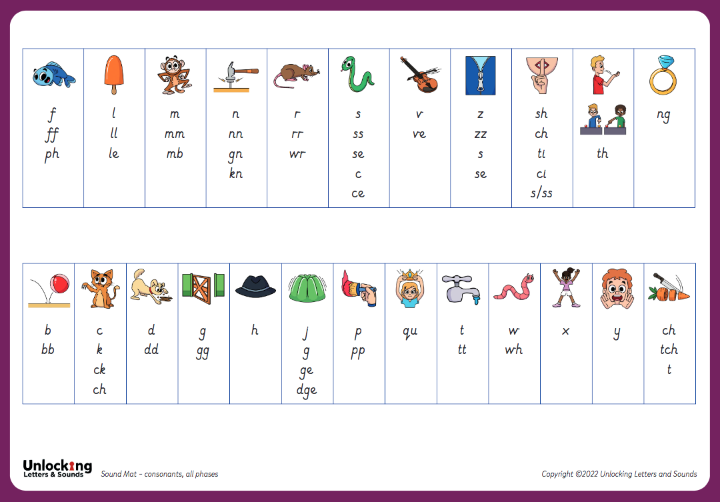
Phonics
Daily sessions
We continue with the Unlocking Letters and Sounds program until the end of term 2.
Children who still need support with phonics beyond term 2 will continue their learning in small groups/individually during reading practice.
Phonics Screening Check takes place June 2027

Slide 8
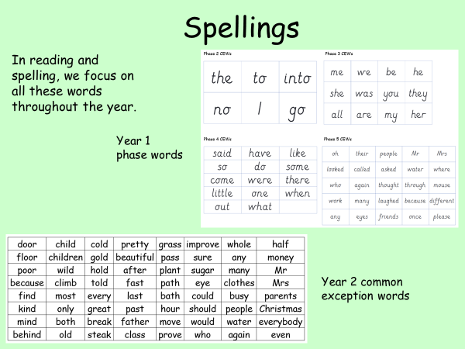

Slide 9
Maths
Secure knowledge of number families. Number bonds to and within 10 and 20 (+ and - facts)
Extra daily Numbersense lessons to support understanding of number facts.
Vocabulary - especially addition, subtraction.
Times tables 2, 5, 10 and their division facts.
Fluency, reasoning and problem solving - need to apply knowledge and communicate thinking through verbal, written methods.

Slide 10
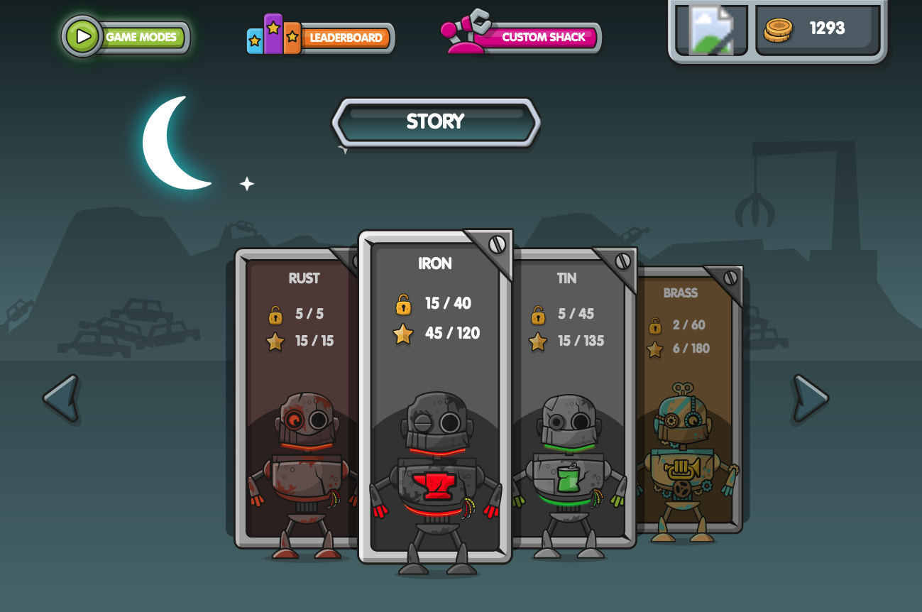
www.numbots.com
The children also have their own logins for Numbots.
This is set as weekly homework and successes are celebrated in Friday service.

Slide 11
Foundation Subjects
Appropriate PE kit for inside (blue shorts, t-shirt, daps) and outside (shorts, t-shirt, warm tracksuit/trousers, top, daps/trainers). We have 2 sessions of PE on Tuesday and Thursday.
Book bags to come into school every day. We look at yellow reading records daily.
Playtimes (water only, fruit is provided. If you do provide a snack, please make sure it is a healthy one. No toys please!)
Please ensure no jewellery.

Slide 12

Last year, we introduced The Zones of Regulation within our PSHE curriculum as a whole school approach to teach pupils about self-regulation and how to catogorise complex feelings and emotional states, using the curriculum designed by Leah Kupver.
The curriculum helps to improve how pupils can recognise and communicate how they are feeling in a safe and non-judgemental way, whilst learning strategies or tools to help them move between four Zones: Blue, Yellow, Red and Green – which are used to help them identify and recognise how regulated they feel.
Our aim to develop a common language within our school community that all pupils, can enage with and understand from EYFS through to Year 6 proved successful and we will be revisiting the tools and strategies in our PSHE sessions across the school during Term 1.
We will also be introducing ‘Regulation Stations’ as areas where children can go to self-regulate around our site, which will have pictorial reminders of the tools and strategies they could use.
If you would like any further information regarding the Zones of Regulation, or further resources you can use at home with your child, please ask a member of the team.

Slide 13
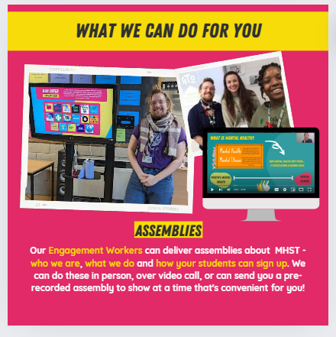


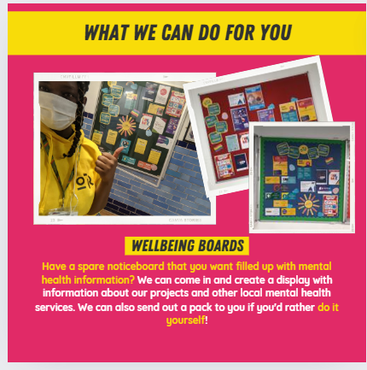



Slide 14

Discovering digital at primary

Slide 15

Please help us...
  8.45 am - drop off time. (Register closes at 8.55am)
  3.20 pm pick-up time.
  Absence - please write a note/make phone call.
  Medicines/health issues - we need to know please.
  Concerns/queries - please see us before/after school. After school is usually much better for a longer chat as it’s important to settle children quickly in the mornings.
  If you are working, then please do email the office with any queries and we will get back to you as soon as we can.
  Space is limited, so please think about whether it is necessary for your child to bring a LARGE bag/rucksack to school.
  Please look at the Year 2 class page on the school website as there are lots of photographs and important information.

Slide 16
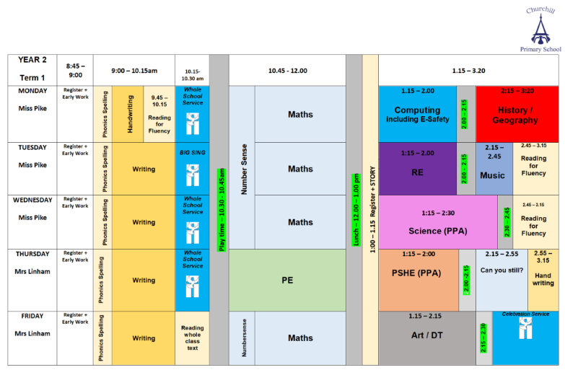
Weekly Timetable

