Slide 1

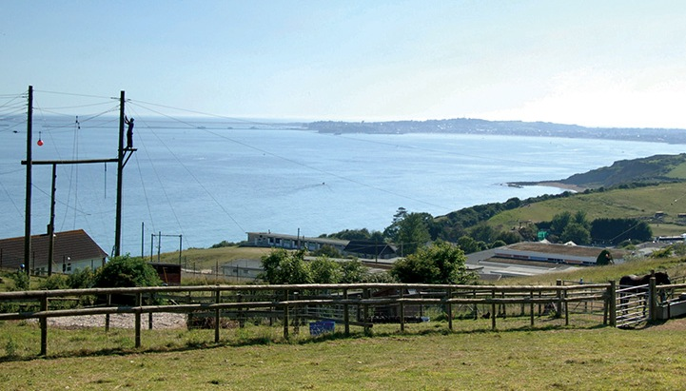
Osmington Bay 2026
Monday 12th October – Friday 16th^{th} October

Slide 2
Virtual Tour

Slide 3
Staff
Mr Davis/ Mrs Bryant
Mrs Baird
Mrs Manson/Mrs Ford
Mrs Holdaway
Mrs Gould-Coates

Slide 4
Departure
We will meet in the hall.
Luggage will be loaded up
Register
Leave
Come to school dressed ready for 1st activity.
Bring a packed lunch with them for the 1st day.

Slide 5
Schedule | Activities
07.00 - 09.00 | Get up, get ready and fuel up for the day ahead with a hearty breakfast.
09.00 - 12.10 | Morning activities - 2 sessions with a 10 minute break in-between.
12.10 - 14.15 | Enjoy a fresh and tasty two-course hot lunch and some free time.
14.15 - 17.25 | Afternoon activities - 2 sessions with a 10 minute break in-between.
17.25 - 19.00 | Time to eat again - a different dinner menu each day.
19.00 - 21.00 | Discos, campfires, quizzes and more - our evening entertainment programme keeps everyone engaged until bedtime.
21.00 / 21.30 | Bedtime. Catch up on some sleep ready to do it all again tomorrow!

Slide 6

Activities are likely to include:
Climbing
Giant Swing
Archery
Aeroball
Stand Up Paddle Boarding
Survivor
Fencing
Trapeze
Raft building
Abseiling

Slide 7


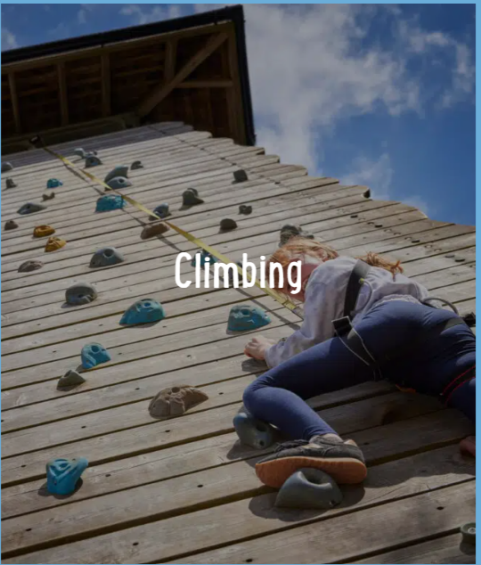
Osmington Bay

Slide 8


Slide 9
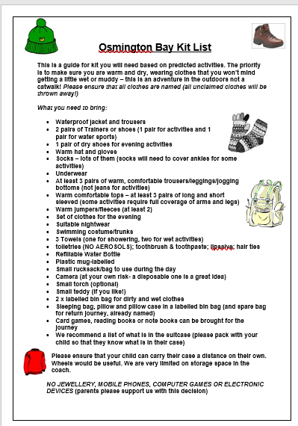
Please ensure all items are named!
If a child chooses to bring a camera, this will need to be named and handed to their group leader.

Slide 10

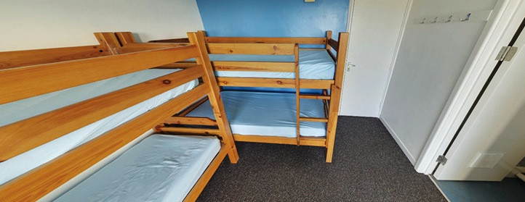
En-suite rooms
Children will be with at least one chosen friend.
Children will be told of rooms when we arrive at camp.
Rooms of 4
All rooms are equipped with en-suite facilities.

Slide 11
Please complete all information boxes on parent pay e.g emergency contacts, medication, dietary requirements, swimming ability, name and address of doctors etc
Medication administration forms
PGL’s website www.pgl.co.uk/insurance to read and understand the Key Facts and Insurance Policy
Kit Lists – please pack bag with them! If possible include 3 towels as we have two water activities
Duvet and pillow in named black bag or something stronger. (+ return journey)
2 named black bags for wet clothes/shoes and washing
No aerosols
Children will need to carry own luggage
Biscuits (if you are happy to contribute these will be distributed throughout the day between activities if required)
Indoor/outdoor/water footwear
Pocket money – maximum £10 – named envelope given to staff
No electronic devices

