Slide 1

Churchill CEVC Primary School
PSHE Curriculum
Term 6 Year 5
Changing me!

Slide 2
Year 5 Term 6
This unit allows children to learn about how bodies change as they and others grow up, sexual reproduction and and looking forward. The lessons will be broken down into 6 lessons:
Self and body image
Puberty for girls
Puberty for boys
Conception
Looking forward to change
Looking forward to change next year

Slide 3
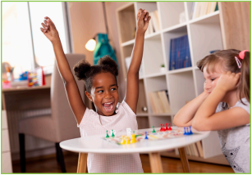
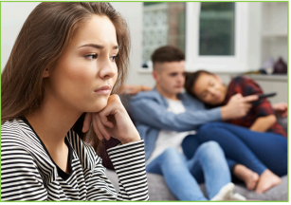

Lesson 1- Self and body image: I am aware of my own self-image and how my body images fits into that. I know how to develop my own self esteem.
This lesson will start by lining up on a line to were they think they should be depending on their own self image – either closer to the happy face or unhappy face.
We will discuss images online and how accurate they are relating to social images – airbrushed or filtered. We will talk about what happens if people think that being thin is really important – lead to anorexia /bulimia. We will be explaining that this is not just a girl problem.
We will be looking at self esteem and how we can help improve this and to think positively and to think about ourselves positively.

Slide 4
Lesson 2 –Puberty for girls: I can explain how a girl’s body changes during puberty and understand the importance of looking after yourself physically and emotionally. I understand that puberty is as natural process that happens for everyone.
We will go through the correct terminology to use for the next few lessons. We will start by explain where the female and male sex cells from from.
We will explain how the female body prepares to have a baby and how this results in menstruation/monthly periods.
We will also talk about what they can use – tampons/pads with/without wings,/pads of varying colours and shapes.
We will then have a carousel activity where children will be in single gender groups to complete activities – thinking about what we have just talked about and a chance to look at the sanitary products.
We will have a class box for any questions that they don’t want to ask in front of the class.

Slide 5
Lesson 3 Puberty for boys: I can describe how boys’ and girls’ bodies change during puberty. I can express how I feel about the changes that will happen to me during puberty.
We will explain that when a boy reaches puberty, his testicles start making more of the hormone called testosterone. We will explain the physical changes for boys – referring to L1, not to compare yourself to others as changes occur at different points. We will explain that the diagram is of a circumcised penis and others will still have their foreskin. Whatever is normal for them, is normal for them. There is no such thing as average sized – everyone is different.
We will talk about the journey of the sperm and how it is mixed with semen and ejaculated. We will talk about ‘wet dreams’ and that this is just a sign that puberty has started and this is normal and nothing to worry about. We will conclude the journey by explaining how the sperm then finds the egg during sexual intercourse. ,
In groups, we will have a quiz so they can share ideas and recall all the information so far.
We will finish by getting into pairs and creating a PowerPoint or leaflet titled – Puberty – It happens to us all! Children will make a 10-point guide to things you shouldn’t worry about.

Slide 6
Lesson 4
Conception: I understand that sexual intercourse can lead to conception and that is how babies are usually made. I also understand that sometimes people need IVF to help them have a baby. I appreciate how amazing it is that human bodies can reproduce in these ways.
We will start by explaining that some people have a physical attraction. These relationships become very close and loving., and people can choose to be in a ‘couple’. Some of these couples can decide to make a life together and get married and start a family. But not all. These are personal choices.
We will think about what is important when deciding if they should have a baby – age, money etc.
We will be thinking about how a bay is formed when the cells have merged together. Can people make love and not have a baby? What happens if a couple wants a baby but they can’t have one?
Groups will play a true or false card game and match the true statements to the explanation.

Slide 7
Lesson 5
Looking ahead 1: I can identify what I am looking forward to about becoming a teenager and understand this brings growing responsibilities (age of consent). I am confident that I can cope with the changes that growing up will bring.
We will start by thinking about life as a teenager – do magazines show us what life is like as a teenager? What responsibilities will have have as you become older? Eg. ‘I am looking forward to staying out later’ will result in the thought of the responsibilities – letting family know where you are.
It will talk about the age of consent being 16 – but this does not mean they are obliged to have sex because they are 16.

Slide 8

Lesson 6 Looking ahead 2: I can identify what I am looking forward to when I move to my next class. I can start to think about changes I will make next year and know how to go about this.
We will be concluding our unit by looking at what they are looking forward to in the next school year.
They will also think about what they may be a little worried about too.
We will finish by thinking about how we feel about getting older. How they feel about puberty. What kind of feelings they might experience at puberty/times of change. How can we managed these?

Slide 9
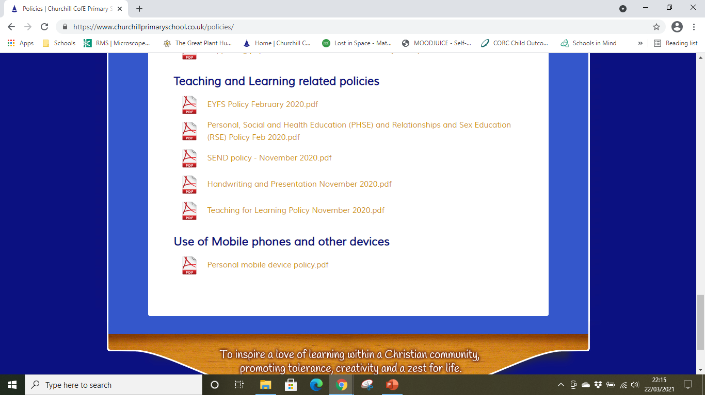
RSHE Policy
In line with the government changes to the Relationships and Sex Education curriculum, we have amended our PSHE policy to include these changes. You may read our PSHE policy on the school websites under Key Information – Policies – Teaching and Learning related policies.

