Slide 1

Churchill CEVC Primary School
PSHE Curriculum
Year 2 TERM 6
CHANGING ME

Slide 2
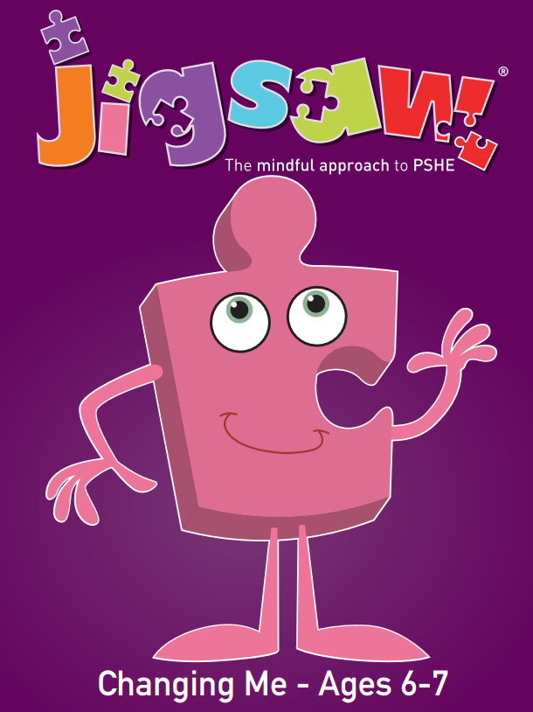
Year 2 Term 6
The Changing Me topic teaches children about the Sex Education aspect of the PSHE curriculum.
This unit allows children to learn about ……..
Life cycles
Growing from young to old
The changing me
Boys’ and girls’ bodies
Assertiveness
Looking ahead

Slide 3
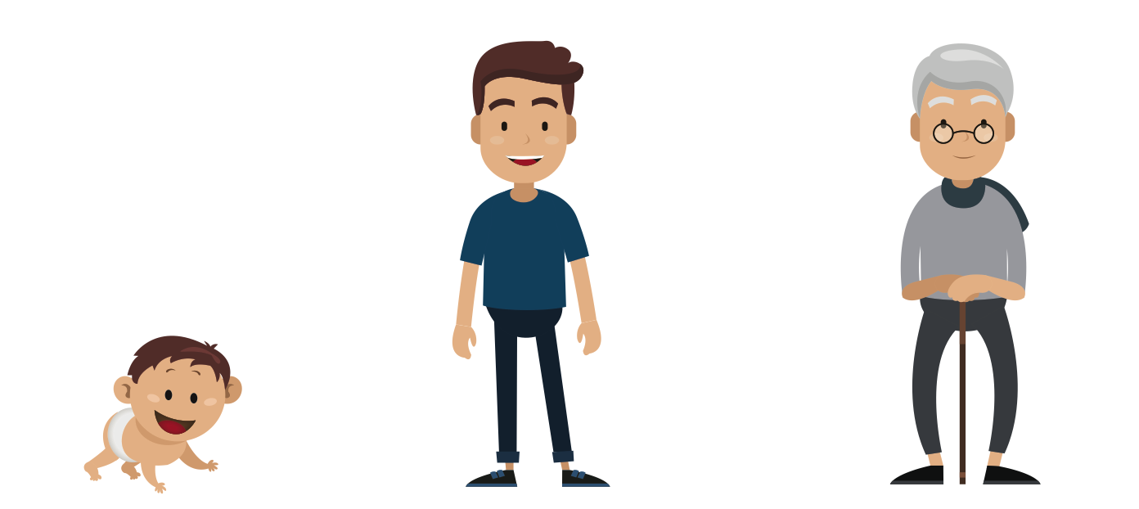
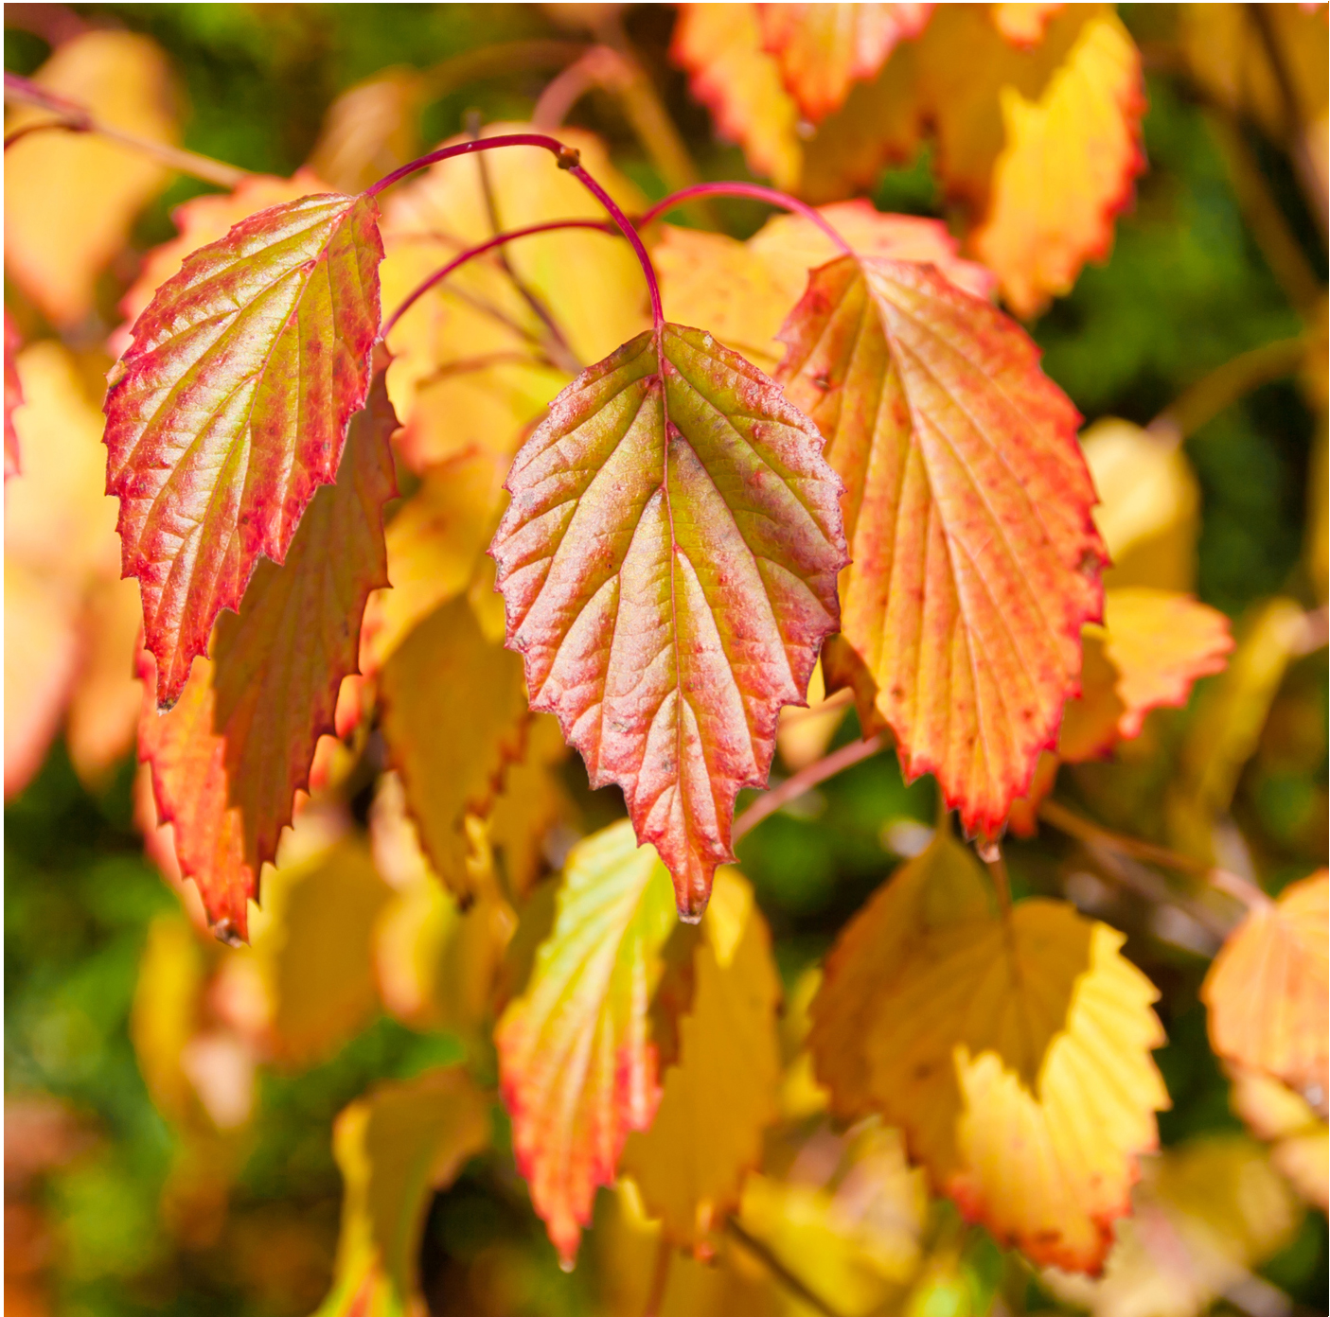
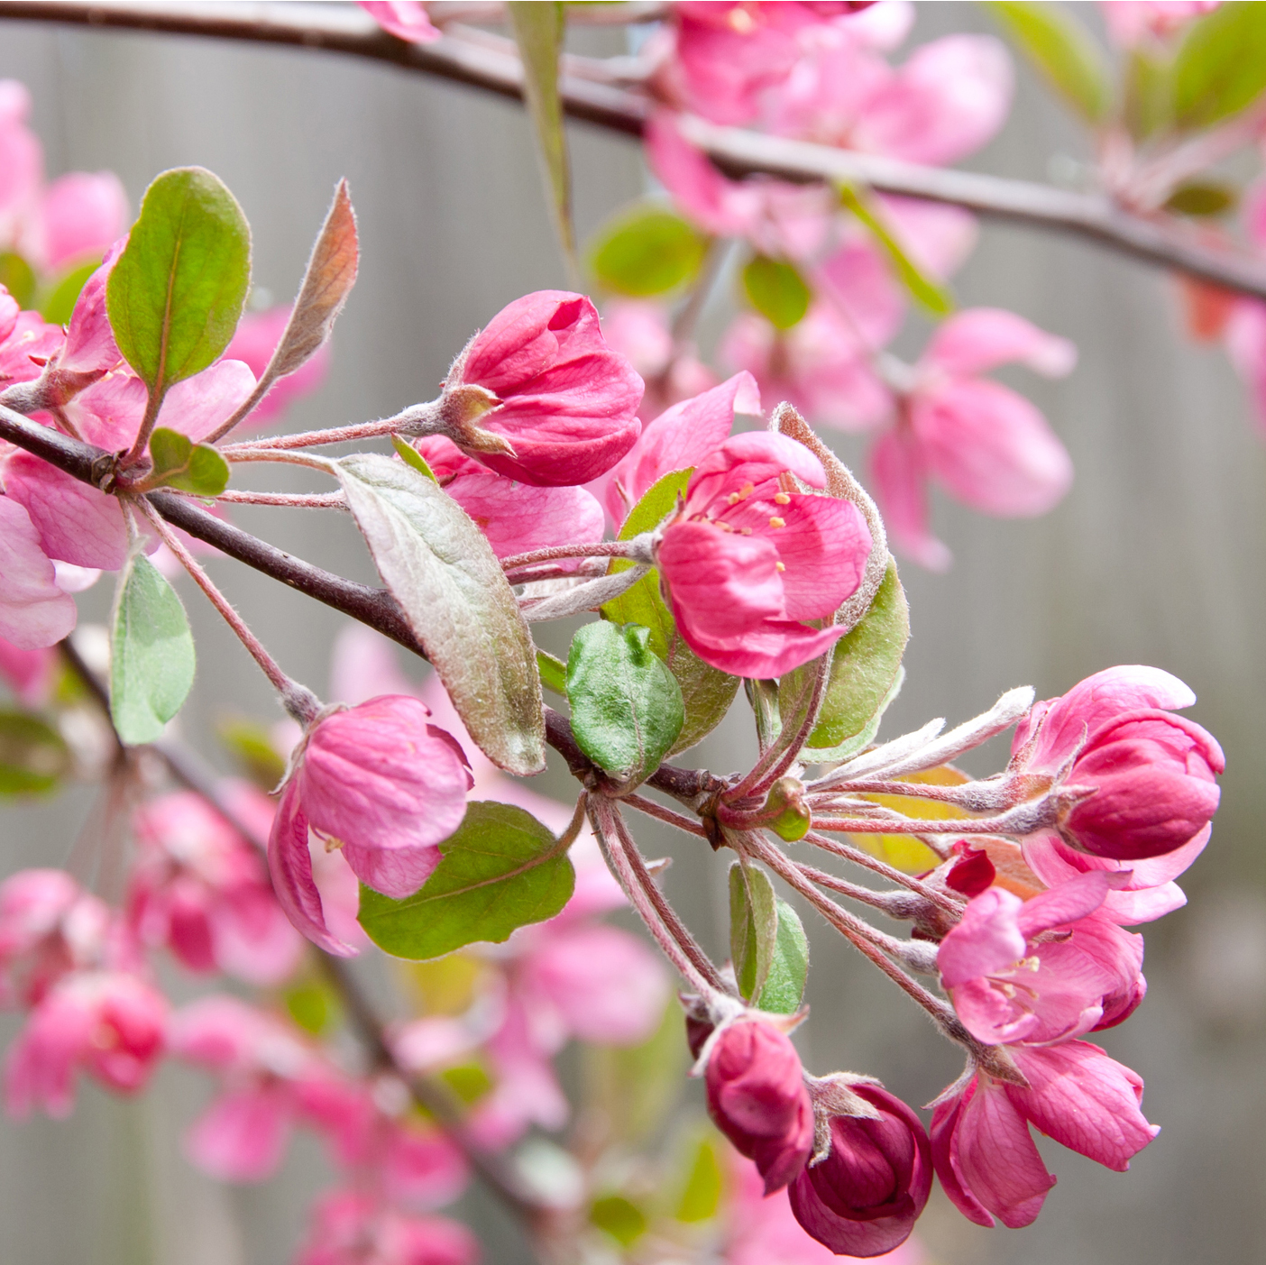
Lesson 1 (Life cycles in nature)
to recognise cycles of life in nature.
to understand there are some changes that are outside my control and to recognise how I feel about this.
The children will share how they feel about the seasons changing. They will be made aware that some things happen and change around us that we are unable to control, eg. the seasons change, our bodies change. Discussion will follow about how they feel about changes they can’t control.
For some children, they may not wish to share their ideas, but teachers will be sensitive to this. For every session, children have the right to pass as well as the right to be heard.
This lesson will look at life cycles, understanding what they are and how things grow and change from a baby to an adult.

Slide 4
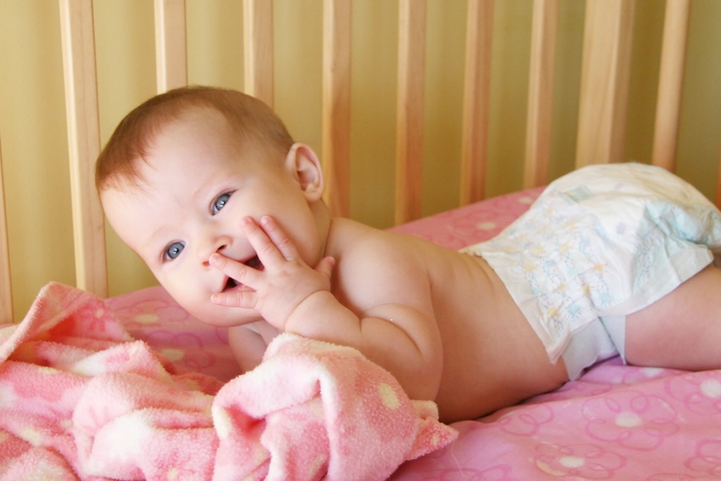
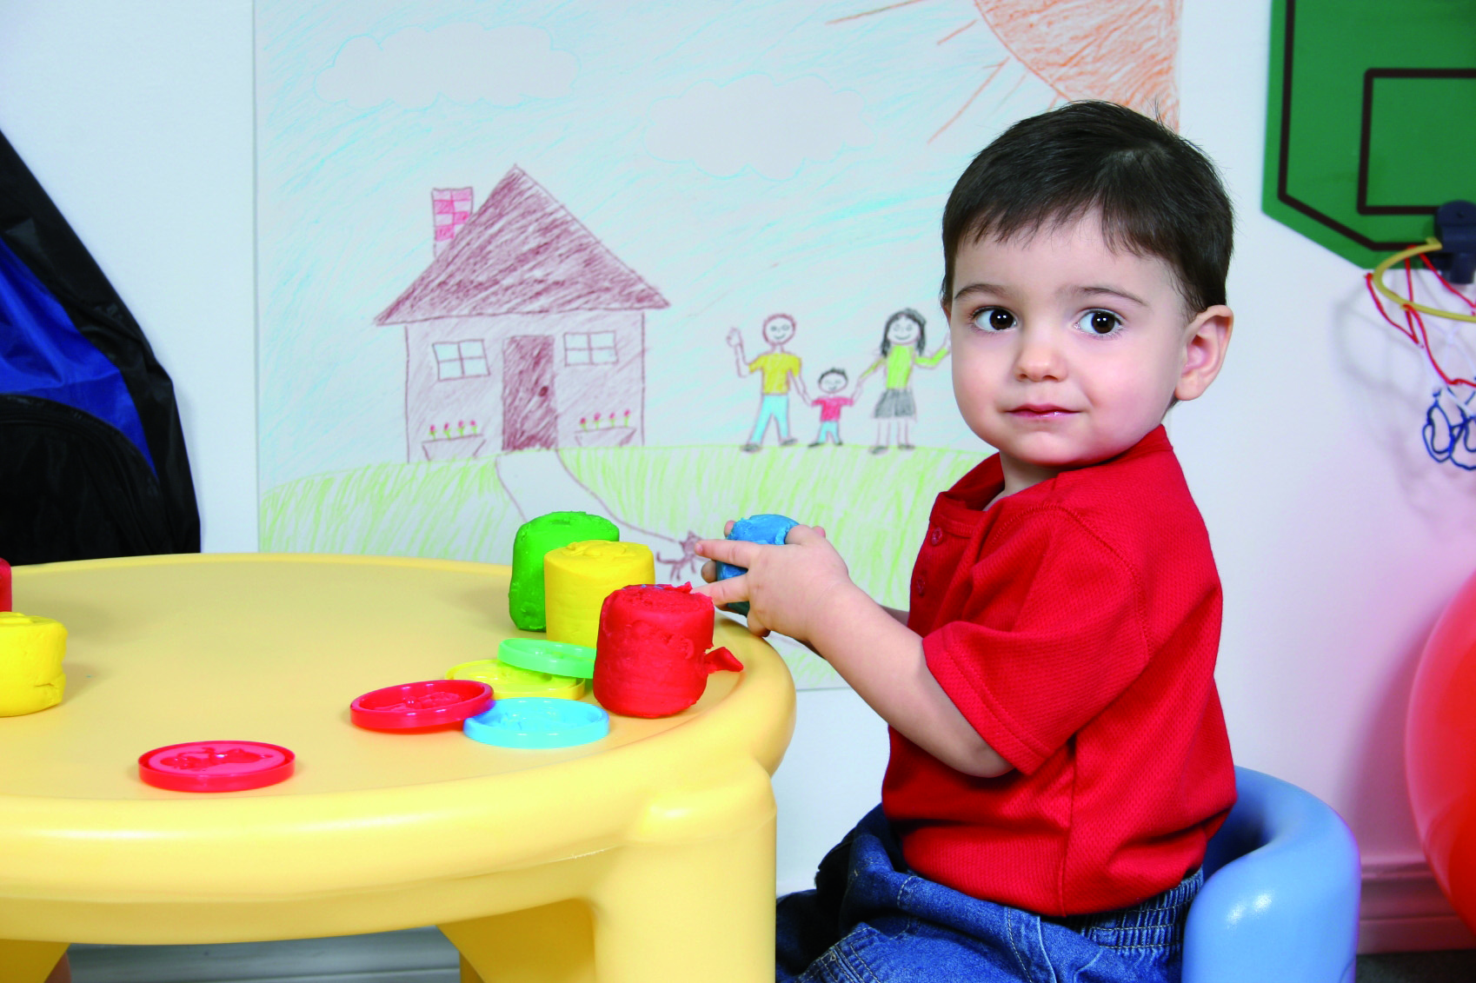

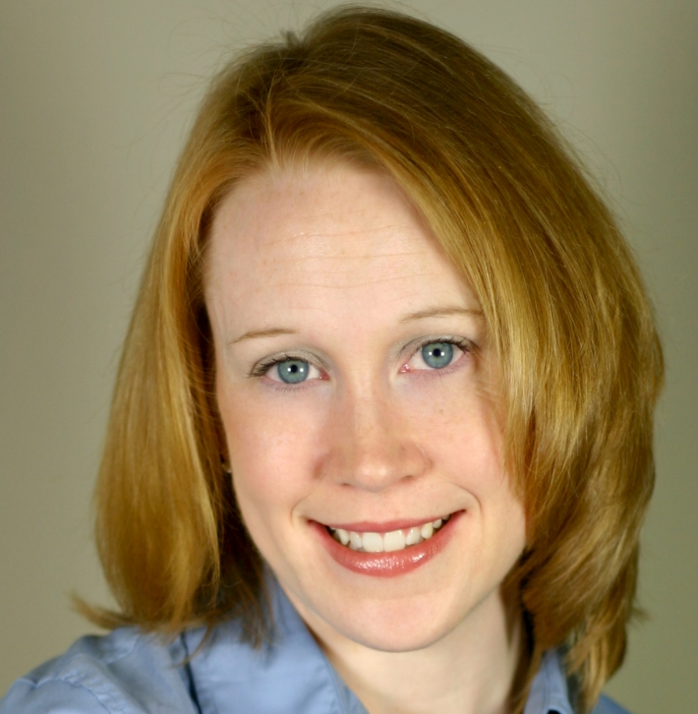
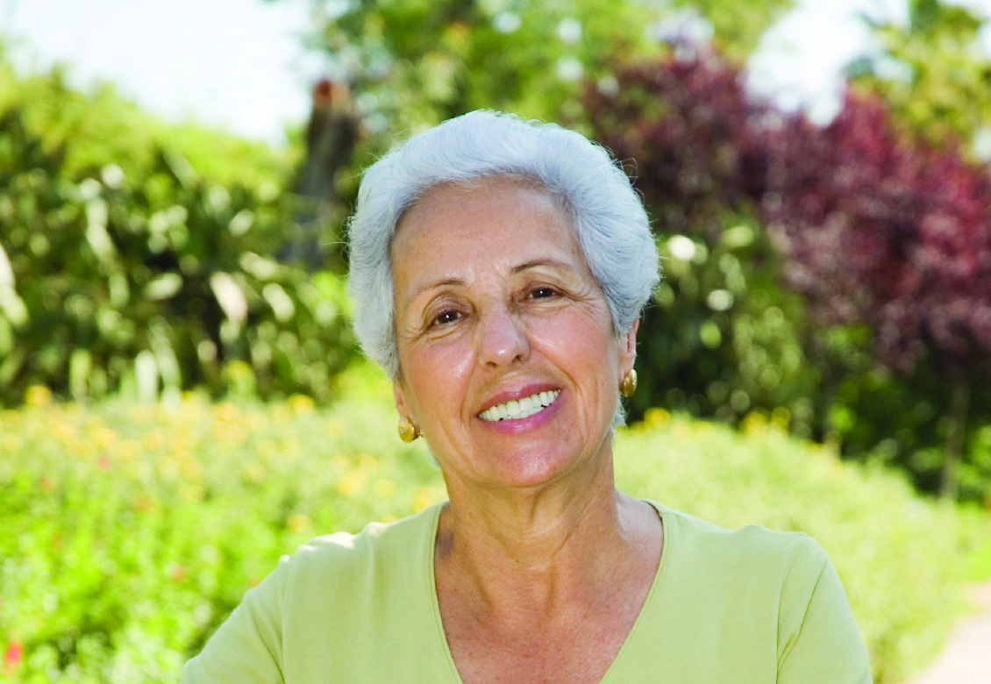
Lesson 2 (Growing from young to old)
to know about the natural process of growing from young to old and to understand that this is not in my control.
to identify people I respect who are older than me.
The children will share ideas about changes they can visibly see that happen to an elderly person, also other changes that might happen, eg. bodies become slower, old people run less but might get wiser and kinder. They will learn that we all become old and all grow from a baby, to a toddler, to a child, to a teenager, to an adult to an old person.
This lesson will also encourage children to think of an older person who is special to them, why they respect/like or love this person.

Slide 5
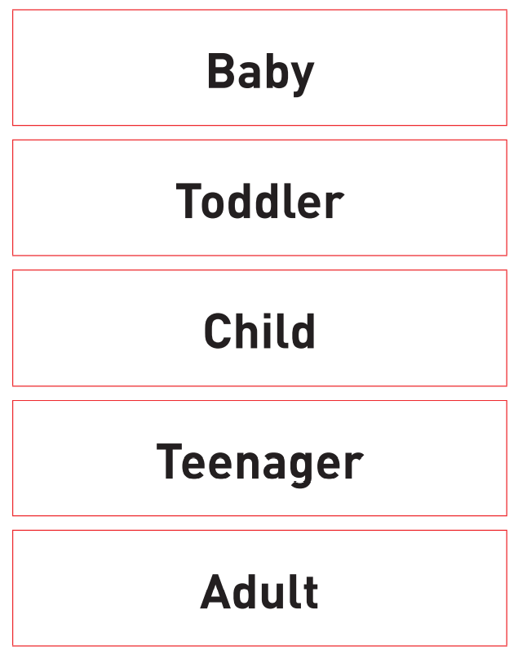

Lesson 3 (The changing me)
to recognise how my body has changed since I was a baby and where I am on the continuum from young to old.
to feel proud about becoming more independent.
The children will learn that, for humans, growing up takes longer than for many living things. It doesn’t only mean getting bigger, but also learning and being able to do more. Growing up comes with a wider range of abilities, more freedom, more independence, more responsibilities and more knowledge.
This lesson will include making a timeline ‘Baby’, ‘Toddler’, ‘Child’, ‘Teenager’, ‘Adult’ and matching items to the correct stage of development.

Slide 6
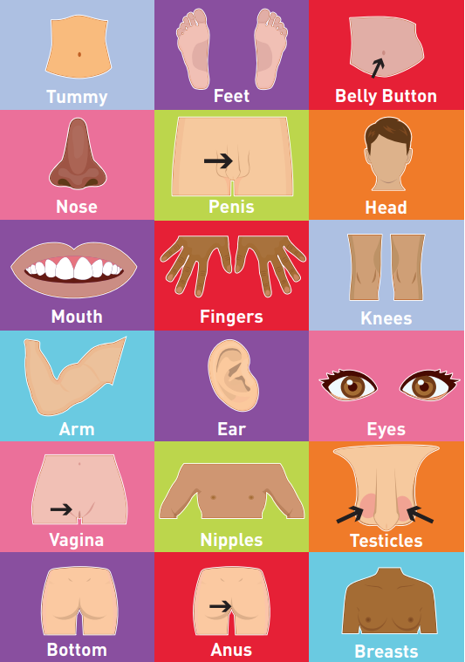
Lesson 4 (Boys’ and girls’ bodies)
to recognise the physical differences between boys and girls, use the correct names for parts of the body (penis, testicles, vagina, vulva, anus) and appreciate that some parts of my body are private.
to tell you what I like/don’t like about being a boy/girl.
Children should know all the words in this lesson’s vocabulary by end of primary school, and at least penis, testicles and vagina in Year 2. (Part of the assessment of this unit of work is about children being able to use the correct names for private body parts).
In this lesson, children will talk about the differences between the things that girls and boys do. They will discuss how clothes can sometimes help us to see from the outside the difference between boys and girls. They will look for differences in how boys and girls behave and reflect on what they like about who they are.

Slide 7
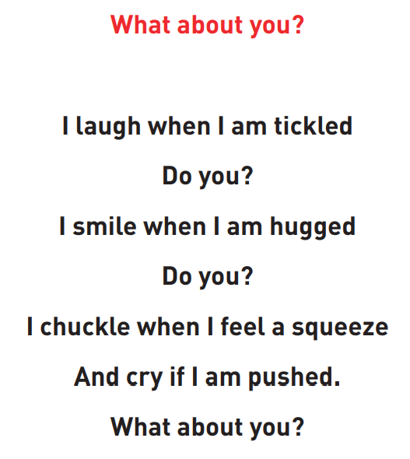

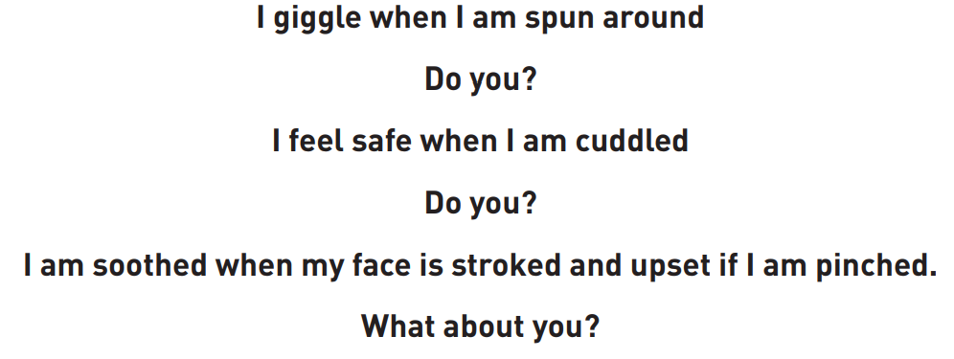
Lesson 5 (Assertiveness)
to understand there are different types of touch and tell you which ones I like and don’t like.
to be confident to say what I like and don’t like and ask for help.
The children will share the poem ‘What About You?’ and discuss the sort of touches they like eg. hug, tickle, hair being brushed. They will learn what they should do if they experience a touch that is hurtful or frightening.

Slide 8

Lesson 6 (Looking ahead)
to identify what I am looking forward to when I move to my next class.
to start thinking about changes I will make in my next year at school and know how to go about this.
We will explain to the children that the start of a new school year can be a big change. They will be encouraged to think about what they might be looking forward to in Year 3. Also…….
How are you feeling about moving to a different class?
What do you like/dislike about moving to a different class?
What are you looking forward to about getting older?
What would you like to change for next year and how will you go about it eg. to get better at reading by practising more often.
How do you feel about getting older and facing new changes?

Slide 9
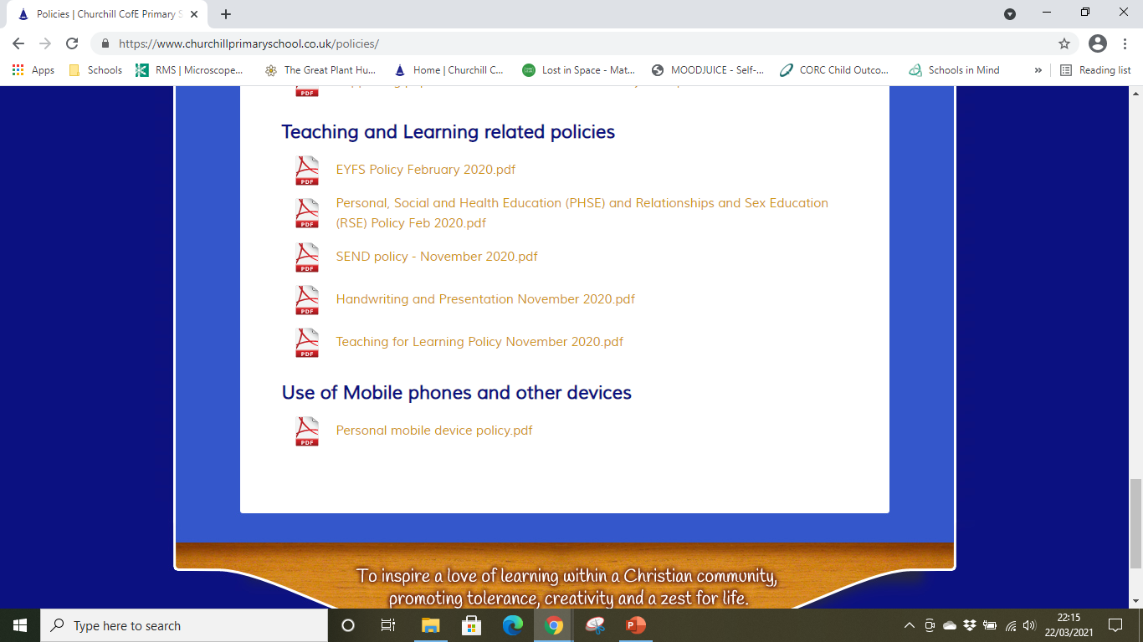
RSHE Policy
In line with the government changes to the Relationships and Sex Education curriculum, we have amended our PSHE policy to include these changes. You may read our PSHE policy on the school website under Key Information – Policies – Teaching and Learning related policies.

