Slide 1

Churchill CEVC Primary School
PSHE Curriculum
Term 6 Year6 CHANGING ME

Slide 2
Year 6 Term 6
The Changing Me topic focusses on puberty and conception.
This unit includes:
My Self Image
Puberty
Babies: Conception to Birth
Boyfriends and Girlfriends
Real self and ideal self
The year ahead

Slide 3
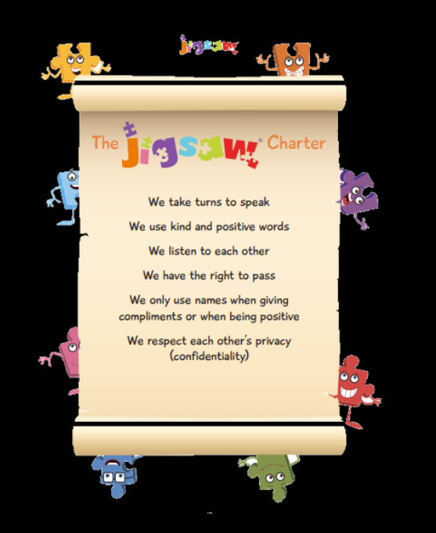

Slide 4
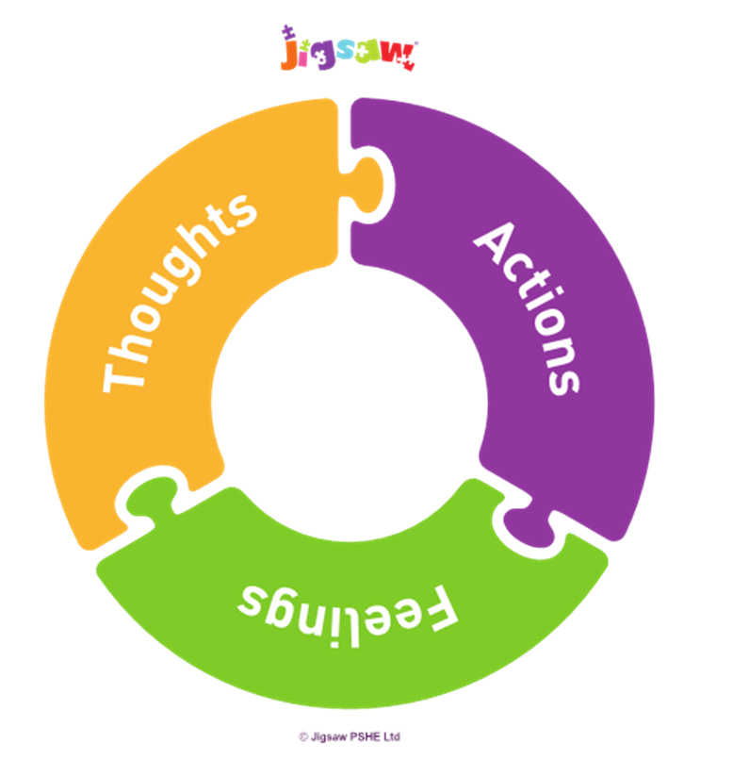
Lesson 1
Learning Intention: I am aware of my own self-image and how my body image fits into that. (I know how I can develop my own self-esteem)
The children will:
Discuss why they think people spend so much time and money on how they look
Consider if there are more helpful ways to ‘measure’ ourselves than just appearance.
In gender specific group boys draw ‘the perfect man’ and girls the ‘perfect woman’. Label the features that make the person perfect. Discuss.
Are we being fair and realistic to ourselves if we always try to look perfect?
Consider how negative self-talk can damage our self-esteem.

Slide 5
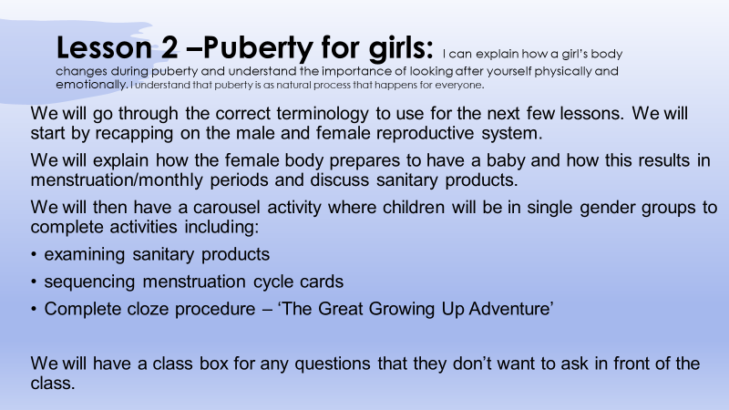

Slide 6
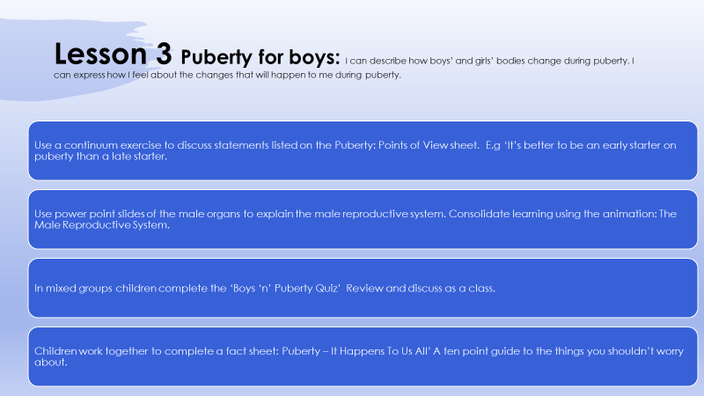

Slide 7
Lesson 4
Learning Intention: Explain how girls’ and boys’ bodies change during puberty and understand the importance of looking after myself physically and emotionally
The children will:
Play a game of Growing-Up Bingo – children move around the room finding someone who can say yes to any of the questions. E.g Has had a talk with their parents about puberty.
Hold up the Puberty Flashcares in turn, they all stand if it’s a female thing, stay sitting if it’s a male thing and put both hands up it applies to all. E.g Pubic Hair
Consolidate learning using male and female body parts power point and the animations of The Female/Male Reproductive Systems.
In small groups childrentake cards from the Puberty Truth or Myth

Slide 8
cards and decide whether they think it is truth or myth. Discuss learning.
Invite children to write privately and anonymously at least one question that they have in their mind concerning puberty and growing up to inform planning of next lesson.
Children split in to same gender groups and discuss ‘Boys worries’ cards and ‘Girls worries’ cards with male/female adult and any relevant question from the group.

Slide 9
Lesson 5
Learning Intention: Describe how a baby develops from conception through the nine months of pregnancy and how it is born
The children will:
View power point slides of a baby developing in the womb.
Play the ‘Baby Can’ game deciding if statements are true or false
View Male/Female Reproductive Systems Animations
Complete cloze procedure ‘From Conception to Birth’
Design a set of cards using pictures and text to present 8 stages on the journey from conception to birth.
Children consider how a new born baby’s parents must feel when the birth is over.
Children consider their own thoughts and feelings about this process.

Slide 10
Lesson 6
Learning Intention: I understand how being physically attracted to someone changes the nature of the relationship and what that might mean about having a girlfriend/boyfriend.
The children will:
Use diamond nine cards to prioritise the best and most important reasons someone might want a boyfriend/girlfriend. Discuss ‘pressures’ girls and boys might feel.
Discuss ‘sexting’ scenario. Discuss ‘pressures’ that young people may feel and the importance of respect in relationships.
In groups sort a set of ‘Should I/Shouldn’t I?’ cards into groups under the headings ‘OK’ and ‘Not OK’. Feed back. Consider personal choice, respect (for self and others) and where to access support.
What have children discovered about having a girlfriend/boyfriend?

Slide 11
Lesson 7
Learning Intention: Be aware of the importance of positive self-esteem and what I can do to develop it.
The children will:
View the power point presentation ‘Ideal bodies’. Consider how these images make them feel.
Consider how negative ‘body talk’ can make somebody feel.
Annotate Ideal Self and Real Self images considering appearance and personality traits. Discuss how the bigger the distance between the ideal self and real self, the greater the possibility of low self-esteem.
Consider the importance of keeping expectations real and being aware of influences on us from the media and friends.
How could they reduce negative ‘body talk’ within their friendship groups.

Slide 12
Lesson 8
Learning Intention: Identify what I am looking forward to and what worries me about the transition to secondary school.
The children will:
Discuss how the slide of an inflatable bungee run is a symbol of them starting their next year in school.
Play ‘Bin the worry’ game. Children write down their biggest worry about the next school year (that they are willing to share) and in groups children take it in turn to journey through ‘solutions alley’. ‘Please can you help me bin this worry?’

