Slide 1

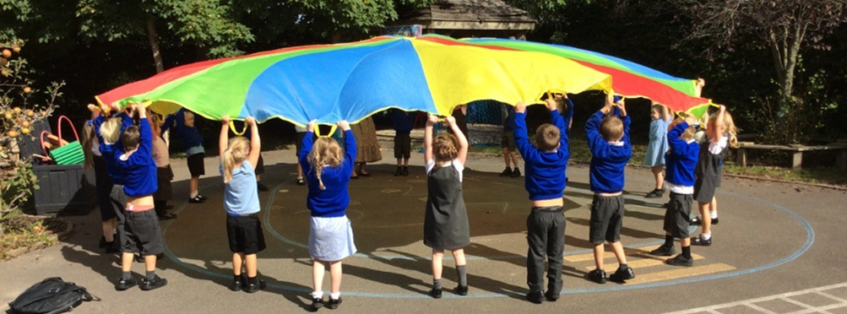
With kind hearts and determined minds, we inspire each other to be the best we can be.
Notes:
1
1
1

Slide 2
Introductions
Class Team
Senior Leadership Team
Chair of Governors
Aspens Catering Company
Kids’ Club
School Nursing Team

Slide 3
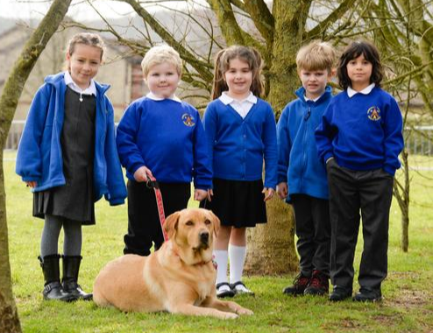
Bracken – our school dog

Slide 4
Kids’ Club
- On site wrap around care
- Sessions run from 7.45am to 8.55am and 3.30pm to 6.00pm Monday to Friday during term time.
More information can be found on our school website.
School Nursing Team
- Visit to school twice in YR to do a weight and height monitoring service and then a sight and hearing check.
- Nasal Flu vaccination in school
- Take over from the Health Visiting Team

Slide 5
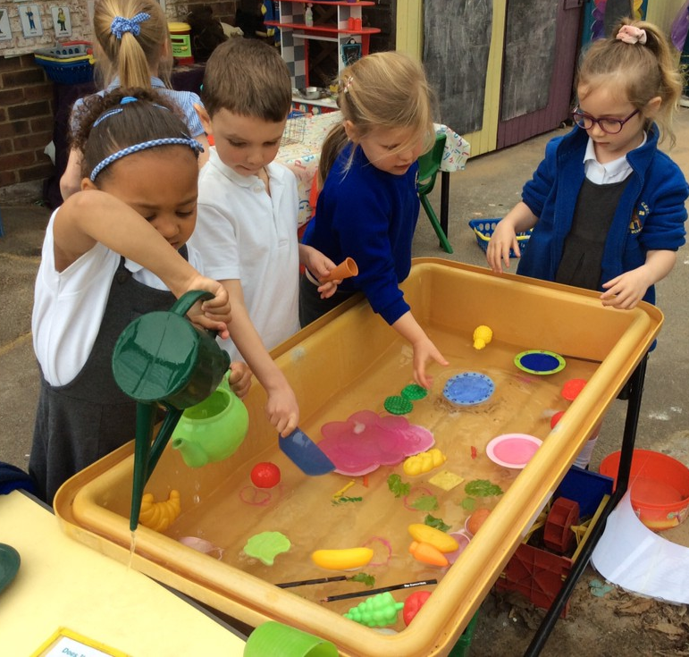
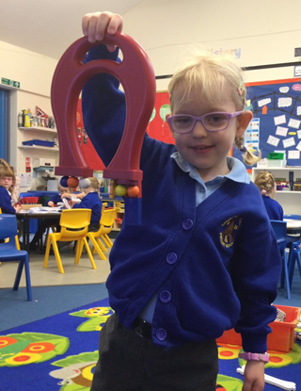
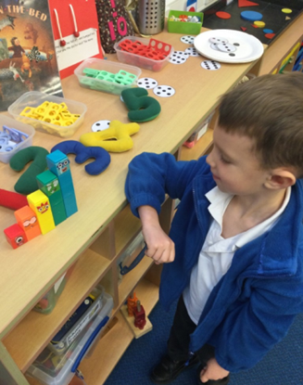
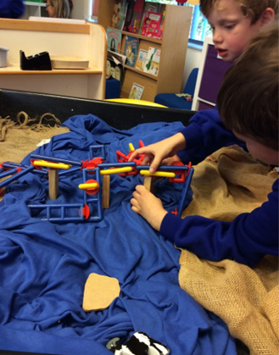
The EYFS Curriculum
7 areas of learning
Prime | Specific
Communication and Language Physical Development Personal, Social and Emotional Development | Mathematics Literacy Understanding the World Expressive Arts and Design
Notes:
5
5

Slide 6
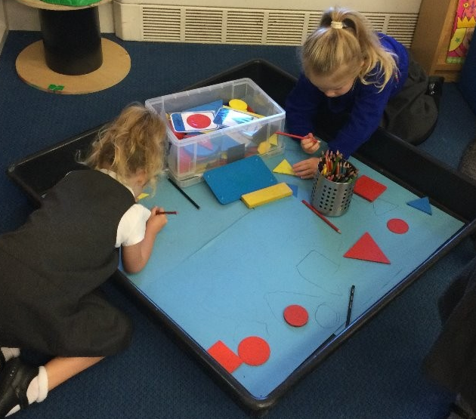
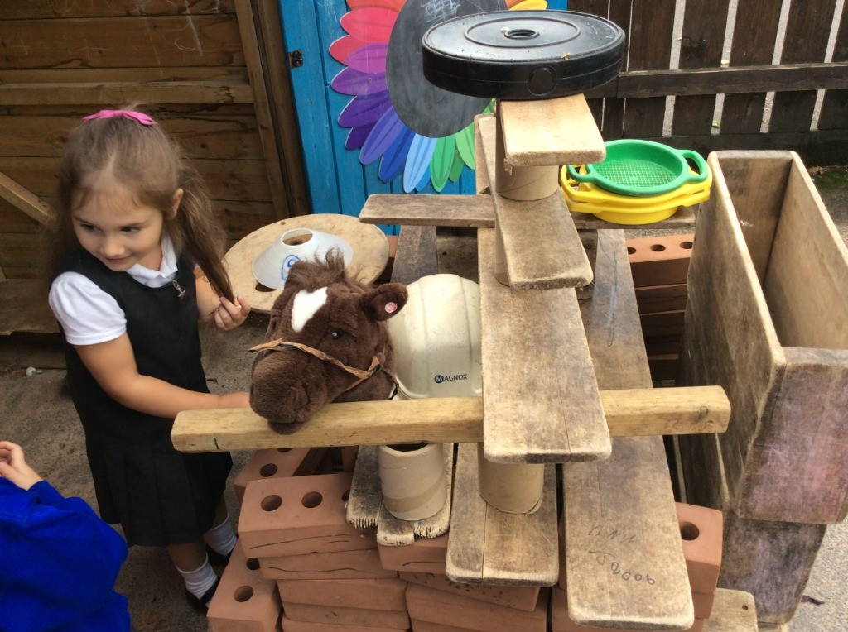
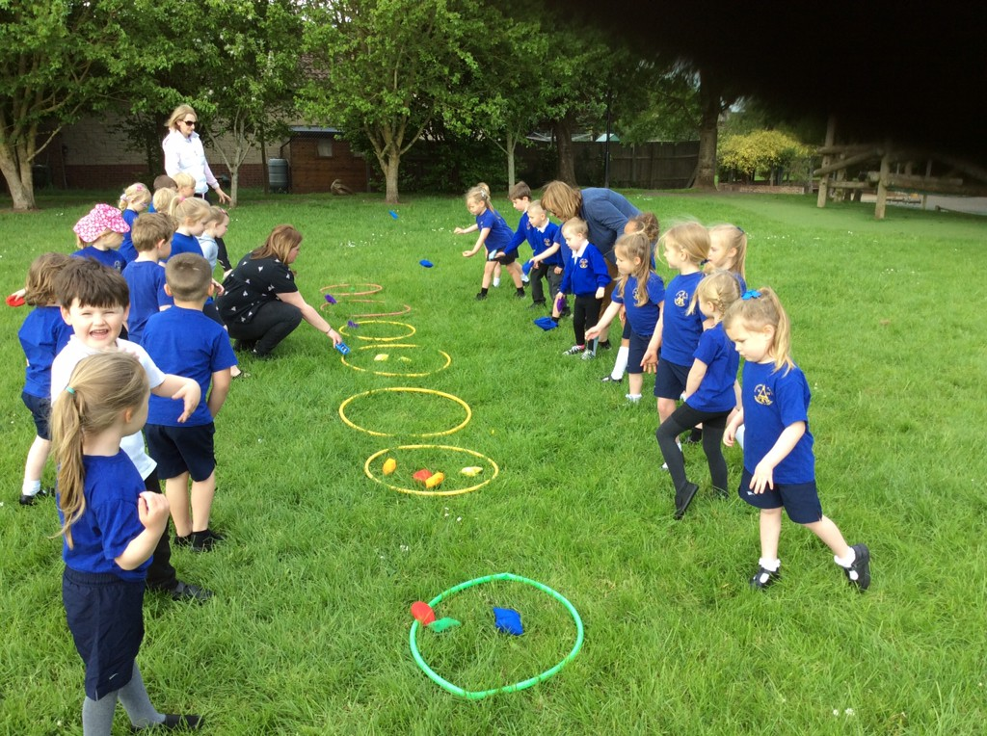
How are the areas of learning taught?
Play based learning
A mix of adult-led activities and child-led activities
Planning is based on children’s interests and their curiosity
Notes:
6
6

Slide 7

How we assess your child in YR
On entry baseline assessment
Observations and photographs via online learning diaries on Tapestry
Notes:
7
7

Slide 8
Induction
‘Stay and Play’ sessions June 11th, 20th and 25th
Home visits on September 2nd, 3^{rd,} 4th and 5th
Half day visit Friday 6th September (either AM or PM)
Week commencing Monday 9th September half days with lunch (Collection at 1:20pm)
Week commencing Monday 16th September full days (optional – to be discussed with class teachers)
Week commencing Monday 23th September full days for all

Slide 9
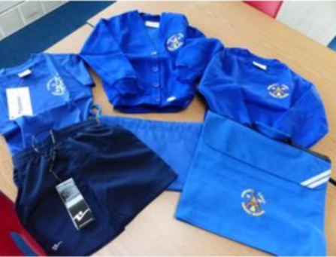
Stay & Play – June 11th, 20th and 25th
Tuesday June 11th - opportunity for your child and 1 adult to visit us and play in the classroom.
Thursday June 20th and Tuesday June 25th – opportunity for your child to visit us and play in the classroom. (Adults are welcome to wait in the library where there will be an opportunity to purchase school uniform).

Slide 10

Useful Information
Drop-off at 8.45am and pick-up at 3.20pm
Please bring daily - coat, water bottle, book bag, spare clothes (if appropriate)
Labelled PE kit to be left in school
Children receive fruit daily and milk (until 5th birthday)
All children entitled to free school meal Reception to the end of Year 2
Please leave personal toys at home
We understand and hugely value the importance of supporting children to settle happily into their new environment. Therefore we will always work closely with parents to enable a positive and happy transition into Year R.

Slide 11

What can you do over the Summer?
Dress independently
Be as independent as possible, especially going to the toilet and using cutlery
Share stories together
Talk
Please complete the ‘All About Me’ book
Share images of staff that they will see coming to school (via the website)
Notes:
11
11

Slide 12
With kind hearts and determined minds, we inspire each other to be the best we can be.
Notes:
12
12
12

