Slide 1

Churchill CEVC Primary School
PSHE Curriculum
Term 6 Year 3
Changing ME

Slide 2
Year 3 Term 6
The Changing Me topic teaches children the Sex education aspect of the PSHE curriculum. This unit is usually taught in Term 6.
This unit allows children to learn about puberty, change and human reproduction. All of the materials used are taken from the Jigsaw scheme and are age appropriate.
The following vocabulary will be used: baby, grow, uterus, womb, nutrients, survive, love, affection, care, changes, birth, animals, mother, growing up, control, puberty, pubic hair, breasts, penis, testicles, male, female, sperm, ovaries, egg, ovum/ova, vagina, stereotypes, roles, task, challenge.

Slide 3
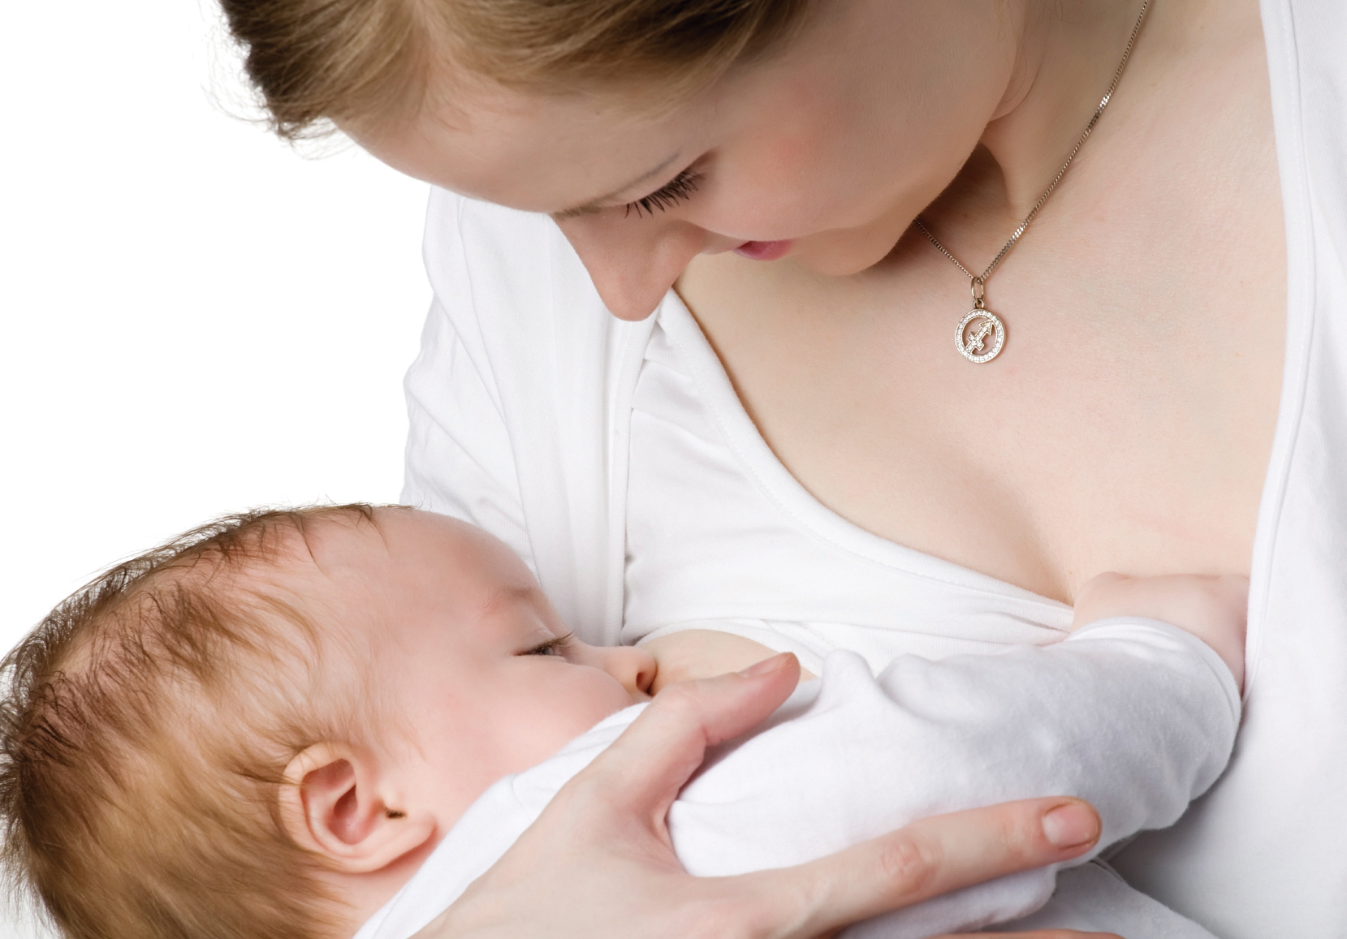
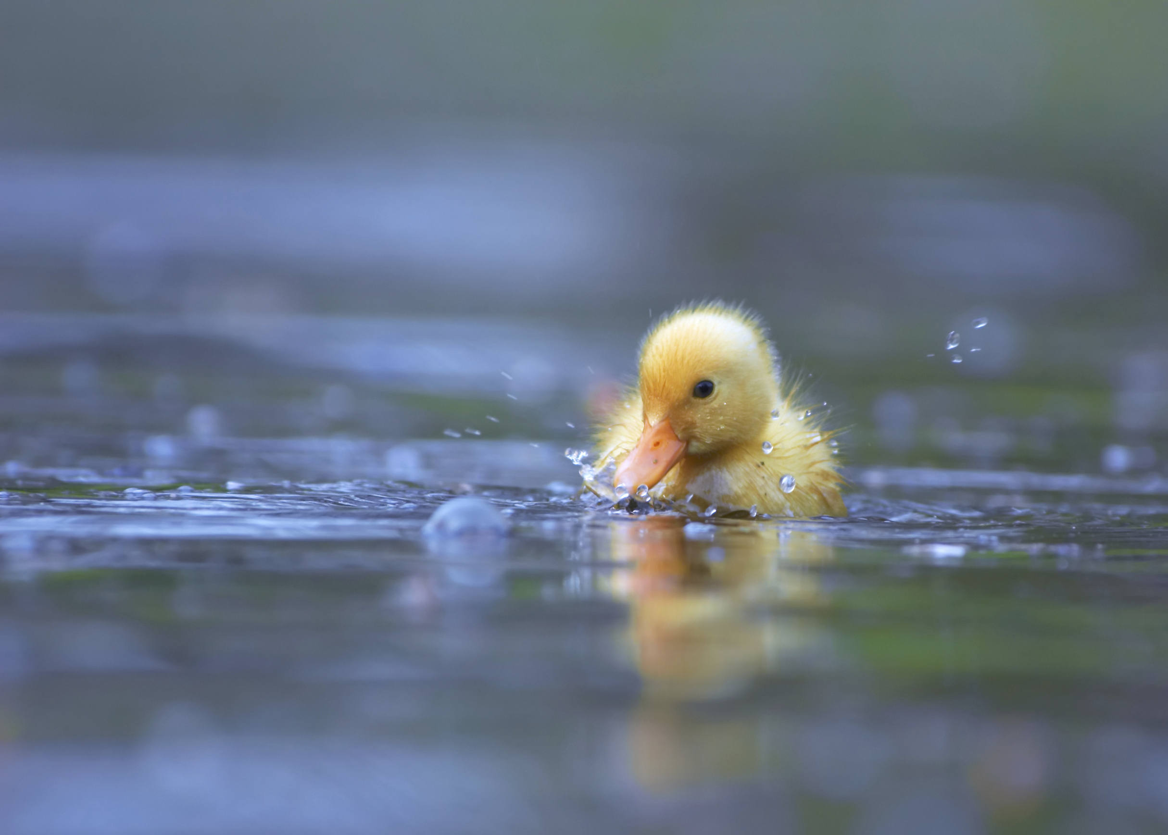
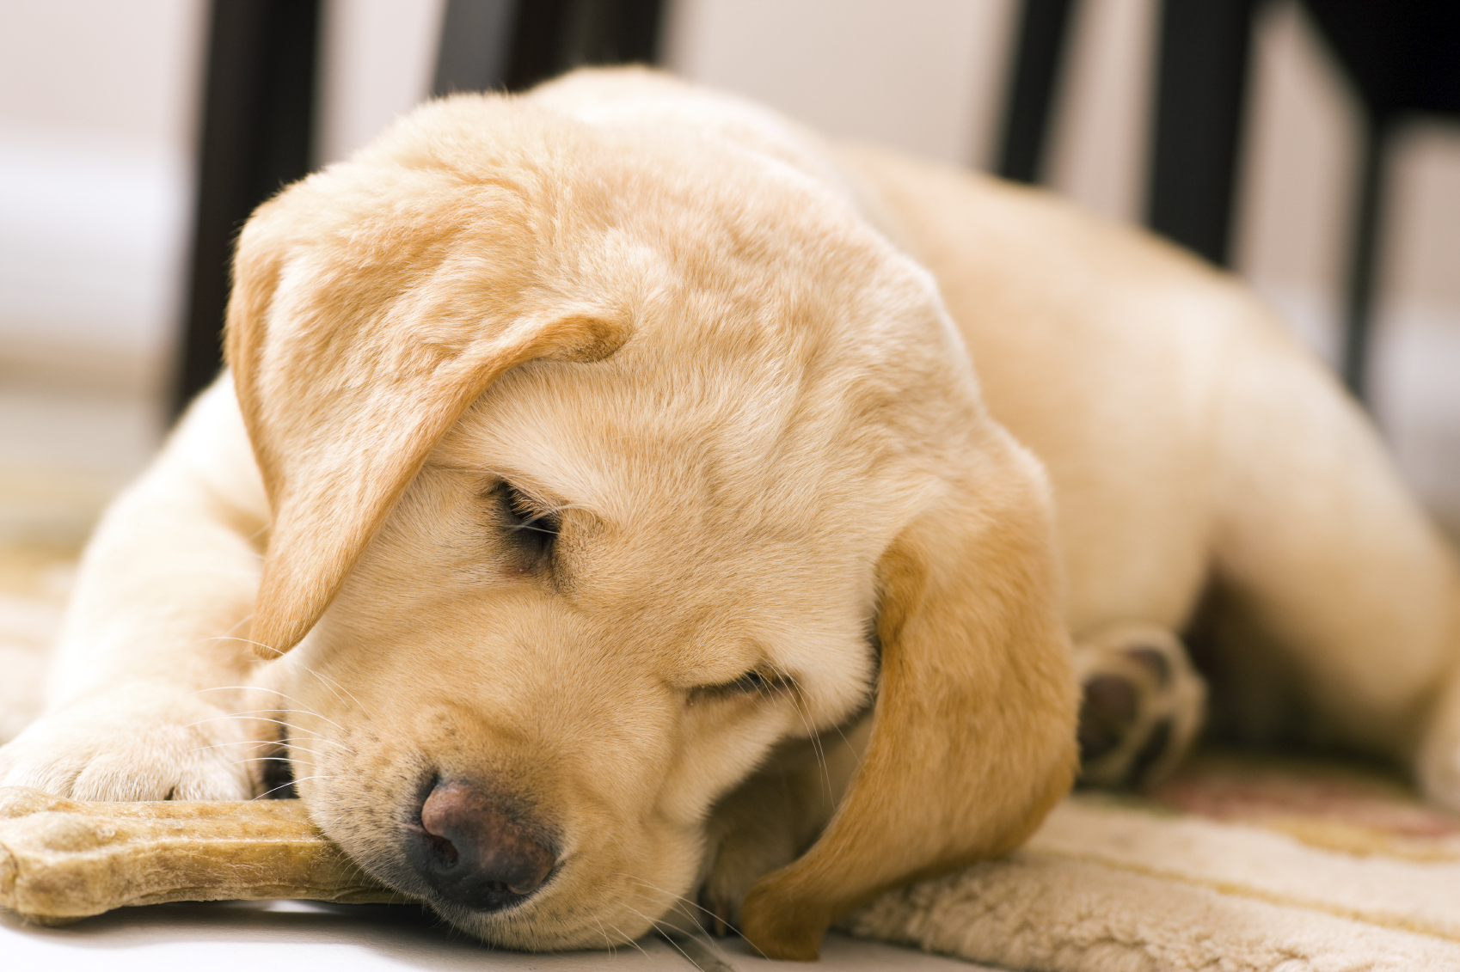
Lesson 1
Understand that in animals and humans lots of changes happen between birth and growing up, and that usually it is the female who has the baby.
Children are shown pictures of babies and discuss how the pictures make them feel. The last slide showing a human mother and baby highlights that usually it is the female that has the baby and looks after it whilst it is young, but dads play an important role too (humans, penguins etc.). Children discuss the things a baby can’t do and things they need an adult to do for them.
Children will discuss how it might feel to have a new baby in the family.

Slide 4
Lesson 2
Understand how babies grow and develop in the mother’s uterus and understand what a baby needs to live and grow.
Children discuss what babies need in order to survive and grow. The lesson will emphasise that a baby needs love and affection as well as physical needs such as milk, nappies, clothes, cot, teddy, etc.
Children will think about where does a baby begin to grow and how it grows. The children will be shown pictures of a baby growing inside a mother’s womb/uterus. The teacher will explain to the children that the baby grows inside the mother’s womb/ uterus and gets all its nutrients in order to grow from the mother.

Slide 5
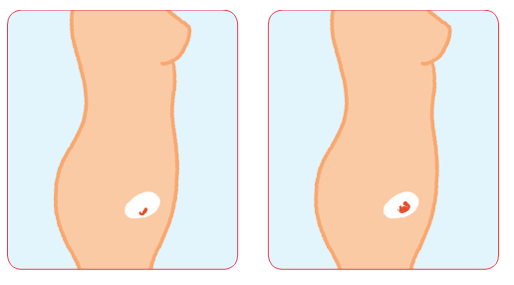
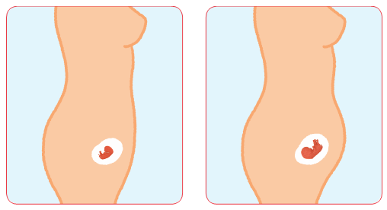
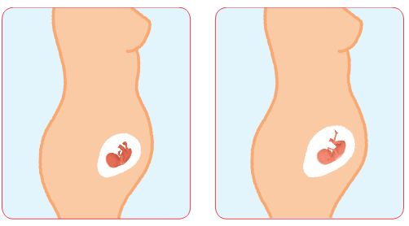
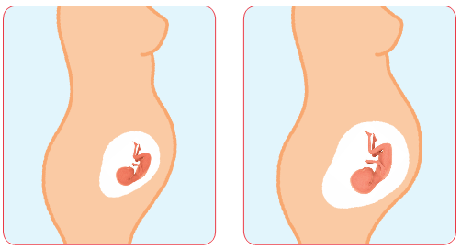
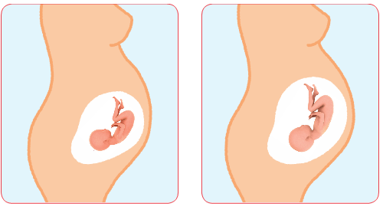

Slide 6
Lesson 3
Understand that boys’ and girls’ bodies need to change so that when they grow up their bodies can make babies. Identify how boys’ and girls’ bodies change on the outside during this growing up process.
Children start by thinking of change that has happened to them, such as moving house, making a new friend, starting a new school, have a pet, had a new baby in the family. Children will be introduced to the term puberty and it will be emphasised that puberty is a natural part of growing up for everyone. The teacher will explain that puberty refers to the collection of changes that will gradually change their bodies from a child’s body into an adult’s body.
Children will discuss the outside changes that will happen to a female body and a male body during puberty. Then the class will discuss how the changes are different between boys and girls. Children will discuss which changes they can make choices about and which changes they can’t control.

Slide 7
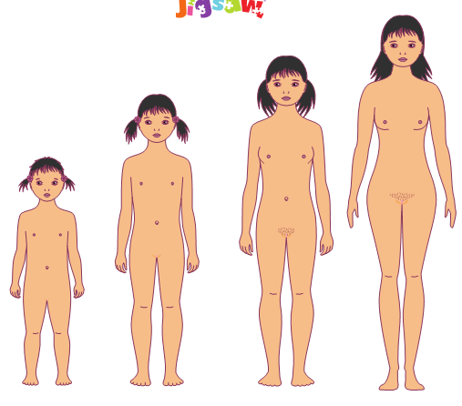
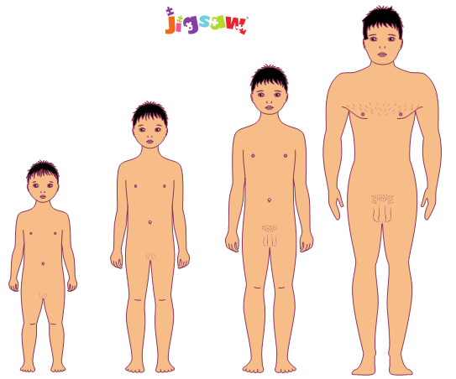

Slide 8
Lesson 4
Identify how boys’ and girls’ bodies change on the inside during the growing up process and can explain why these changes are necessary so that their bodies can make babies when they grow up.
This lesson does not talk about how the sperm and egg come together and the topic of sexual intercourse is not age appropriate in Year 3. This is covered in Year 5.
Children discuss how new life starts, looking at different animals. This subject may touch upon the subject of adoption and fostering.
This lesson will discuss the internal changes in female and male bodies during puberty. The teacher will explain that puberty is really about getting boys’ and girls’ bodies ready for making and having babies when they are grown up.

Slide 9
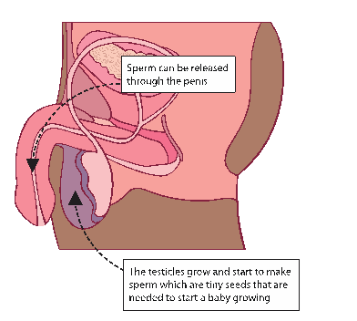
The boy’s testicles grow and start to make sperm which are tiny seeds that are needed to start a baby growing.
Sperm can be released through the penis.
Erections and ejaculation will be covered in Year 4.

Slide 10
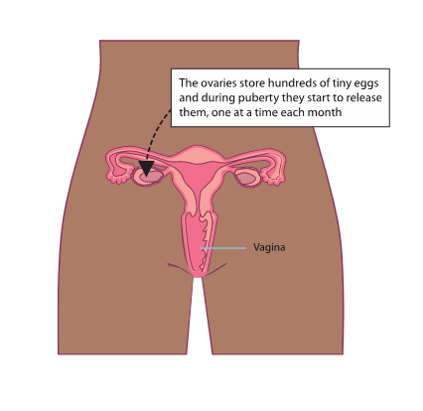
The girl’s ovaries store hundreds of tiny eggs and during puberty they start to release them, one at a time each month. Girls are born with all these eggs inside their ovaries (called ova) waiting for puberty to start.
Menstruation is covered in more detail in Year 4.

Slide 11
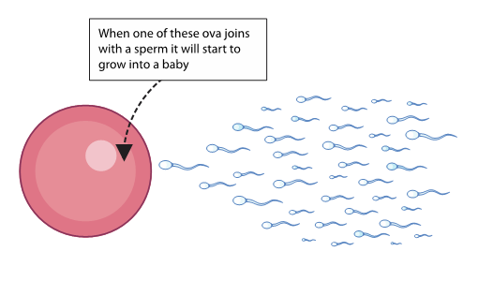
When one of these eggs (or ova) joins with a sperm it will start to grow into a baby.
This is how much detail will be given about sperm meeting an egg. No further information will be given as it is not age appropriate at this time.
The topic of conception and how a baby is made is covered in Year 5.

Slide 12
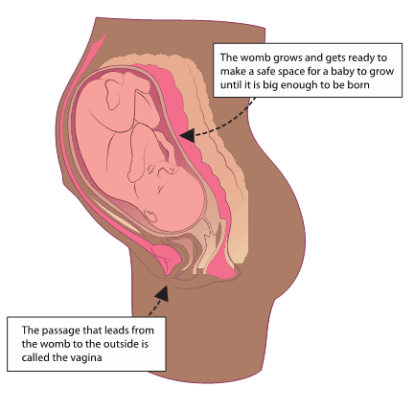
The womb/uterus grows and gets ready to make a safe space for a baby to grow until it is big enough to be born.
The passage that leads from the womb to the outside is called the vagina. If an ovum isn’t fertilised it passes out of the body as a ‘period’.
Menstruation will be covered in more detail in Year 4.

Slide 13
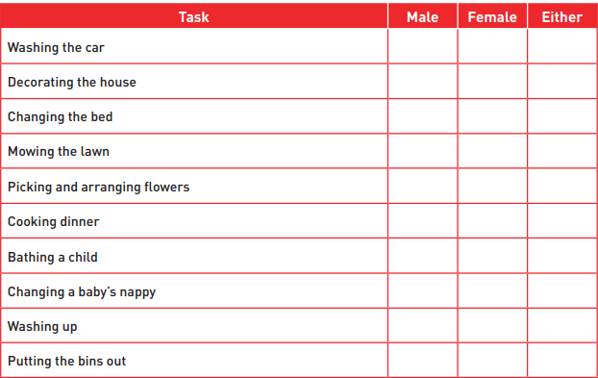
Lesson 5
Start to recognise stereotypical ideas they might have about parenting and family roles.
This lesson will be looking at tasks within parenting and the family. Children will discuss whether they think the role is male, female or either. Children discuss their opinion with a partner and explain how they came up with their ideas. The class will then discuss how it feels to have their opinion, thoughts or ideas about something challenged.

Slide 14
Lesson 6
Identify what I am looking forward to when I move to my next class.
The lesson will discuss what they are looking forward to next year. Children will talk about how they feel about going into another school year.
In this lesson, children will reflect upon what has been covered in this unit by talking about change and what they could do if they were worried about growing up and puberty. The class will discuss who would be a good person for them to talk to about puberty and growing up. Then children will discuss what are the good things about growing up and what things are less good.

Slide 15
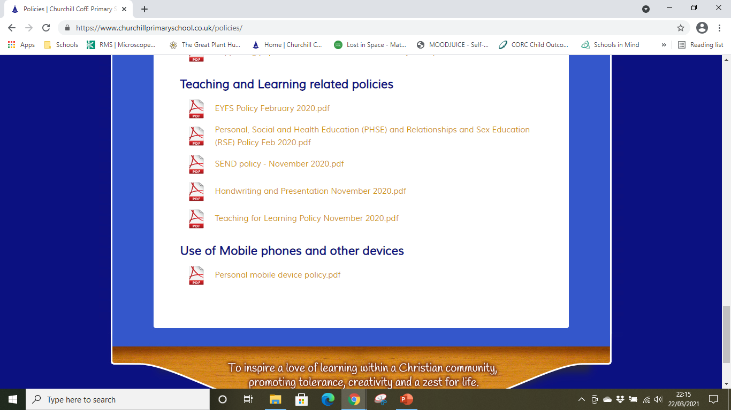
RSHE Policy
In line with the government changes to the Relationships and Sex Education curriculum, we have amended our PSHE policy to include these changes. You may read our PSHE policy on the school websites under Key Information – Policies – Teaching and Learning related policies.

