Slide 1
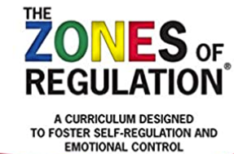

Slide 2
What is self-regulation?
self-control
self-management
anger control
impulse control

Slide 3
What are The Zones of Regulation?
A conceptual framework used to teach pupils self-regulation and categorise complex feelings and states.
This improves a pupil’s ability to recognise and communicate how they are feeling in a safe and non-judgmental way and tap into strategies or tools to help them move between Zones.

Slide 4
The Blue Zone is used to describe low states of alertness, such as when one feels sad, tired, sick or bored. This is when one’s body and/or brain is moving slowly or sluggishly.
The Green Zone is used to describe a regulated state of alertness. A person may be described as calm, happy, focused, or content when in the Green Zone. This is the Zone students generally need to be in for schoolwork and for being social. Being in the Green shows control.
The Yellow Zone is used to describe a heightened state of alertness; however, a person has some control when in the Yellow Zone. A person may be experiencing stress, frustration, anxiety, excitement, silliness, nervousness, confusion and many more slightly elevated emotions and states when in the Yellow Zone (such as wiggly, squirmy or sensory seeking). The Yellow Zone is starting to lose some control.
The Red Zone is used to describe extremely heightened states of alertness or very intense feelings. A person may be experiencing anger, panic, terror, devastation or elation when in the Red Zone. Being in the Red Zone can be explained by being overwhelmed by one’s feelings and having a loss of control.

Slide 5
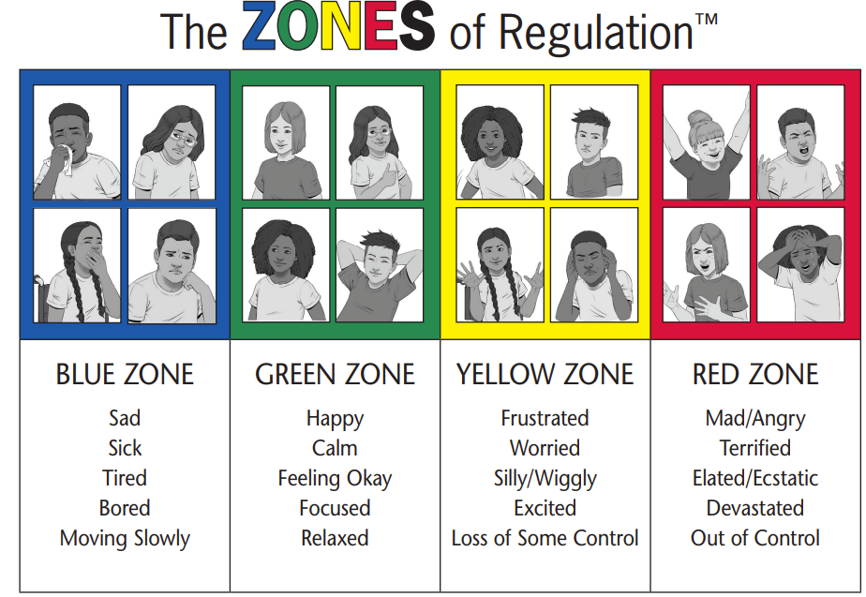

Slide 6


