Slide 1
Welcome to Year 3
Class teacher: Miss Green
LSA support: Mrs Ford/ Mrs McDermott/ Ms Harris
We are thrilled to be working with you and your children this year and are delighted to welcome them back this September. Your child's well-being and success are our top priorities, and we are committed to making this a positive and productive year.
If you have any questions or need assistance, please don't hesitate to speak with us in the morning or afternoon. Alternatively, you can contact the school office, and we will be happy to help in any way we can.
We look forward to a fantastic year together!
.

Slide 2
Things you might want to know.
Reading records need to be in everyday as we have ERIC at the end of the day.
PE is on a Tuesday and Wednesday. (Summer kit/ Winter kit. Hair tied back if longer than shoulders.)
No spelling tests- copy of class spelling worksheet can be available for those who wish.
Reading books are independently changed by the children either at the start of the day, break times and end of the day. Please encourage your child to change their books regularly.
Spring time- Year 3 are taking part in the NSSPEA dance festival at the Weston Playhouse

Slide 3

Homework
Reading:
Children are expected to read at least 5 times per week.
Reading should be done with an adult when possible to:
Discuss the text
Develop understanding
Practice answering questions
Make simple inferences
Maths:
Secure recall of number bonds
Begin rapid recall of multiplication and division facts
By the end of Year 3, children should be able to quickly recall:
Number bonds to 20
Times tables for 2, 3, 4, 5, 8, and 10, including division facts
Children will be set tasks on Times Tables Rockstars:
They should use it at least 10 minutes, 2 times per week
The programme helps consolidate facts in a fun and interactive way
Homework:
Optional! Home learning project based on History/Science learning

Slide 4
Curriculum
Maths- Place value
English-The secret of Black Rock
Science- Animals
Humanities: Stone Age
PE- Football/Hockey
Music- Violin project throughout the year
PSHE- Being me in my world/ Zones of regulation
RE- Judaism
Art- Collaborative project/Human body/faces
DT- Picture frames (Christmas time)

Slide 5


Slide 6
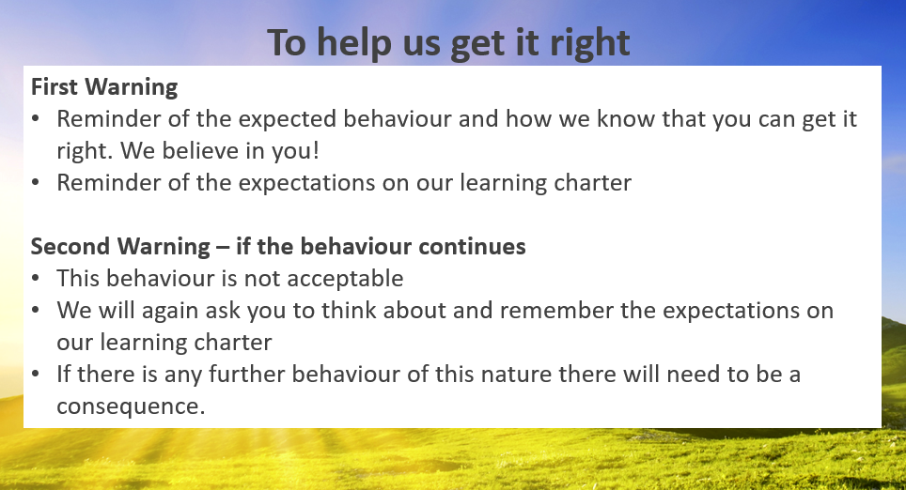

Slide 7
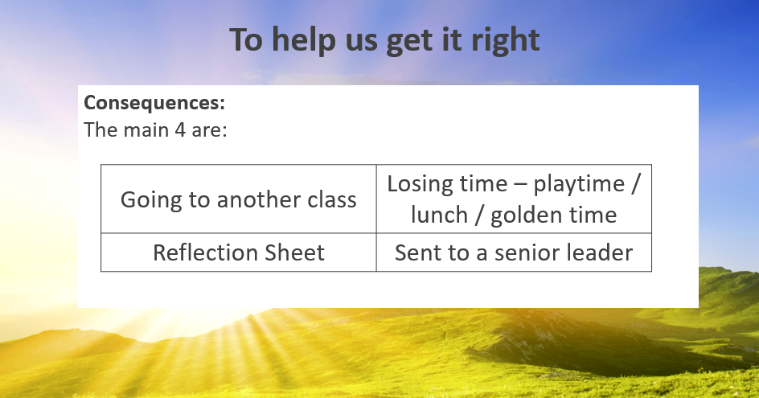

Slide 8

We use ‘The Zones of Regulation’ within our PSHE curriculum as a whole school approach to teach pupils about self-regulation and how to categorise complex feelings and emotional states, using the curriculum designed by Leah Kupver.
The curriculum helps to improve how pupils can recognise and communicate how they are feeling in a safe and non-judgemental way, whilst learning strategies or tools to help them move between four Zones: Blue, Yellow, Red and Green – which are used to help them identify and recognise how regulated they feel.
Our initial aim to develop a common language within our school community that all pupils can engage with and understand from EYFS through to Year 6 proved successful and we will be revisiting the tools and strategies in our PSHE sessions across the whole school during Term 1.
We will also be introducing ‘Regulation Stations’ as areas where children can go to self-regulate around our site, which will have pictorial reminders of the tools and strategies they could use. In Key Stage 1, these ‘stations’ will be within the individual classrooms, with Year 2 starting the year with one and one being developed in Year 1 as Terms 1 and 2 progress.
If you would like any further information regarding the Zones of Regulation, or further resources you can use at home with your child, please ask a member of the team.

Slide 9

The Six Principles of Nurture
Here at Churchill Primary, we embed the Six Principles of Nurture across all areas of our school life, and they are at the root of our vision, values, ethos and policies.
We have child-friendly versions of the principles displayed at school for our pupils to engage with.

Slide 10

SEND at Churchill Primary
Ms Ford is our SENDCo (special educational needs and disabilities coordinator) and her working days as SENDCo are Wednesdays and Thursdays. She can be contacted via the office email (office@churchill-pri.n-somerset.sch.uk) if you need to discuss any SEND-related matters or concerns, or would like to book a meeting. Ms Ford also aims to hold informal ‘Drop-in Sessions’ once a term which are open to everyone.
Ms Ford works closely with our staff to ensure that all pupils can access our universal provision, and for any pupils requiring more individual provision that is not within our universal offer, coordinating how that provision can be put in place through reasonable adjustments. This includes liaising with and requesting the support of external professionals or agencies to provide guidance and advice, as well as working with the local authority regarding higher needs pupils who may require an educational health care plan due to the level of individual support they may need.
Our universal provision offer can be seen on our website.
For information on the local offer for any services who support pupils and parents/carers of pupils with SEND, please follow the links on our website under ‘SEND and the Local Offer’.

Slide 11

PINS Project 2025-2026
As shared via a link to a parents/carers’ questionnaire at the end of July, we are excited to share that we have been chosen to take part in a project funded by NHS England in collaboration with the Department of Education, North Somerset Council and the NSPCWT (North Somerset Parent Carers Working Together).
The PINS Project is the ‘Partnerships for Inclusion of Neurodiversity in Schools’ and it is in it’s second year here in North Somerset.
This collaboration gathers input from all our stakeholders – parents/carers, pupils, governors, staff – to identify how best to support us as a school to ensure our inclusivity for neurodiverse pupils through shaping a bespoke package for our setting including input from external professionals.
We will be sharing further details of how you can get more involved as parents/carers as the project moves forward, but we are very excited to be given this opportunity to further our universal provision offer for all our neurodiverse pupils regardless of whether they have an official diagnosis or not.

Slide 12

Introduction to the Mental Health Support Team
  The MHST service is part of a national Government strategy to improve access to Mental Health support for children and young people.
  The service is designed specifically to provide extra capacity for prevention and early intervention.
  It is designed to complement and extend existing support systems, not replace them - and to deliver “Whole School Approach” work
  MHSTs work with children and young people aged 5-18 specifically in education settings

Slide 13


Slide 14
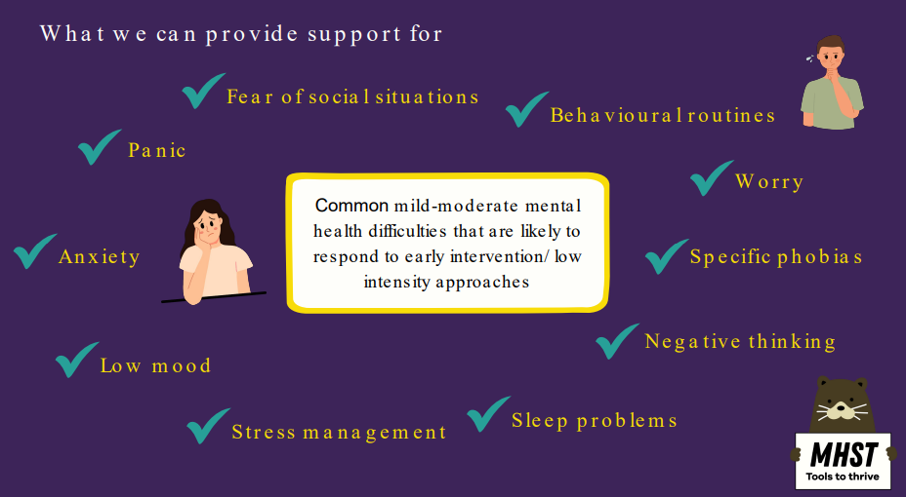

Slide 15
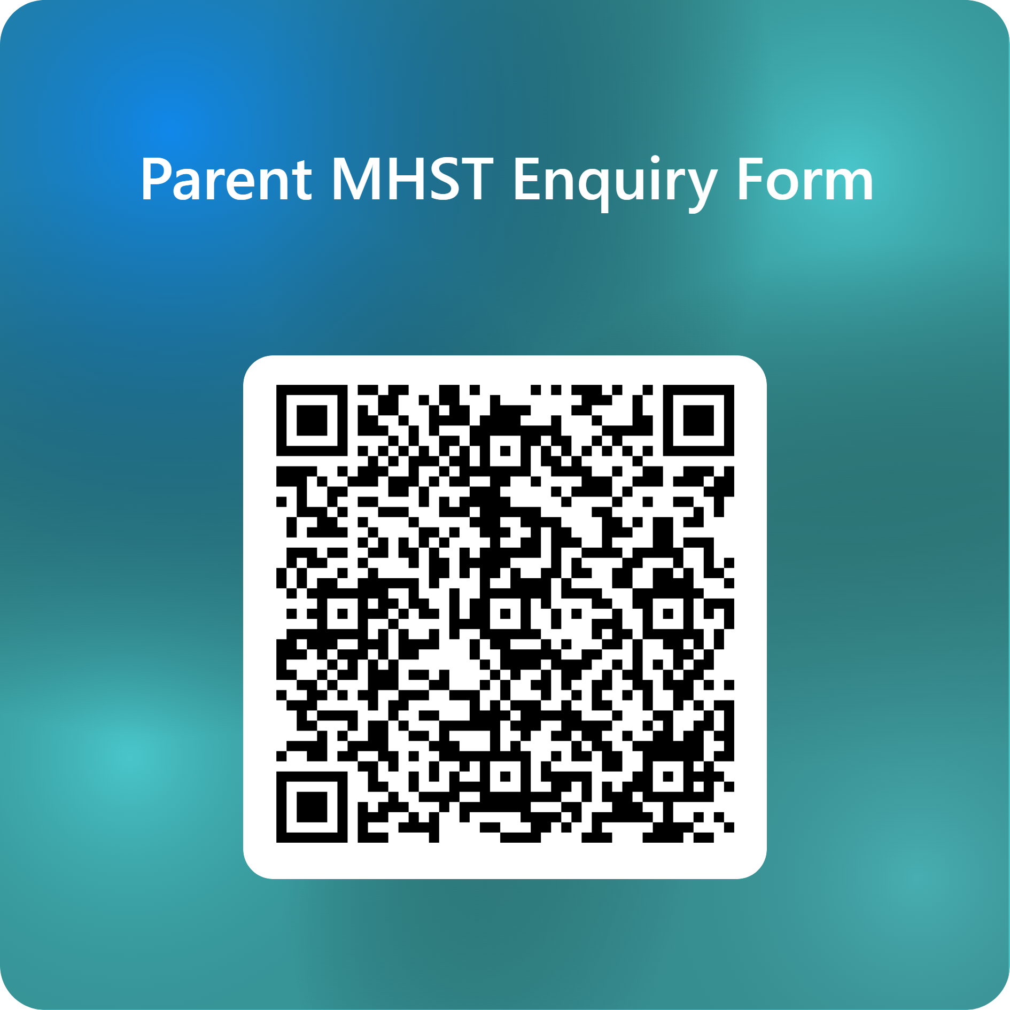

Support is here for you or/and your
child/children
Scan the QR code.
Complete the online form to register your interest.
Mr G will contact you to discuss your concerns.
A time will be made to meet with your child’s class teacher to complete the MHST referral form.
Once the referral has been accepted by the MHST, you will be contacted to meet with them in school.

Slide 16
Who we work with:
  The child / young person
  The child/young person and their parent/carer
  Parent/carer alone - for children under 8 (anxiety/ behaviour)
  Anxiety or worries - specific, social, separation, panic, general and some obsessive compulsive difficulties (OCD).
  Low Mood (most often found in secondary but can present in primary)
  Behavioural difficulties
We only ever work with people who consent to and want the
support

Slide 17

There are going to be ‘Regulation stations’ for the last 15 mins of lunch where a member of SLT and teaching staff will be available for children who are dysregulated and or children who need a check in. This is to encourage children to deal with any issues at lunchtime to have minimum impact to their learning time.

Slide 18
Any questions?

