Slide 1
Welcome to Year 6 2025-26

Slide 2
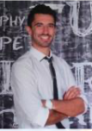
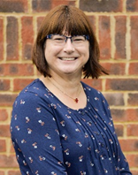
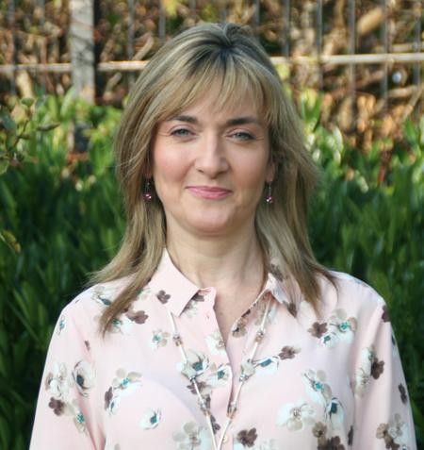
Meet the teachers
Mr Davis
Class Teacher
Mrs Gould-Coates
Class Assistant
Mrs Campbell
Class Assistant
Year 6 2025 - 2026

Slide 3

Welcome to the Year 6 team….
Class teachers: Mr Davis
Support staff: Mrs Gould-Coates and Mrs Campbell

Slide 4

The year ahead…
Our topics this year are:
    Term 1: Britain at War (WW2)
    Term 2: Geography – Coral Biomes
    Term 3: The Windrush Generation in Bristol
    Term 4: Geography – Desert Biomes
    Term 5: Early Islamic Civilisation/SATs preparation and revision
    Term 6: Geography – Global Trade
    Transition to secondary school/End of year production

Slide 5

Visits and first-hand experiences…
STEAM visit Swindon – 6th Oct
Lifeskills visit, Bristol – Term 3 – Tuesday 27th April
Transition days at secondary schools, alongside transition projects to prepare children for moving on (details t.b.c.)
End of year production (details t.b.c.)
End of year 6 trip (details t.b.c.)
Leavers’ service on last day of Term 6.

Slide 6

Roles and responsibilities…
Year 6 have LOTS of roles and responsibilities within the school.
An opportunity for individuals to shine and be role-models for younger pupils.
Whole school roles include:
    School Ambassadors
    House Captains
    Librarians
Year 6 enjoy the opportunity to take on these roles and understand that they need to ensure they are setting a super example to the rest of school within them.
Of course, there will be the opportunity for new school council reps to be chosen too, as in previous years.

Slide 7

Class work & homework…
Curriculum – following same patterns as previous years with our curriculum jigsaws available to view each term on the class page of the website.
Reading – same system of changing reading books/expectation for children to take ownership of having a varied reading diet, especially as Free Readers. Encouragement to read at home as well as at school, even if it isn’t their school reading book. Please ensure these reads are recorded in their Reading Records which are expected to be in school EVERY DAY. See reading section and class page on the website for suggested reads. Also in the front of reading records is a bookmark with example questions that parents can share with their children about the texts they are reading.
Homework – following on from their previous homework routines, the children will have reading and TTRS homework consistently, and very soon they will be given additional tasks to support English and Maths which mirrors the areas of these subjects we are working on each week within the classroom. The homework will be set weekly and needs to be handed in on Tuesday mornings.
Intervention – as in previous years, your child may attend some smaller group sessions in particular subject areas in order to help their confidence with certain tasks or give them the opportunity to ask questions and address misconceptions in a smaller group or 1 to 1 environment. These will be fluid and change according to all pupils’ needs as the year progresses.

Slide 9
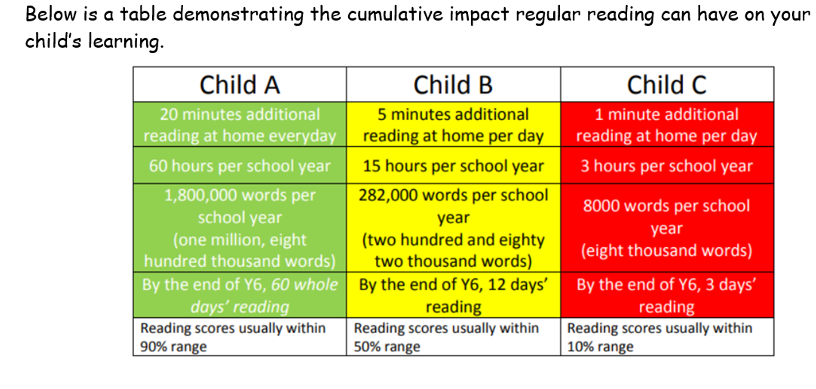

Slide 10
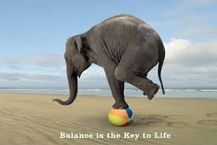
Assessment…
Continuous within normal learning and class practice.
Opportunities to understand what SATs questions actually look like and reassurance that they are in line with the type of assessments they have already experienced in school.
Responding to individual needs of pupils on a daily basis to make sure that they can feel empowered by their learning and access all the areas they need to in order to be successful.
Striking the right balance!

Slide 11

We use ‘The Zones of Regulation’ within our PSHE curriculum as a whole school approach to teach pupils about self-regulation and how to categorise complex feelings and emotional states, using the curriculum designed by Leah Kupver.
The curriculum helps to improve how pupils can recognise and communicate how they are feeling in a safe and non-judgemental way, whilst learning strategies or tools to help them move between four Zones: Blue, Yellow, Red and Green – which are used to help them identify and recognise how regulated they feel.
Our initial aim to develop a common language within our school community that all pupils can engage with and understand from EYFS through to Year 6 proved successful and we will be revisiting the tools and strategies in our PSHE sessions across the whole school during Term 1.
We will also be introducing ‘Regulation Stations’ as areas where children can go to self-regulate around our site, which will have pictorial reminders of the tools and strategies they could use.
If you would like any further information regarding the Zones of Regulation, or further resources you can use at home with your child, please ask a member of the team.

Slide 12


Slide 13


Slide 14


Slide 15


Slide 16


Slide 17


Slide 18
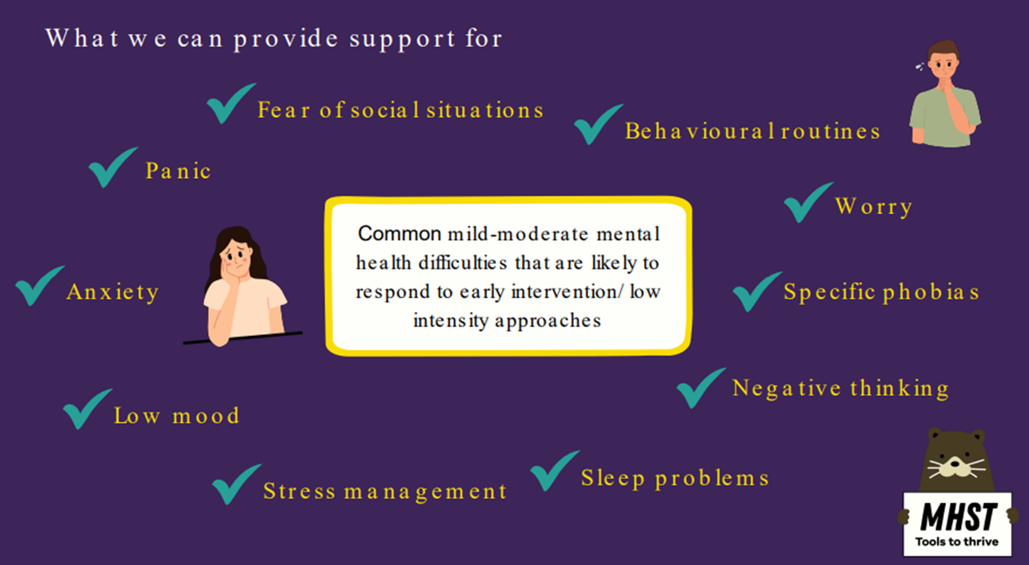

Slide 19
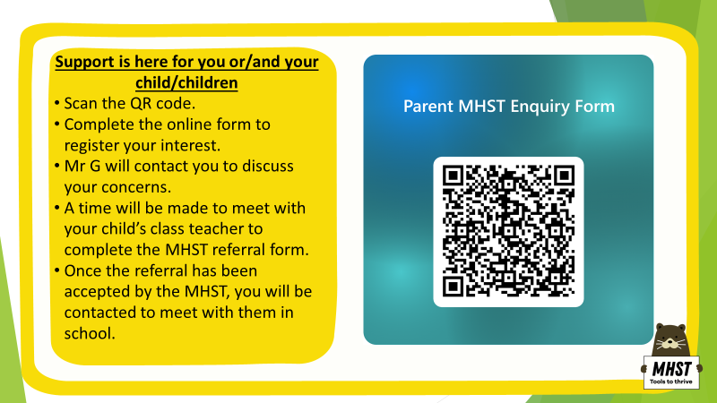

Slide 20
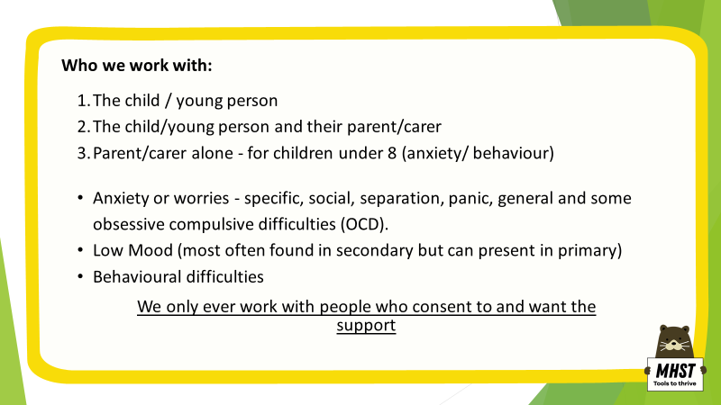

Slide 21

Moving on…
A big part of Year 6 is getting the children ready to make the transition to secondary school; the next part of their learning adventure. We will aim to do this through…
  Transition days and events, working closely with Churchill Academy, plus any other secondary schools children may be moving on to.
  Preparing the children for the changes ahead, socially, emotionally and academically, and alleviating any worries or concerns that they may have.
  Making sure that any communication from secondary schools has been shared with you as parents/carers, and hopefully answering any questions you may have about the application process.

Slide 22

General information & dates for the diary…
Any specific dates and information for terms 1 and 2 will be circulated to you a.s.a.p.
The school website is, as always, a fantastic resource for checking dates for the diary, event details or general information specific to our class. We will endeavour to keep it as up to date as possible.
SATS – W/C May 11th-14th
This year, parents’ evening dates are W/C 10th November and 2rd March.
We do not monitor the class email address which is linked to TEAMS so please make sure you send any communication via the office email address as usual.
Walking to and from school: you will have received the forms to complete – it is really important that you inform us when any specific arrangements change – please do not just send a message in with your child – either speak to us directly at the classroom door or speak/email the office to let us know, particularly if you are changing pick up arrangements for the end of a day.

Slide 23
Thank you!
I

