Slide 1

Welcome to Year 2
Ms Ford / Miss Pike
Mrs Holdaway / Miss Betts

Slide 2
Our aims in Year 2
To enjoy school.
To become independent and confident learners.
To build on and apply the skills taught in Year 1.
To work hard to one’s own potential.
To be kind, caring and well behaved at all times.
To prepare for the transition into Key Stage 2.
To celebrate success and achievements.

Slide 3
How We Work
Year 2
Ms Ford - Monday and Tuesday
Miss Pike - Wednesday, Thursday and Friday
PPA times
Miss Pike – Wednesday pm (Mrs Campbell will teach Science)

Slide 4

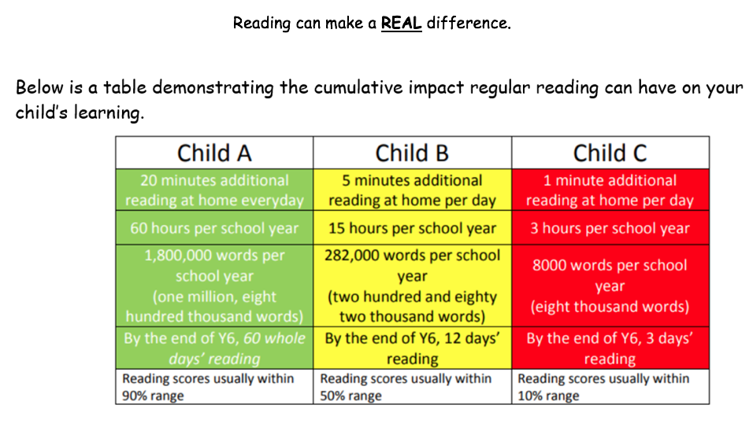
Reading
Reading at home……..aim for 5 times a week if possible.
In school, books can be changed if yellow reading records have been signed by an adult.

Slide 5
Reading For Fluency
This means reading with a story telling voice, using expression, taking note of punctuation and reading words accurately and automatically.
It does not mean reading a text in the quickest possible time!!!
Reading For Pleasure
Be inspired and excited about reading texts- ANYTHING……. fiction, comics, poetry, magazines, dictionaries, newspapers etc

Slide 6
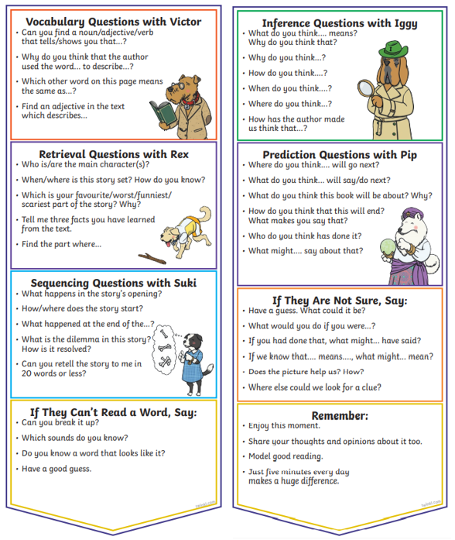
Reading Comprehension
Children have a bookmark stuck inside the front cover of their
yellow reading records.
This helps support parents with
structuring questions to ask
children to make sure they
understand what they are
reading.

Slide 7
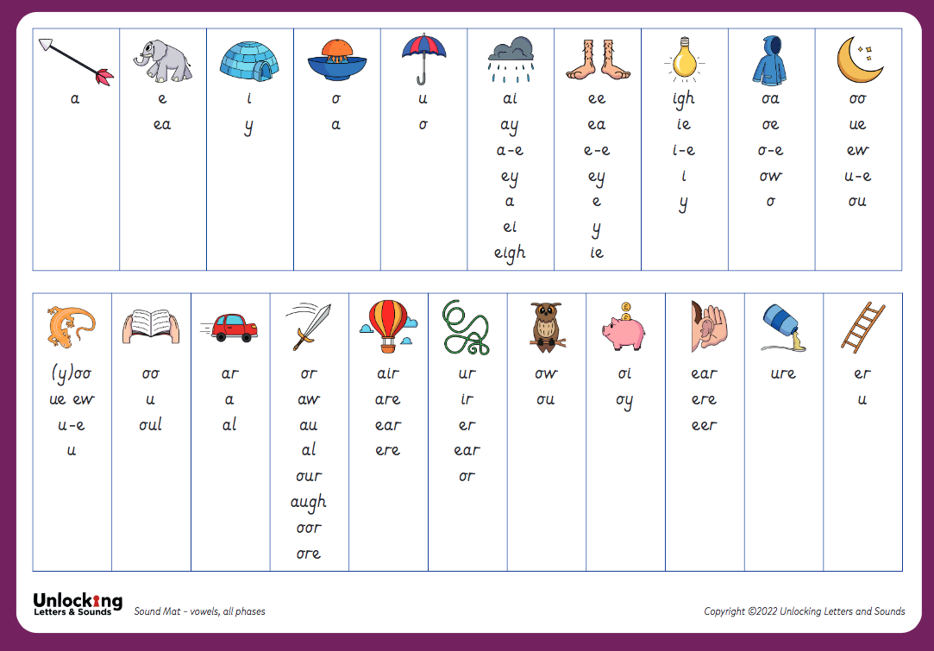
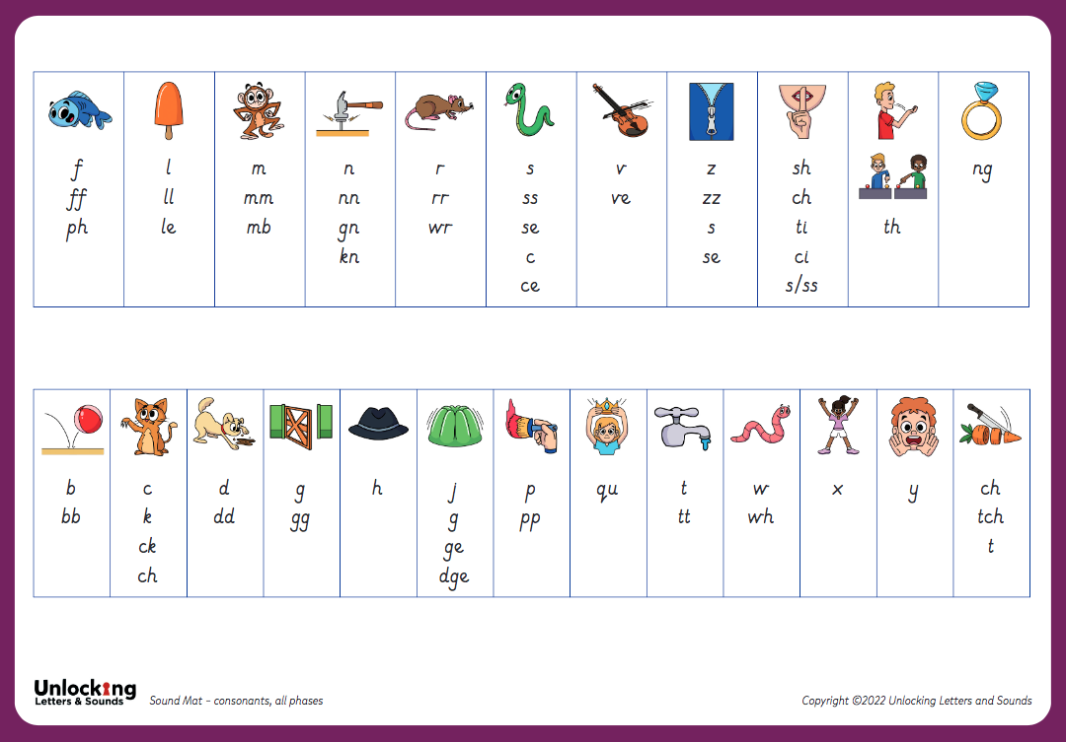
Phonics
Daily sessions
We continue with the Unlocking Letters and Sounds program until the end of term 2, when we swap to the ULS Spelling Programme
Children who still need support with phonics beyond term 2 will continue their learning in small groups/individually during reading practice.
Phonics Screening Check takes place June 2026

Slide 8
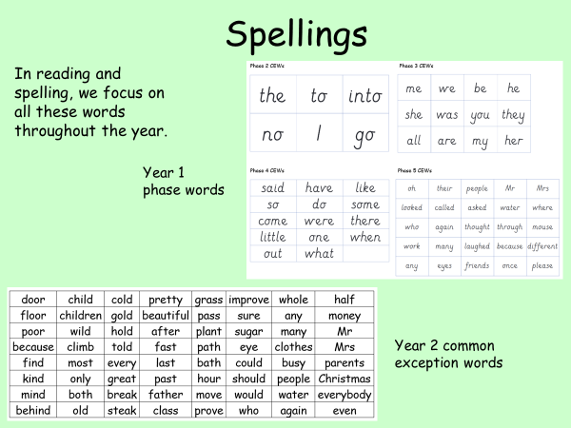

Slide 9

Homework Expectations…

Slide 10
Maths
Secure knowledge of number families. Number bonds to and within 10 and 20 (+ and - facts)
Extra daily Numbersense lessons to support understanding of number facts.
Vocabulary - especially addition, subtraction.
Times tables 2, 5, 10 and their division facts.
Fluency, reasoning and problem solving - need to apply knowledge and communicate thinking through verbal, written methods.
Homework - weekly mental maths/number bonds/computing task. Numbots.

Slide 11
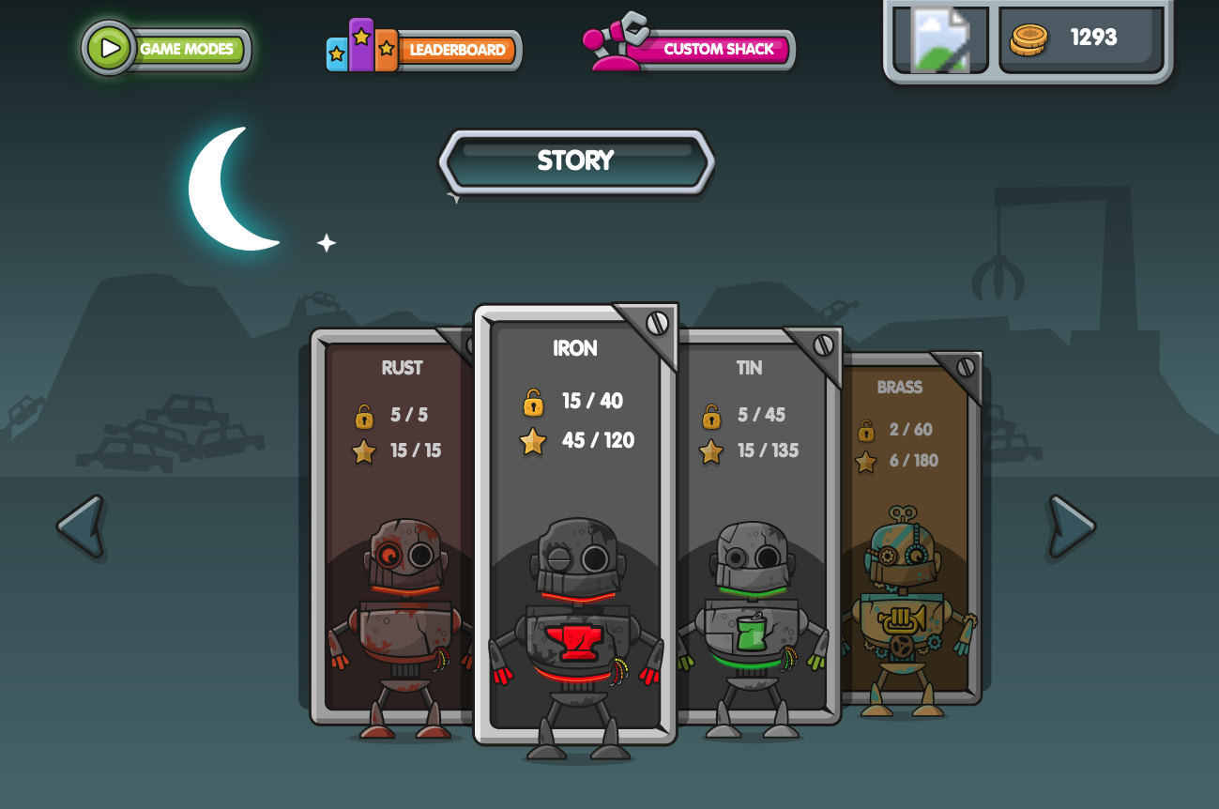
www.numbots.com
The children also have their own logins for Numbots.
This is set as weekly homework and successes are celebrated in Friday service.

Slide 12
Foundation Subjects
Appropriate PE kit for inside (blue shorts, t-shirt, daps) and outside (shorts, t-shirt, warm tracksuit/trousers, top, daps/trainers). We have 2 sessions of PE on Tuesday and Thursday.
Book bags to come into school every day. We look at yellow reading records daily.
Playtimes (water only, fruit is provided. If you do provide a snack, please make sure it is a healthy one. No toys please!)
Please ensure no jewellery – if earrings can’t be removed then we will supply micropore tape to go over them for PE sessions. Please remember that our uniform policy includes only stud earrings, not hoops.

Slide 13

We use ‘The Zones of Regulation’ within our PSHE curriculum as a whole school approach to teach pupils about self-regulation and how to categorise complex feelings and emotional states, using the curriculum designed by Leah Kupver.
The curriculum helps to improve how pupils can recognise and communicate how they are feeling in a safe and non-judgemental way, whilst learning strategies or tools to help them move between four Zones: Blue, Yellow, Red and Green – which are used to help them identify and recognise how regulated they feel.
Our initial aim to develop a common language within our school community that all pupils can engage with and understand from EYFS through to Year 6 proved successful and we will be revisiting the tools and strategies in our PSHE sessions across the whole school during Term 1.
We will also be introducing ‘Regulation Stations’ as areas where children can go to self-regulate around our site, which will have pictorial reminders of the tools and strategies they could use. In Key Stage 1, these ‘stations’ will be within the individual classrooms, with Year 2 starting the year with one and one being developed in Year 1 as Terms 1 and 2 progress.
If you would like any further information regarding the Zones of Regulation, or further resources you can use at home with your child, please ask a member of the team.

Slide 14

The Six Principles of Nurture
Here at Churchill Primary, we embed the Six Principles of Nurture across all areas of our school life, and they are at the root of our vision, values, ethos and policies.
We have child-friendly versions of the principles displayed at school for our pupils to engage with.

Slide 15

SEND at Churchill Primary
Ms Ford is our SENDCo (special educational needs and disabilities coordinator) and her working days as SENDCo are Wednesdays and Thursdays. She can be contacted via the office email (office@churchill-pri.n-somerset.sch.uk) if you need to discuss any SEND-related matters or concerns, or would like to book a meeting. Ms Ford also aims to hold informal ‘Drop-in Sessions’ once a term which are open to everyone.
Ms Ford works closely with our staff to ensure that all pupils can access our universal provision, and for any pupils requiring more individual provision that is not within our universal offer, coordinating how that provision can be put in place through reasonable adjustments. This includes liaising with and requesting the support of external professionals or agencies to provide guidance and advice, as well as working with the local authority regarding higher needs pupils who may require an educational health care plan due to the level of individual support they may need.
Our universal provision offer can be seen on our website.
For information on the local offer for any services who support pupils and parents/carers of pupils with SEND, please follow the links on our website under ‘SEND and the Local Offer’.

Slide 16

PINS Project 2025-2026
As shared via a link to a parents/carers’ questionnaire at the end of July, we are excited to share that we have been chosen to take part in a project funded by NHS England in collaboration with the Department of Education, North Somerset Council and the NSPCWT (North Somerset Parent Carers Working Together).
The PINS Project is the ‘Partnerships for Inclusion of Neurodiversity in Schools’ and it is in it’s second year here in North Somerset.
This collaboration gathers input from all our stakeholders – parents/carers, pupils, governors, staff – to identify how best to support us as a school to ensure our inclusivity for neurodiverse pupils through shaping a bespoke package for our setting including input from external professionals.
We will be sharing further details of how you can get more involved as parents/carers as the project moves forward, but we are very excited to be given this opportunity to further our universal provision offer for all our neurodiverse pupils regardless of whether they have an official diagnosis or not.

Slide 17

Introduction to the Mental Health Support Team
  The MHST service is part of a national Government strategy to improve access to Mental Health support for children and young people.
  The service is designed specifically to provide extra capacity for prevention and early intervention.
  It is designed to complement and extend existing support systems, not replace them - and to deliver “Whole School Approach” work
  MHSTs work with children and young people aged 5-18 specifically in education settings

Slide 18


Slide 19
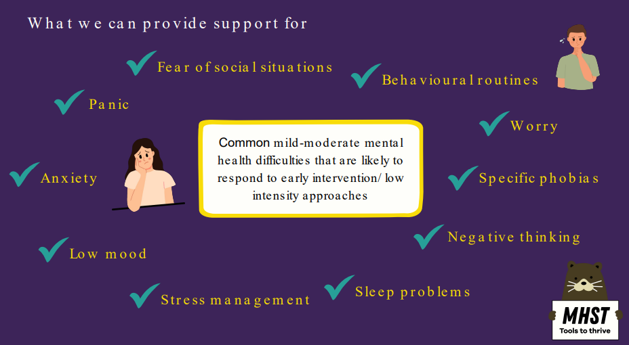

Slide 20
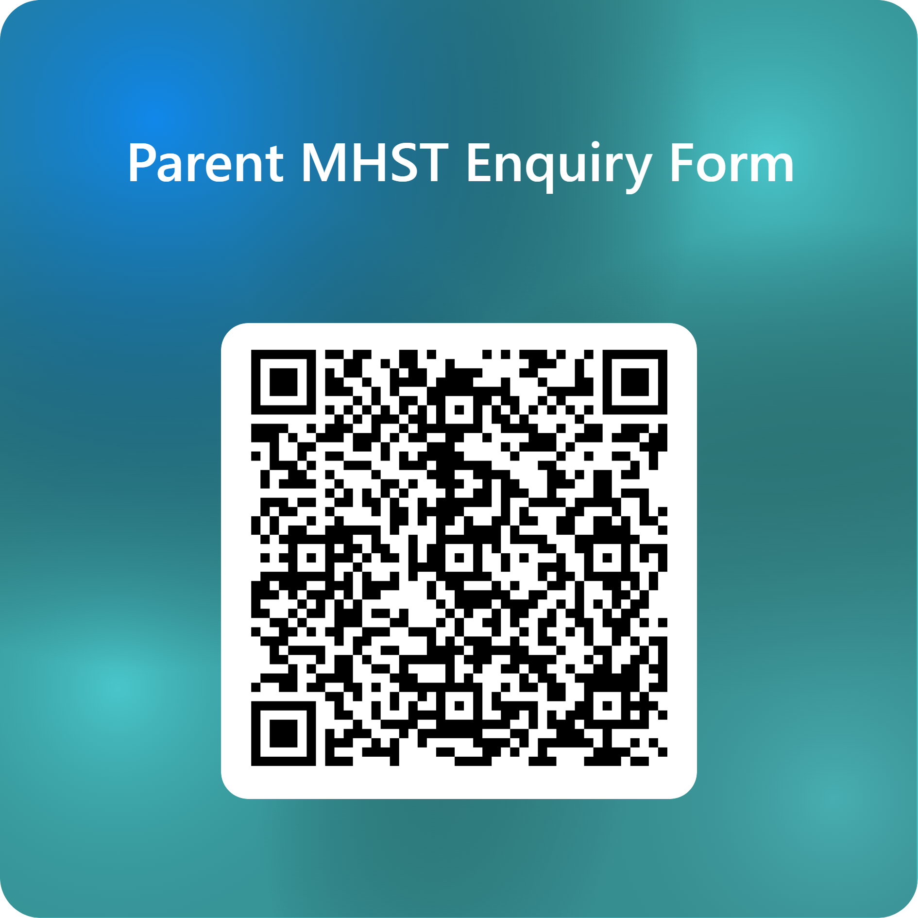

Support is here for you or/and your
child/children
Scan the QR code.
Complete the online form to register your interest.
Mr G will contact you to discuss your concerns.
A time will be made to meet with your child’s class teacher to complete the MHST referral form.
Once the referral has been accepted by the MHST, you will be contacted to meet with them in school.

Slide 21
Who we work with:
  The child / young person
  The child/young person and their parent/carer
  Parent/carer alone - for children under 8 (anxiety/ behaviour)
  Anxiety or worries - specific, social, separation, panic, general and some obsessive compulsive difficulties (OCD).
  Low Mood (most often found in secondary but can present in primary)
  Behavioural difficulties
We only ever work with people who consent to and want the
support

Slide 22

We are really pleased to be continuing our fantastic relationship with Churchill Music this year – a local concert and music education charity known for its excellence, innovation and energy in encouraging primary-aged pupils to experience the wide range of opportunities that music can offer.
Please watch their information video ‘How music helps us learn’ (link on each class page) to see the philosophy behind the work they tirelessly do in our local community.

Slide 23

Please help us...
  8.45 am - drop off time. (Register closes at 8.55am)
  3.20 pm pick-up time.
  Absence - please send an email and/or make a phone call.
  Medicines/health issues - we need to know please.
  Concerns/queries - please see us before/after school. After school is usually much better for a longer chat as it’s important to settle children quickly in the mornings.
  If you are working, then please do email the office with any queries and we will get back to you as soon as we can.
  Space is limited, so please think about whether it is necessary for your child to bring a LARGE bag/rucksack to school.
  Please look at the Year 2 class page on the school website as there are lots of photographs and important information. Also please look at the newsletters when they are sent out as they also include very important whole school information.

Slide 24
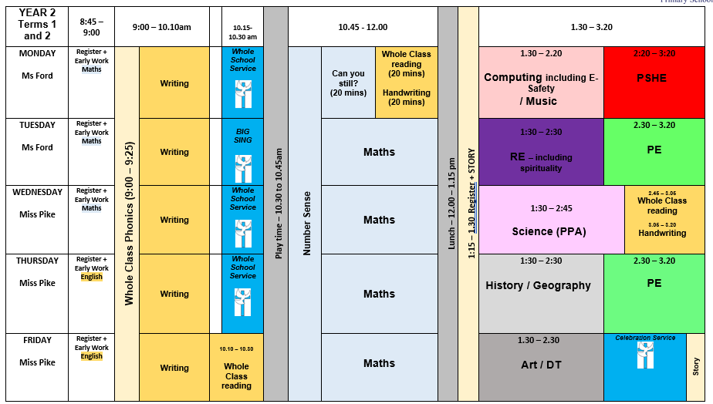
Weekly Timetable

