Slide 1

Welcome to Year 5
2025-2026

Slide 2
Class 5 Team
Teacher – Mrs Bryant (Monday, Tuesday, Wednesday)
Mrs Linham (Thursday, Friday)
Support staff: Wednesday - Friday AM = Mrs Campbell
Monday and Tuesday AM = Mrs Gould-Coates
Tuesday = Mrs Baird

Slide 3
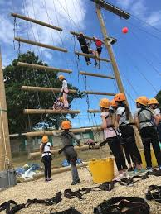
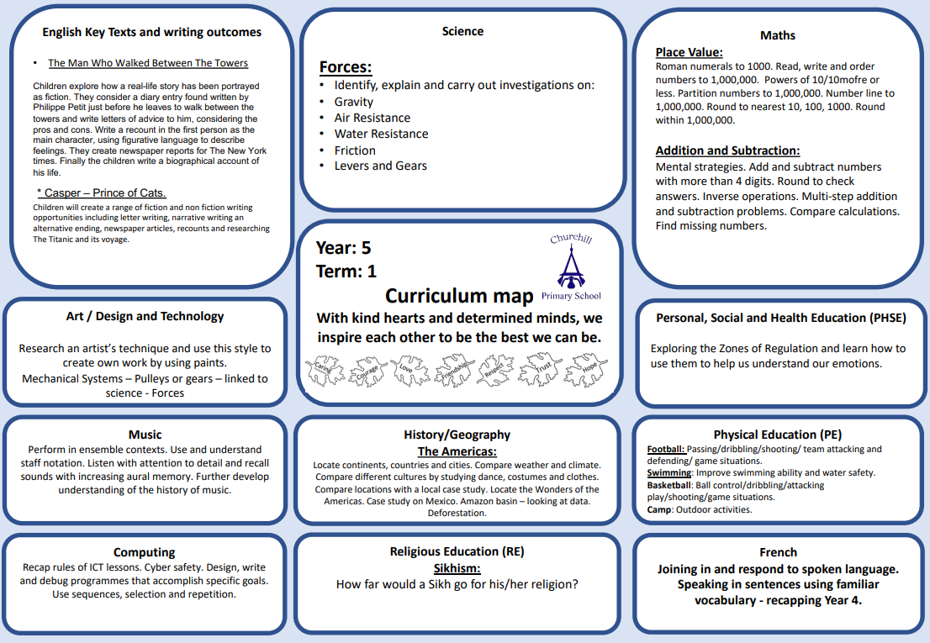
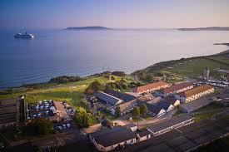
About Year 5
Developing Independent Learners
Osmington Bay
Developing greater independence. Walking home.
Greater responsibility and expectations – setting the example for the rest of the school. Young Leaders.

Slide 4


Slide 5
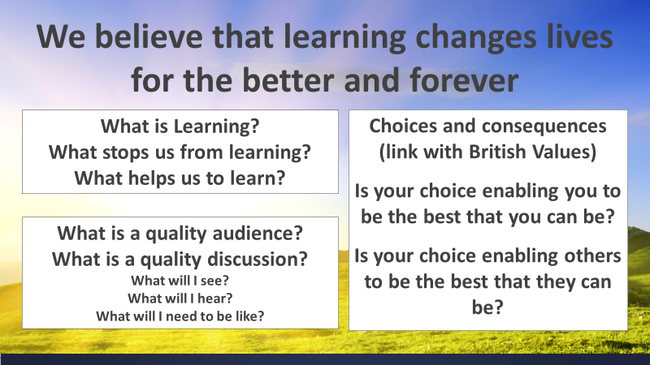

Slide 6


Slide 7


Slide 8
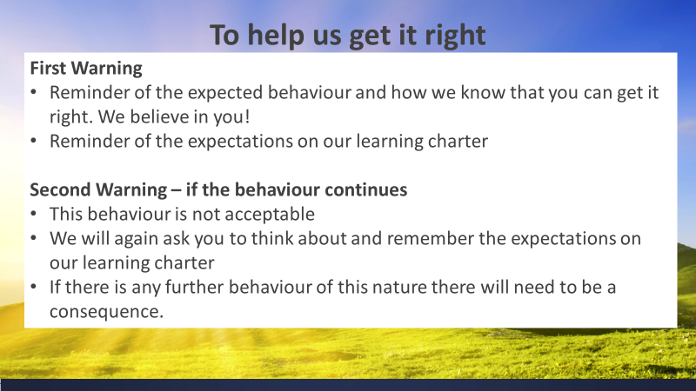

Slide 9
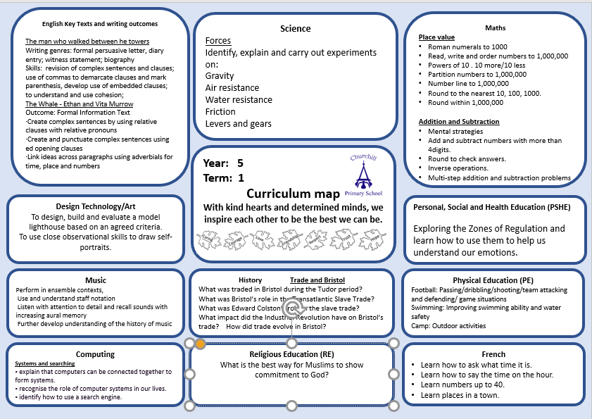
https://schoolreadinglist.co.uk/reading-lists-for-ks2-school-pupils/suggested-reading-list-for-year-5-pupils-ks2-age-9-10/

Slide 10


Slide 11
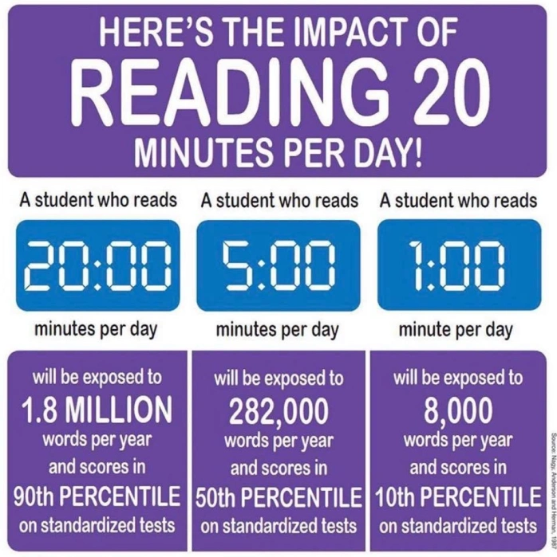

Slide 12
Year 5
History & Geography:
Term 1 – Trade in Bristol
Term 2 – Informal settlements
Term 3 – Benin
Term 4 - Earthquakes
Term 5 – Democracy in Ancient Greece
Term 6 – Renewable and non-renewable energy

Slide 13
Class 5 reminders:
Term 1 – swimming lessons every Friday this term starting Friday 12th September 2024. Please bring swimming kit in a bag.
Please make sure the correct PE kit is in school every day – we will send it home at the end of each term.
Homework: Maths = TT Rockstars.
Reading = Please read 5 times a week to an adult and get it signed.
If you haven’t already, please send back your forms for how your children will get home from school and permission slips to watch PG films.

Slide 14
Class 5 – Dates to remember:
Osmington Bay Camp Talk is set for September 18th @ 3.20pm. Until then, please let your child know that it is so much fun and that they will be with friends in their room!
T@3 – Friday 14th November
Parents Evenings – week beginning 10t^{h} November.
Bikeability – Week beginning 9th March (date tbc)
Farm Visit – Tuesday 5th May
St Giles Trust workshop – 3rd June
Operation Topaz workshop – 29th April
RNLI Water safety workshop – date to be confirmed

Slide 15

We use ‘The Zones of Regulation’ within our PSHE curriculum as a whole school approach to teach pupils about self-regulation and how to categorise complex feelings and emotional states,
The curriculum helps to improve how pupils can recognise and communicate how they are feeling in a safe and non-judgemental way, whilst learning strategies or tools to help them move between four Zones: Blue, Yellow, Red and Green – which are used to help them identify and recognise how regulated they feel.
This provides us with a common language within our school community that all pupils can engage with and understand from EYFS through to Year 6 and we regularly revisit the tools and strategies in our PSHE sessions across the whole school during Term 1.
We have also introduced‘Regulation Stations’
as areas where children can go to self-regulate
around our site, which will have pictorial reminders
of the tools and strategies they could use.
If you would like any further information regarding
the Zones of Regulation, or further resources you
can use at home with your child, please ask a
member of the team.

Slide 16

The Six Principles of Nurture
Here at Churchill Primary, we embed the Six Principles of Nurture across all areas of our school life, and they are at the root of our vision, values, ethos and policies.
We have child-friendly versions of the principles displayed at school for our pupils to engage with.

Slide 17
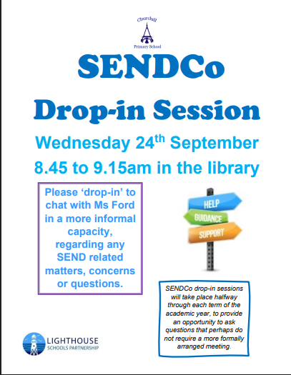
SEND at Churchill Primary
Ms Ford is our SENDCo (special educational needs and disabilities coordinator) and her working days as SENDCo are Wednesdays and Thursdays. She can be contacted via the office email (office@churchill-pri.n-somerset.sch.uk) if you need to discuss any SEND-related matters or concerns, or would like to book a meeting. Ms Ford also aims to hold informal ‘Drop-in Sessions’ once a term which are open to everyone.
Ms Ford works closely with our staff to ensure that all pupils can access our universal provision, and for any pupils requiring more individual provision that is not within our universal offer, coordinating how that provision can be put in place through reasonable adjustments. This includes liaising with and requesting the support of external professionals or agencies to provide guidance and advice, as well as working with the local authority regarding higher needs pupils who may require an educational health care plan due to the level of individual support they may need.
Our universal provision offer can be seen on our website.
For information on the local offer for any services who support pupils and parents/carers of pupils with SEND, please follow the links on our website under ‘SEND and the Local Offer’.

Slide 18

PINS Project 2025-2026
As shared via a link to a parents/carers’ questionnaire at the end of July, we are excited to share that we have been chosen to take part in a project funded by NHS England in collaboration with the Department of Education, North Somerset Council and the NSPCWT (North Somerset Parent Carers Working Together).
The PINS Project is the ‘Partnerships for Inclusion of Neurodiversity in Schools’ and it is in it’s second year here in North Somerset.
This collaboration gathers input from all our stakeholders – parents/carers, pupils, governors, staff – to identify how best to support us as a school to ensure our inclusivity for neurodiverse pupils through shaping a bespoke package for our setting including input from external professionals.
We will be sharing further details of how you can get more involved as parents/carers as the project moves forward, but we are very excited to be given this opportunity to further our universal provision offer for all our neurodiverse pupils regardless of whether they have an official diagnosis or not.

Slide 19



Music opportunities in KS2
Ms Ford runs the Key Stage 2 choir, which takes place on Wednesdays at 3.10 to 4pm. It will be starting again this term on Wednesday 24th September – letters will be sent home with any KS2 pupils who are interested in taking part for you to complete and return.
We are really pleased to be continuing our fantastic relationship with Churchill Music this year – a local concert and music education charity known for its excellence, innovation and energy in encouraging primary-aged pupils to experience the wide range of opportunities that music can offer.
Please watch their information video ‘How music helps us learn’ (link on each class page) to see the philosophy behind the work they tirelessly do in the community.

Slide 20

Introduction to the Mental Health Support Team
  The MHST service is part of a national Government strategy to improve access to Mental Health support for children and young people.
  The service is designed specifically to provide extra capacity for prevention and early intervention.
  It is designed to complement and extend existing support systems, not replace them - and to deliver “Whole School Approach” work
  MHSTs work with children and young people aged 5-18 specifically in education settings

Slide 21


Slide 22
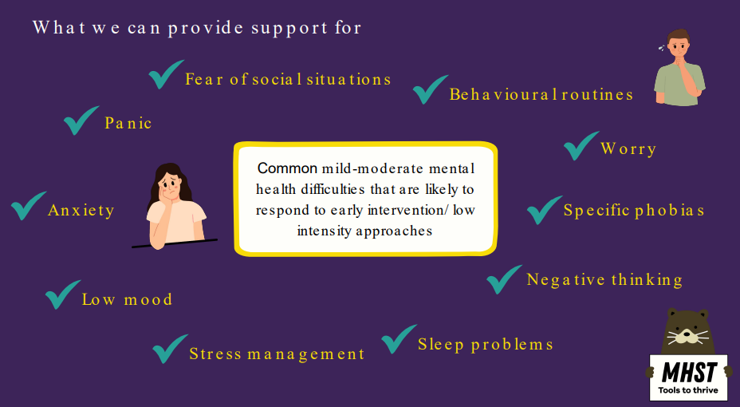

Slide 23
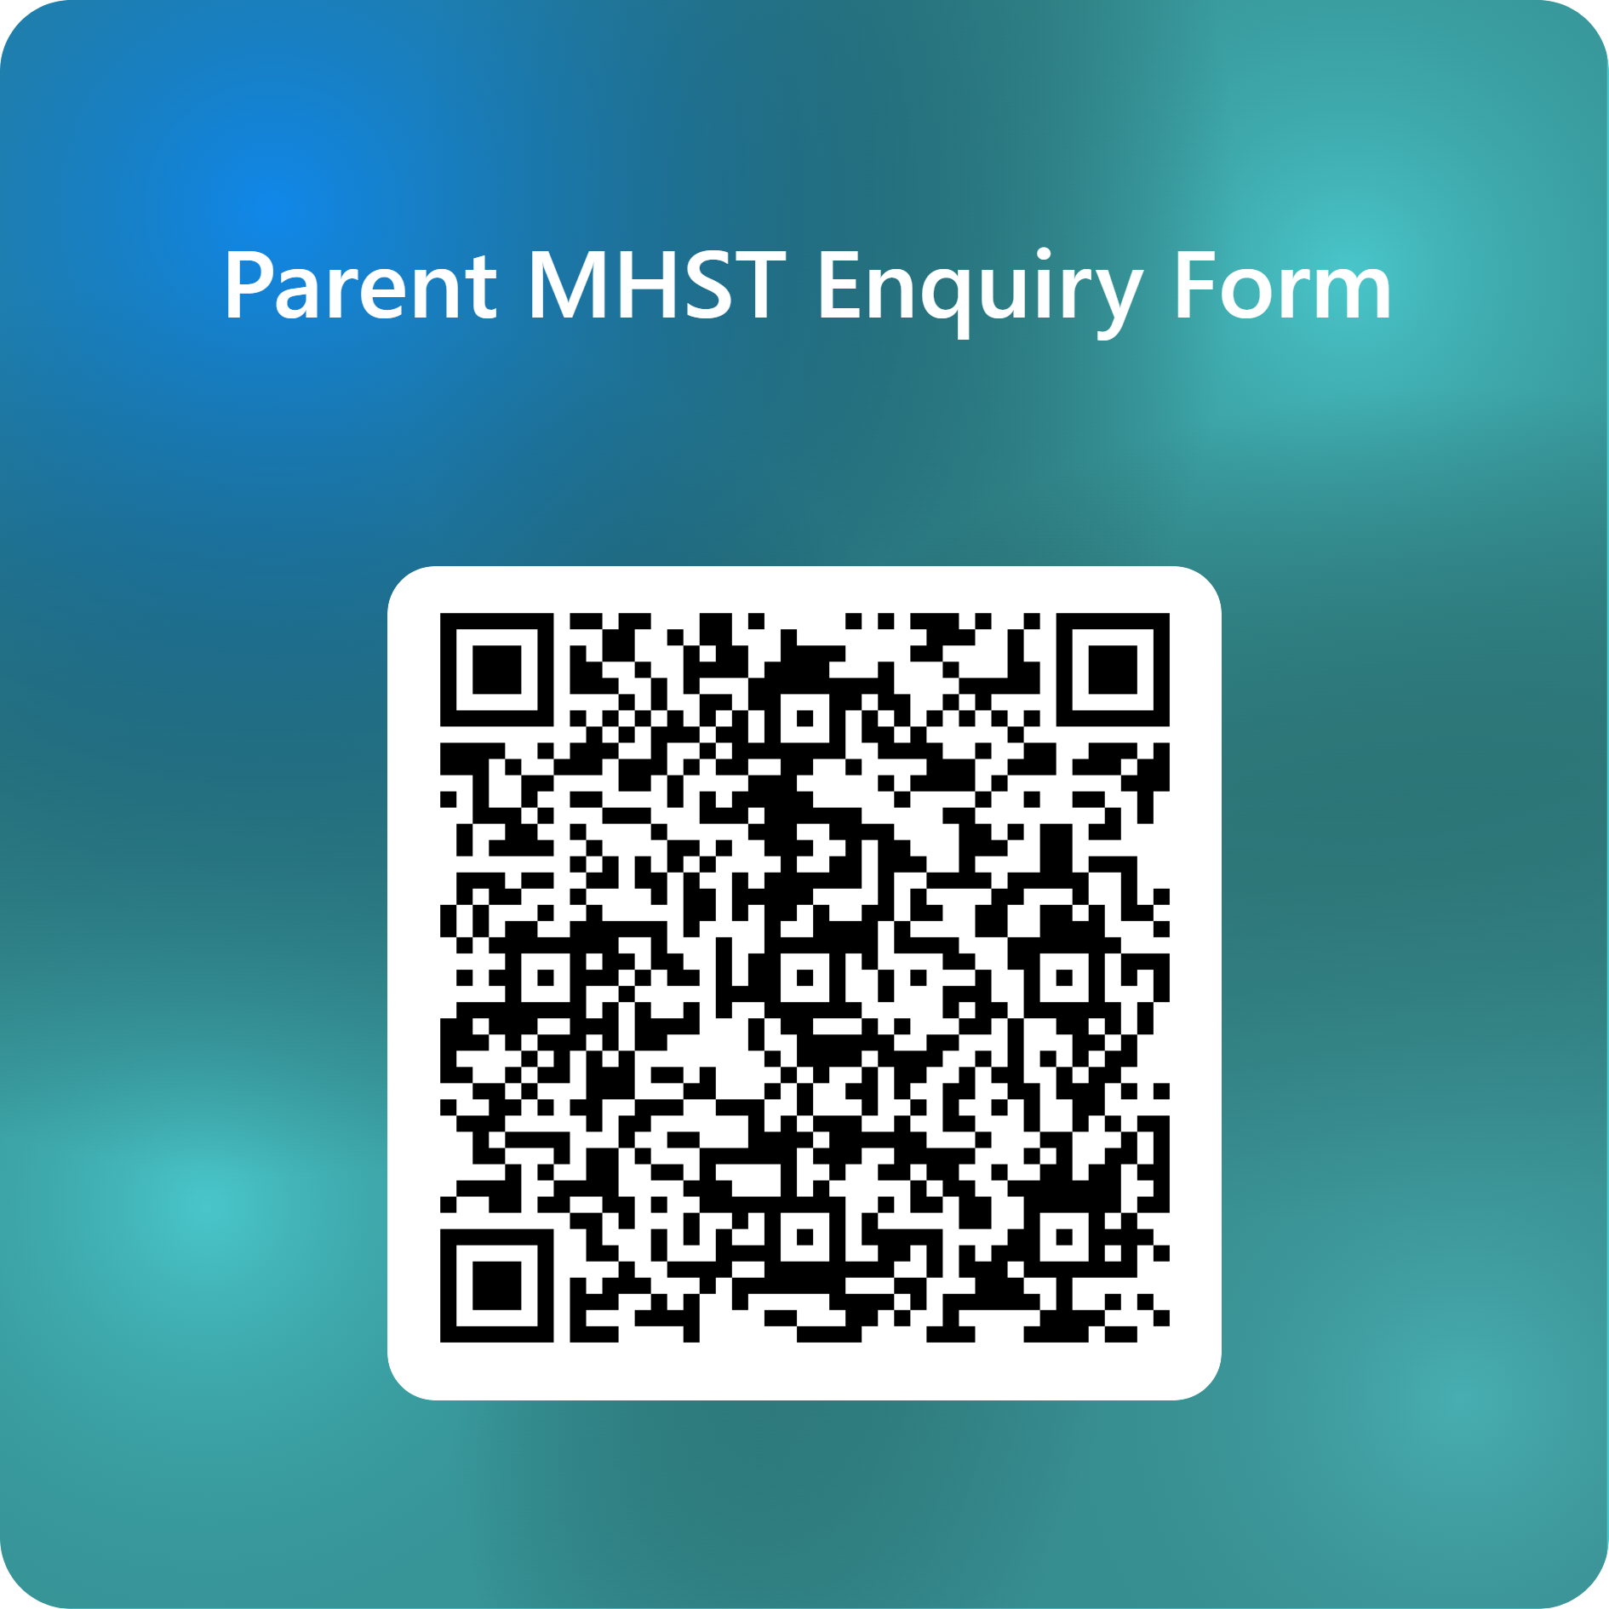

Support is here for you or/and your
child/children
Scan the QR code.
Complete the online form to register your interest.
Mr G will contact you to discuss your concerns.
A time will be made to meet with your child’s class teacher to complete the MHST referral form.
Once the referral has been accepted by the MHST, you will be contacted to meet with them in school.

Slide 24
Who we work with:
  The child / young person
  The child/young person and their parent/carer
  Parent/carer alone - for children under 8 (anxiety/ behaviour)
  Anxiety or worries - specific, social, separation, panic, general and some obsessive compulsive difficulties (OCD).
  Low Mood (most often found in secondary but can present in primary)
  Behavioural difficulties
We only ever work with people who consent to and want the
support

Slide 25
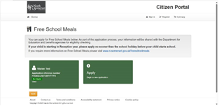
£100 Household Support Fund vouchers for children on Free School Meals
This month, North Somerset Council will be providing £100 Household Support Fund vouchers to all pupils who are registered to be entitled to Benefits Related ‘Free School Meals’. Please note, this does not apply to families who just receive the Universal Infant ‘Free School Meals’.
If you think that your child (and remember an application needs to be done per child) may be entitled to Benefits Related ‘Free School Meals’, and the associated additional benefits, then now is the time to apply.
Applications are quick and easy via the North Somerset website.
www.n-somerset.gov.uk/freeschoolmeals
You only need to apply if they don’t already have an entitled application. This can be seen on your North Somerset Citizen’s account. All applications should be made by Tuesday 16th September, to ensure that they meet the deadline. If you have any difficulties and would like some support, please do not hesitate to nip into the school office or contact them on 01934 852446.

Slide 26

Class 5:
Please always feel free to come and talk to us if you have any questions or contact us through the office email if this is more convenient. We will do our best to get back to you as soon as possible.
We very much look forward to working alongside you in the coming academic year.

Slide 27

Class 5

