Slide 1

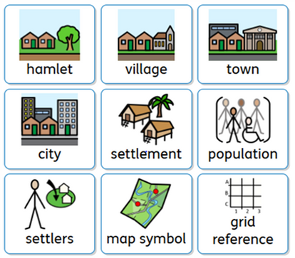
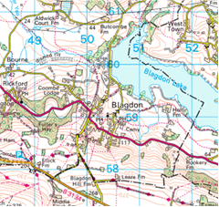
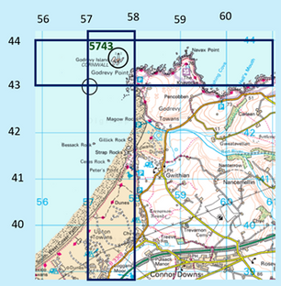
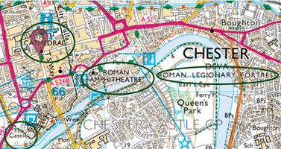
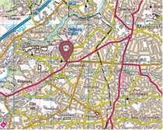
Settlements
Geography Year 3
How are settlements established?
Factors that would be good for developing a settlement
Water supply nearby
Close to building materials
Access to wood
Flat land
Protection
Shelter from the weather
Near to a bridging point
On an existing route/road
Fertile land for animals or growing food
Blagdon is a small village, which grew when Blagdon lake was developed.
It has one school, a few small shops, a café and Yeo Valley farm.
Factors that would be good for developing a settlement Water supply nearby Close to building materials Access to wood Flat land Protection Shelter from the weather Near to a bridging point On an existing route/road Fertile land for animals or growing food.
To find a four figure grid reference we go along and then up. The lighthouse is in 5743.
Maps show historical features, which gives us clues about a settlements past.

